Slide 1


The right skills, at the right time, in the right way. Indiana’s Demand Driven Workforce
Adult Education and Workforce Development Statewide Webinar
September 5, 2018
Marilyn Pitzulo | Adult Education Staff
Department of Workforce Development | Indiana ADULT EDUCATION
10 N. Senate Avenue, IGCS SE 203 | Indianapolis, IN 46204
AdultEd@dwd.in.gov

Slide 2
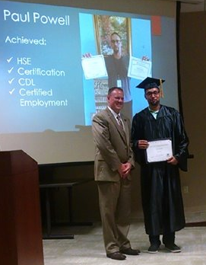

program is open to anyone age 16 or older who is not attending a high school. It helps people prepare for the equivalency test, earn workforce
certification and even learn English as a second language.
“It’s really all about getting people into career training and employment,” said Robert Moore, director of the program.
The program serves about 500 people each year. Historically, there has been one ceremony in May to recognize their accomplishments. A second
ceremony was added in December this year.
“- 1
Indiana ADULT EDUCATION
Basic Skills. High School Equivalency. Short-term Training. Certifications and More.
Tears rolled down the face of Paige Powell as her father – Paul Powell – received a standing ovation from the MSD of Warren Township School Board, superintendent, and audience for earning his high school equivalency (HSE), CDL career certification, and certified employment 20 years after dropping out of school.
Paying rent, buying groceries, and attending high school proved too much for this young man on his own; so he quit.
“We moved a lot. I attended over 12 schools by the time I was 16.”
PAUL Powell
Indianapolis
-

Slide 3

program is open to anyone age 16 or older who is not attending a high school. It helps people prepare for the equivalency test, earn workforce
certification and even learn English as a second language.
“It’s really all about getting people into career training and employment,” said Robert Moore, director of the program.
The program serves about 500 people each year. Historically, there has been one ceremony in May to recognize their accomplishments. A second
ceremony was added in December this year.
“- 1
Indiana ADULT EDUCATION
Basic Skills. High School Equivalency. Short-term Training. Certifications and More.
PAUL Powell
Indianapolis
He started working in construction and continued doing so for many years but it was back breaking work.
Without health insurance, he began to self-medicate and became addicted to prescriptions drugs. Through perseverance and the support of his wife he was able to recover from his addiction.
He excelled in his CDL class and passed his certification test on the first try. Paul was offered a local truck driving job.
He has now been working for three months.
“CDL classes were hard but HSE classes taught me how to study.”
√ HSE Graduate
√ Certification
√ CDL
√ Employed

Slide 4

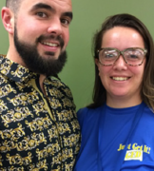
program is open to anyone age 16 or older who is not attending a high school. It helps people prepare for the equivalency test, earn workforce
certification and even learn English as a second language.
“It’s really all about getting people into career training and employment,” said Robert Moore, director of the program.
The program serves about 500 people each year. Historically, there has been one ceremony in May to recognize their accomplishments. A second
ceremony was added in December this year.
“- 1
Indiana ADULT EDUCATION
Basic Skills. High School Equivalency. Short-term Training. Certifications and More.
Meet Christy & Billy Greene
Christy Greene’s formal education ended in the 7th grade and Billy dropped out of high school in the 10th grade. They are parents of two young sons and both wanted to obtain their HSE. Christy attended classes at the LaPorte County Career and Technical Education Center first so that Billy could watch their kids. They then reversed roles and Billy began classes while he worked nights. Both earned HSEs last year.
Christy is now employed with Michigan City Area Schools as an instructional assistant in the adult education program, and plans to enroll in the parapro IET. Billy is a grocery store manager and was appointed by the Mayor to the Michigan City Historic Review Board. He has aspirations to become involved in politics at a local level.
Success Comes in Pairs

Slide 5

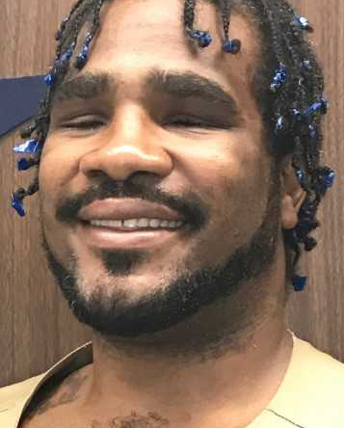

program is open to anyone age 16 or older who is not attending a high school. It helps people prepare for the equivalency test, earn workforce
certification and even learn English as a second language.
“It’s really all about getting people into career training and employment,” said Robert Moore, director of the program.
The program serves about 500 people each year. Historically, there has been one ceremony in May to recognize their accomplishments. A second
ceremony was added in December this year.
“- 1
Indiana ADULT EDUCATION
Basic Skills. High School Equivalency. Short-term Training. Certifications and More.
“I stayed determined and focused. I never doubted myself and always believed. My momma always said to take the word ‘can’t’ out of your vocabulary. You can do anything if you put forth the effort and try,” Oscar said.
Oscar still has a few more years to serve in IDOC and will likely request to be admitted to one of the many vocational training programs.
Meet Oscar Griffin
In 2008, at the age of 27, Oscar Griffin was shot in the face, leaving him completely blind. Oscar never learned braille. So he has totally relied on voice/conversation to function.
He was incarcerated in the Indiana Department of Correction (IDOC) in March of 2017. His teacher, Dawn Grage, said that Oscar was very persistent and never gave up. He overcame many obstacles within the correctional facility to achieve his HSE diploma.

Slide 6

program is open to anyone age 16 or older who is not attending a high school. It helps people prepare for the equivalency test, earn workforce
certification and even learn English as a second language.
“It’s really all about getting people into career training and employment,” said Robert Moore, director of the program.
The program serves about 500 people each year. Historically, there has been one ceremony in May to recognize their accomplishments. A second
ceremony was added in December this year.
“- 1
Indiana ADULT EDUCATION
Basic Skills. High School Equivalency. Short-term Training. Certifications and More.
Sarah
Dalrymple
“Well, We Did It!”
“We Accomplished a Major Milestone in Life – Graduation.”
“Awesome classmates made things easier and helped me realize I wasn’t on this journey alone.”
When Sarah first started adult education classes at Vincennes University, she was scared and nervous. Sarah already had a full plate with a 40-hour work week and a family at home. She doubted her success in the classroom many times, but with the help of her teacher, her fears soon subsided. “One of my favorite things was being able to bounce questions that I didn’t understand off my classmates.”

Slide 7
program is open to anyone age 16 or older who is not attending a high school. It helps people prepare for the equivalency test, earn workforce
certification and even learn English as a second language.
“It’s really all about getting people into career training and employment,” said Robert Moore, director of the program.
The program serves about 500 people each year. Historically, there has been one ceremony in May to recognize their accomplishments. A second
ceremony was added in December this year.
“- 1
Indiana ADULT EDUCATION
Basic Skills. High School Equivalency. Short-term Training. Certifications and More.
Sarah
Dalrymple
“Well, We Did It!”
“We Accomplished a Major Milestone in Life – Graduation.”
The First Step is Always the Hardest
“Getting my HSE means the world to me because it taught my children, as well as me, that you could do anything you set your mind to do. I also made a promise to my mother, who passed away in 2006, that I would get it. Well, Momma, I did it!” In addition to working full time, she plans to take college courses in the future. “If I never took the first step by registering for the HSE class, none of this would be possible.”

Slide 8
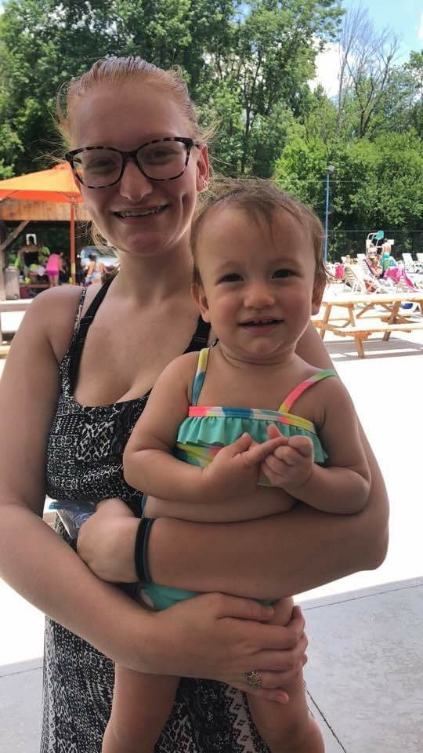
Indiana ADULT EDUCATION
Basic Skills. High School Equivalency. Short-term Training. Certifications and More.
Makaila Kirk
Success Stories
Stories to Inspire. Share Your Program’s Successes.
These do not all have to be HSE completion stories.
► Did someone receive basic skills remediation to pass WorkKeys and get a great job?
► Were they able to remediate and improve their AccuPlacer score to get into credit bearing classes at Ivy Tech or Vincennes University?
► Was an employer able to promote an employee because their language skills improved to the point they could supervise?
These do not all have to be about students.
► Has your program forged a new relationship with an employer?
► Did someone on your staff have an accomplishment that is noteworthy?
► Is there a change in your programming that has worked particularly well for students?
► Is there a special community partnership that is beneficial to your program?
Everyone has a dream. Everyone has a story to tell. Share it.
Then one day, after nearly ten years of sticking to his dream of pursuing music, and becoming an accomplished Elvis and Johnny Cash impersonator, his father had a proposition for him. “He said he knew I had this dream of recording music in Memphis and basically told me he would pay for half of everything if I got my (HSE).”
So, after years out of traditional high school, and an attempt at another high school equivalency (HSE) program out of state, Bennett enrolled at the MACC for daily adult education afternoon classes. “The teacher was great- he motivated me when I needed to be motivated.” After about four months in class, Bennett passed his HSE test and received his diploma. Bennett says, “If it wasn’t for Mr. Smith keeping me on track, I would have never gotten it done.”
“If I can make it, anyone can make it,” says Bennett.

Slide 9
program is open to anyone age 16 or older who is not attending a high school. It helps people prepare for the equivalency test, earn workforce
certification and even learn English as a second language.
“It’s really all about getting people into career training and employment,” said Robert Moore, director of the program.
The program serves about 500 people each year. Historically, there has been one ceremony in May to recognize their accomplishments. A second
ceremony was added in December this year.
“- 1
Indiana ADULT EDUCATION
Basic Skills. High School Equivalency. Short-term Training. Certifications and More.
2019-2020 Grant
Program Performance Metrics
AE Performance Metric | Point Value
Adult Education Enrollment | 1 Point
Measurable Skill Gain | 1 Point
Attained HSE Diploma | 1 Point
Attained Certification | 1 Point
or}
- Indiana’s Program Performance Metrics will be used to award grants for 2019-2020
- Adult Education Enrollment NRS Table 4, Column B
- Measurable Skill Gain NRS Table 4, Column E
- Attained Secondary School Diploma/Equivalent NRS Table 4, Column F

Slide 10
program is open to anyone age 16 or older who is not attending a high school. It helps people prepare for the equivalency test, earn workforce
certification and even learn English as a second language.
“It’s really all about getting people into career training and employment,” said Robert Moore, director of the program.
The program serves about 500 people each year. Historically, there has been one ceremony in May to recognize their accomplishments. A second
ceremony was added in December this year.
“- 1
Indiana ADULT EDUCATION
Basic Skills. High School Equivalency. Short-term Training. Certifications and More.
2019-2020 Grant
Program Performance Metrics
IET Performance Metric | Point Value
Enrollment | 1
Completion | 1
Certification | Multiple
IET = 15%

Slide 11
program is open to anyone age 16 or older who is not attending a high school. It helps people prepare for the equivalency test, earn workforce
certification and even learn English as a second language.
“It’s really all about getting people into career training and employment,” said Robert Moore, director of the program.
The program serves about 500 people each year. Historically, there has been one ceremony in May to recognize their accomplishments. A second
ceremony was added in December this year.
“- 1
Indiana ADULT EDUCATION
Basic Skills. High School Equivalency. Short-term Training. Certifications and More.
2019-2020 Grant
Program Performance Metrics
Workforce Education Initiative (WEI)
Competed 10%
2019-2020
No Performance Points | Demonstrate Effectiveness

Slide 12

program is open to anyone age 16 or older who is not attending a high school. It helps people prepare for the equivalency test, earn workforce
certification and even learn English as a second language.
“It’s really all about getting people into career training and employment,” said Robert Moore, director of the program.
The program serves about 500 people each year. Historically, there has been one ceremony in May to recognize their accomplishments. A second
ceremony was added in December this year.
“- 1
Indiana ADULT EDUCATION
Basic Skills. High School Equivalency. Short-term Training. Certifications and More.
More to Come
Tests of Adult Basic Education
Visit TABETest.com to Learn More

Slide 13
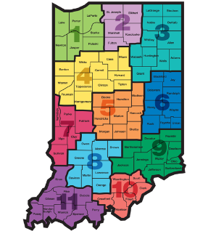
Indiana ADULT EDUCATION
Basic Skills. High School Equivalency. Short-term Training. Certifications and More.
STATE Performance Metrics
Measurable Skill Gain
High School Equivalency
#1
#2
INDIANA
Performance
Metrics
Then one day, after nearly ten years of sticking to his dream of pursuing music, and becoming an accomplished Elvis and Johnny Cash impersonator, his father had a proposition for him. “He said he knew I had this dream of recording music in Memphis and basically told me he would pay for half of everything if I got my (HSE).”
So, after years out of traditional high school, and an attempt at another high school equivalency (HSE) program out of state, Bennett enrolled at the MACC for daily adult education afternoon classes. “The teacher was great- he motivated me when I needed to be motivated.” After about four months in class, Bennett passed his HSE test and received his diploma. Bennett says, “If it wasn’t for Mr. Smith keeping me on track, I would have never gotten it done.”
“If I can make it, anyone can make it,” says Bennett.

Slide 14
New NRS State Table 4 – 2018-2019 8-29-18

Slide 15
Indiana ADULT EDUCATION
Basic Skills. High School Equivalency. Short-term Training. Certifications and More.
MEASURABLE SKILL GAIN
Basic Skills Remediation
NRS Table 4, Column H NRS Table 4, Column I
2017-2018* 2018-2019*
64%
– Indiana Target
2018-2019
63.54%
10.32%
Instructional IMPACT
*Data as of 8.30.18
Then one day, after nearly ten years of sticking to his dream of pursuing music, and becoming an accomplished Elvis and Johnny Cash impersonator, his father had a proposition for him. “He said he knew I had this dream of recording music in Memphis and basically told me he would pay for half of everything if I got my (HSE).”
So, after years out of traditional high school, and an attempt at another high school equivalency (HSE) program out of state, Bennett enrolled at the MACC for daily adult education afternoon classes. “The teacher was great- he motivated me when I needed to be motivated.” After about four months in class, Bennett passed his HSE test and received his diploma. Bennett says, “If it wasn’t for Mr. Smith keeping me on track, I would have never gotten it done.”
“If I can make it, anyone can make it,” says Bennett.

Slide 16
Indiana ADULT EDUCATION
Basic Skills. High School Equivalency. Short-term Training. Certifications and More.
#1 MEASURABLE SKILL GAIN
Basic Skills Remediation
NRS Table 4, Columns B, D, I
64%
– Indiana Target
2018-2019
Enrolled 5,050 (ABE/ELL)
Majority of Students – Level 3. Next Highest – Level 2
28.72 Average Attendance Hours
10.32%
Data as of 8.29.18
Then one day, after nearly ten years of sticking to his dream of pursuing music, and becoming an accomplished Elvis and Johnny Cash impersonator, his father had a proposition for him. “He said he knew I had this dream of recording music in Memphis and basically told me he would pay for half of everything if I got my (HSE).”
So, after years out of traditional high school, and an attempt at another high school equivalency (HSE) program out of state, Bennett enrolled at the MACC for daily adult education afternoon classes. “The teacher was great- he motivated me when I needed to be motivated.” After about four months in class, Bennett passed his HSE test and received his diploma. Bennett says, “If it wasn’t for Mr. Smith keeping me on track, I would have never gotten it done.”
“If I can make it, anyone can make it,” says Bennett.

Slide 17
Indiana ADULT EDUCATION
Basic Skills. High School Equivalency. Short-term Training. Certifications and More.
Enrolled 3,829
2018-2019 – ABE
8.29.18 ABE Enrollment
ABE Level 1 – 259
ABE Level 5 – 221
ABE Level 6 – 136
16%
65%
Levels
2-3
ABE Level 3
1,342
35%
Data as of 8.29.18
Then one day, after nearly ten years of sticking to his dream of pursuing music, and becoming an accomplished Elvis and Johnny Cash impersonator, his father had a proposition for him. “He said he knew I had this dream of recording music in Memphis and basically told me he would pay for half of everything if I got my (HSE).”
So, after years out of traditional high school, and an attempt at another high school equivalency (HSE) program out of state, Bennett enrolled at the MACC for daily adult education afternoon classes. “The teacher was great- he motivated me when I needed to be motivated.” After about four months in class, Bennett passed his HSE test and received his diploma. Bennett says, “If it wasn’t for Mr. Smith keeping me on track, I would have never gotten it done.”
“If I can make it, anyone can make it,” says Bennett.

Slide 18
Indiana ADULT EDUCATION
Basic Skills. High School Equivalency. Short-term Training. Certifications and More.
Then one day, after nearly ten years of sticking to his dream of pursuing music, and becoming an accomplished Elvis and Johnny Cash impersonator, his father had a proposition for him. “He said he knew I had this dream of recording music in Memphis and basically told me he would pay for half of everything if I got my (HSE).”
So, after years out of traditional high school, and an attempt at another high school equivalency (HSE) program out of state, Bennett enrolled at the MACC for daily adult education afternoon classes. “The teacher was great- he motivated me when I needed to be motivated.” After about four months in class, Bennett passed his HSE test and received his diploma. Bennett says, “If it wasn’t for Mr. Smith keeping me on track, I would have never gotten it done.”
“If I can make it, anyone can make it,” says Bennett.

Slide 19
Indiana ADULT EDUCATION
Basic Skills. High School Equivalency. Short-term Training. Certifications and More.
MEASURABLE SKILL GAIN
Basic Skills Remediation
NRS Table 4, Column H
2017-2018 2016-2017
ABE 65.15% +5.49% 59.66%
ELL 57.29% + 6.48% 50.81%
TOTAL 63.54%* +5.94% 57.60%
60%
– Indiana Target
2017-2018
Instructional IMPACT
*Data as of 8.30.18
Then one day, after nearly ten years of sticking to his dream of pursuing music, and becoming an accomplished Elvis and Johnny Cash impersonator, his father had a proposition for him. “He said he knew I had this dream of recording music in Memphis and basically told me he would pay for half of everything if I got my (HSE).”
So, after years out of traditional high school, and an attempt at another high school equivalency (HSE) program out of state, Bennett enrolled at the MACC for daily adult education afternoon classes. “The teacher was great- he motivated me when I needed to be motivated.” After about four months in class, Bennett passed his HSE test and received his diploma. Bennett says, “If it wasn’t for Mr. Smith keeping me on track, I would have never gotten it done.”
“If I can make it, anyone can make it,” says Bennett.

Slide 20
Indiana ADULT EDUCATION
Basic Skills. High School Equivalency. Short-term Training. Certifications and More.
Distance Education Measurable Skill Gains
7.31.17
2016-2017
NRS Table 4C Column H
64.96%
8.30.18
2017-2018
NRS Table 4C
Column H
70.86%
Distance Ed
2016-2017
2017-2018*
*Data as of 8.30.18

Slide 21
Indiana ADULT EDUCATION
Basic Skills. High School Equivalency. Short-term Training. Certifications and More.
No. Separated Before Gain
2016-2017
9,817
36.36%
2017-2018*
7,931
30.07%
*Data as of 8.30.18
Notes:
NK
Number separated before gain is inching up as we finalize reports for 2017-2018. We are at 30 percent, six percentage points down from a year ago. Let’s continue to work on reducing the number of students who exit without gains.

Slide 22
Indiana ADULT EDUCATION
Basic Skills. High School Equivalency. Short-term Training. Certifications and More.
No. Separated Before Gain
2017-2018
– ABE/ASE Levels 1-6 28.57% Separated
– ELL Levels 1-6 35.86% Separated
_______________________________
30.07% Separated
*Data as of 8.30.18

Slide 23
Indiana ADULT EDUCATION
Basic Skills. High School Equivalency. Short-term Training. Certifications and More.
ABE/ELL
- 619
Down
Enrollment
2017-1018 2016-2017
ABE 1-6 20,958 ↑ 20,720
ELL 1-6 5,416 ↓ 6,273
*Data as of 8.30.18

Slide 24
Indiana ADULT EDUCATION
Basic Skills. High School Equivalency. Short-term Training. Certifications and More.
How Did We Do?
High School Equivalency
INDIANA
Performance
Metrics
Pass Rate
77.22%* 2017-2018
75.55% 2016-2017
*Data of 8.30.18

Slide 25

Indiana ADULT EDUCATION
Basic Skills. High School Equivalency. Short-term Training. Certifications and More.
TASC Summary All Indiana Examinees
2017-2018* 5,469
2016-2017 5,388
+ 81
*Data as of 6.8.18
InTERS Summary All Enrolled Indiana Examinees
2017-2018* 4,845
2016-2017 4,870
- 25
*Data of 8.30.18

Slide 26

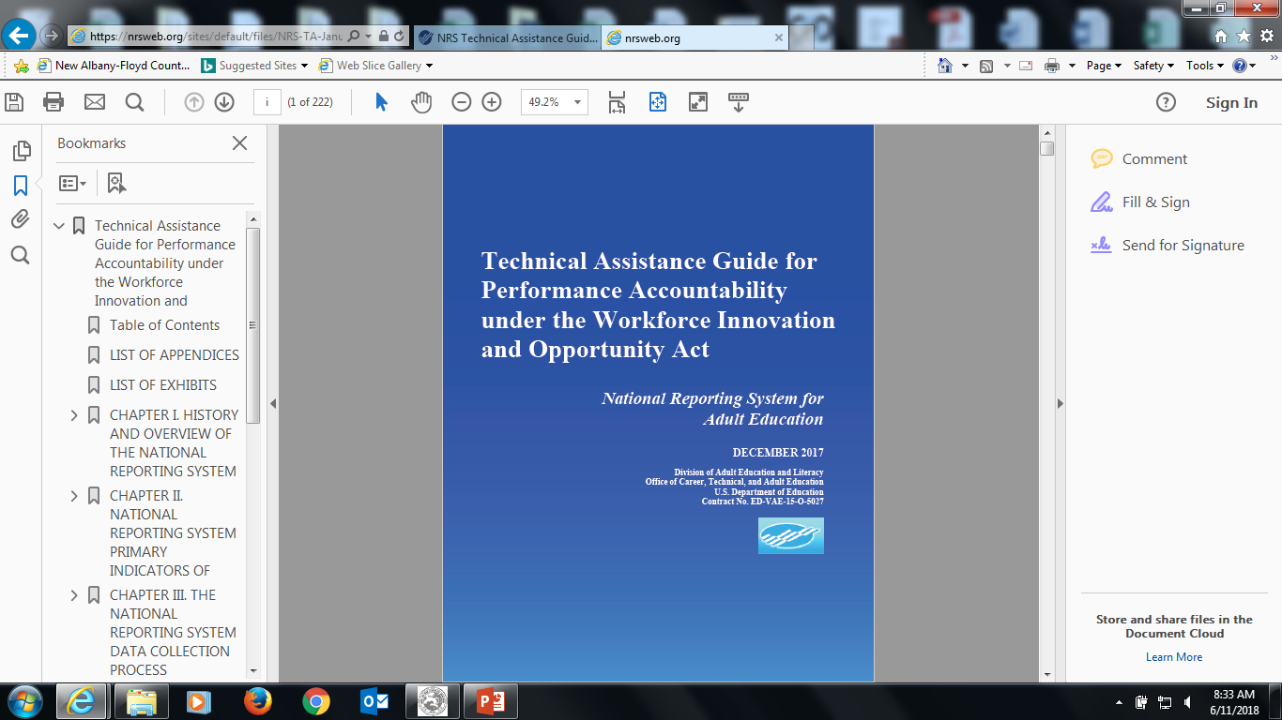
Indiana ADULT EDUCATION
Basic Skills. High School Equivalency. Short-term Training. Certifications and More.
REMINDER
New NRS TABLES
PROGRAM YEAR 2018-19
REPORTING ON OCTOBER 1, 2019
https://nrsweb.org/training-ta/nrs-reporting-tables-webinar
BEGINS
Slide 154

Slide 27

Indiana ADULT EDUCATION
Basic Skills. High School Equivalency. Short-term Training. Certifications and More.
REMINDER
Changes to Tables 4 and 5 and New NRS Tables
Table 2A – Reportable Individuals by Age, Ethnicity, and Sex
Table 4 – Measurable Skills Gains (MSG) by Entry Level (columns added)
Table 4A – Educational Functioning Level Gain
Table 5 – Primary Indicators of Performance (column headings)
Table 11 – Outcome Achievement for Participants in Integrated Education & Training Programs

Slide 28
Indiana ADULT EDUCATION
Basic Skills. High School Equivalency. Short-term Training. Certifications and More.
REMINDER
Changes to Tables 4 and 5 and New NRS Tables
Table 2A – Reportable Individuals by Age, Ethnicity, and Sex
► Reportable Individuals = Less than 12 hours attendance hours
► Participants = 12 or more attendance hours
Reportable Individuals – Do Not Count Toward Accountability Measures

Slide 29

Indiana ADULT EDUCATION
Basic Skills. High School Equivalency. Short-term Training. Certifications and More.
Statute WIOA
U.S. Department of Education
OCTAE
Office of Career, Technical, and Adult Education
MONITORING PROTOCOL
- Program Regulations
- Uniform Guidance
- EDGAR (Education Department General Administrative
Regulations)
Program Regulations 34 CFR 462 34 CFR 463
Uniform Guidance 2 CFR 200 .327 .328 .331 .338 .339
EDGAR 34 CFR 76.770, 76.720, 76.722

Slide 30
Indiana ADULT EDUCATION
Basic Skills. High School Equivalency. Short-term Training. Certifications and More.
U.S. Department of Education
What is Monitoring?
#1 More than on-site visits
#2 Any action taken by the state
or grantee throughout the life of
a grant to ensure legal
compliance and program
performance
#3 Ongoing process
OCTAE
Office of Career, Technical, and Adult Education
MONITORING PROTOCOL
- Program Regulations
- Uniform Guidance
- EDGAR (Education Department General Administrative
Regulations)

Slide 31
Indiana ADULT EDUCATION
Basic Skills. High School Equivalency. Short-term Training. Certifications and More.
Are local grantees –
Serving eligible adults?
Carrying out allowable activities?
Using AEFLA funds in ways that are allowable under the statute?
Meeting acceptable levels of performance?
Providing the state with data that is valid and reliable?
Fulfilling their one-stop partner roles and responsibilities?
U.S. Department of Education
OCTAE
Office of Career, Technical, and Adult Education
MONITORING PROTOCOL

Slide 32
Indiana ADULT EDUCATION
Basic Skills. High School Equivalency. Short-term Training. Certifications and More.
Scheduled monitoring reviews are organized and planned with a grantee and may include one or more of the following methods –
► Desk Monitoring
► On-Site Monitoring
► Other monitoring techniques that ensure effective monitoring of grantee progress in meeting performance standards and compliance with grant requirements
U.S. Department of Education
OCTAE
Office of Career, Technical, and Adult Education
MONITORING PROTOCOL

Slide 33
Indiana ADULT EDUCATION
Basic Skills. High School Equivalency. Short-term Training. Certifications and More.
Using a Risk-Based Monitoring Approach
U.S. Department of Education
► Identify appropriate risk indicators, and assign each a value or weight
► Evaluate and rank programs based on relative risk
► Identify available monitoring resources and staff – weigh against monitoring needs
► Adjust monitoring plan, including monitoring activities and schedule based on risk and resource assessments
OCTAE
Office of Career, Technical, and Adult Education
MONITORING PROTOCOL
2 CFR 200.331(b)

Slide 34
Indiana ADULT EDUCATION
Basic Skills. High School Equivalency. Short-term Training. Certifications and More.
Risk Indicator
Review financial and performance reports
Risk Indicator
Issue a decision for audit findings
Risk Indicator
Verify that every subgrantee is audited as required
Risk Indicator
Ensure that local programs takes timely and appropriate action on all deficiencies and take action if not (CAP)
Required Risk Factors in a Risk-Based
Monitoring
Approach 2 CFR 200.331(b)

Slide 35
Indiana ADULT EDUCATION
Basic Skills. High School Equivalency. Short-term Training. Certifications and More.
Required Risk Factors in a Risk-Based
Monitoring
Approach
Subgrantees
2018-2019
Adult Education Continuation Grant And
Competitive Application (Request for Application)
Granting of Funds to Contracting Entities
DWD allows the use of contracted service providers (sub-grantees) subject to the approval of DWD. The grantee will assume all responsibility for the performance of the contracted services providers (subgrantees). This includes, but is not limited to ensuring that contracted services providers (subgrantees) follow DWD policies and that contracted services providers (subgrantees) are in compliance with applicable state and federal law.
Grantees will also be responsible for the monitoring of contracted services providers’ (subgrantees) performance and data.

Slide 36
Indiana ADULT EDUCATION
Basic Skills. High School Equivalency. Short-term Training. Certifications and More.
Required Risk Factors in a Risk-Based
Monitoring
Approach
Subgrantees
2018-2019
Risk Indicator
Why do grantees have to monitor subrecipients?
How do grantees have to monitor?
It’s up to the grantee.
It’s the law.

Slide 37
Indiana ADULT EDUCATION
Basic Skills. High School Equivalency. Short-term Training. Certifications and More.
Required Risk Factors in a Risk-Based
Monitoring
Approach
Subgrantees
2018-2019
Risk Indicator
STANDARD: Monitoring efforts must provide a reasonable assurance that a subgrantee administers Federal funds in compliance with laws and regulations, and that performance goals are achieved.

Slide 38
Indiana ADULT EDUCATION
Basic Skills. High School Equivalency. Short-term Training. Certifications and More.
FEDERAL
MONITORING INSTRUMENT
NEXT
STEPS
Moving Forward
2018-2019
Federal Instrument for States
Adult Education and Family Literacy Act (AEFLA) Monitoring Protocol
Module 1 – Performance Accountability
Module 2 – Fiscal
Module 3 – State Leadership (professional
development)
Module 4 – Competition and Monitoring Locals
Module 5 – WIOA Shared Monitoring
Notes:
.

Slide 39
Indiana ADULT EDUCATION
Basic Skills. High School Equivalency. Short-term Training. Certifications and More.
MONITORING INSTRUMENT for Indiana Adult Education Programs
NEXT
STEPS
Moving Forward
2018-2019
Draft Indiana Adult Education
Program Quality Review
Section 1 – Performance Accountability
Section 2 – Fiscal
Section 3 – Local Leadership (professional
development)
Section 4 – Monitoring
Section 5 – State Targets
Notes:
.

Slide 40
Indiana ADULT EDUCATION
Basic Skills. High School Equivalency. Short-term Training. Certifications and More.
2018-2019 INDIANA Grant
Program Quality Review Examples
Draft Indiana Adult Education Program Quality Review
Section 1 – Performance Accountability
Does the grantee require that all sites and subaward recipients (if applicable) use a standardized intake form (electronic or paper) to collect all participant information required for the Adult Education and Family Literacy Act (AEFLA)? Does the intake form include the correct definitions for all data elements?
Does the grantee and subaward recipients (if applicable) require a confidentiality release form at intake for data exchange?
Do the grantee and subaward recipients (if applicable) follow the state’s assessment policy to meet Measurable Skill Gains requirements?
Notes:
.

Slide 41
Indiana ADULT EDUCATION
Basic Skills. High School Equivalency. Short-term Training. Certifications and More.
2018-2019 INDIANA Grant
Program Quality Review Examples
Draft Indiana Adult Education Program Quality Review
Section 1 – Performance Accountability
Do the grantee and subaward recipients (if applicable) follow the instructional hours to administer pre- and post-tests to students? Is the time for administering the post-test long enough after the pre-test to allow the test to measure educational functioning level gains according to test publisher's guidelines?
Do the grantee and subaward recipients (if applicable) accurately use the score ranges tied to educational functioning levels for placement and for reporting gains for accountability?
Do the grantee and subaward recipients (if applicable) accurately identify and record the skill areas in InTERS to measure educational gain?
Notes:
.

Slide 42
Indiana ADULT EDUCATION
Basic Skills. High School Equivalency. Short-term Training. Certifications and More.
2018-2019 INDIANA Grant
Program Quality Review Examples
Draft Indiana Adult Education Program Quality Review
Section 1 – Performance Accountability
Do the grantee and subaward recipients (if applicable) adhere to training requirements that staff must meet in order to be qualified to administer and score each test for placement and educational gain?
Do the grantee and subaward recipients (if applicable) use a locator test for guidance on identifying the appropriate pre-test?
Do the grantee and subaward recipients (if applicable) identify the appropriate alternate form or forms of each test to use for posttesting?
How do the grantee and subaward recipients monitor data quality?

Slide 43
Indiana ADULT EDUCATION
Basic Skills. High School Equivalency. Short-term Training. Certifications and More.
2018-2019 INDIANA Grant
Program Quality Review Examples
Draft Indiana Adult Education Program Quality Review
Section 1 – Performance Accountability
Do the grantee and subaward recipients enter data into InTERS at least by the 10th of each month to ensure accurate reviews by the state?
Do the grantee and subaward recipients review InTERS data by the 10th of each month for errors, missing data, out-of-range values, and is there a process in place to resolve problems?
Do the grantee and subaward recipients have procedures to verify that local reports accurately reflect data collected (e.g., through review of local program documentation, onsite auditing)?
Notes:
.

Slide 44
Indiana ADULT EDUCATION
Basic Skills. High School Equivalency. Short-term Training. Certifications and More.
2018-2019 INDIANA Grant
Program Quality Review Examples
Draft Indiana Adult Education Program Quality Review
Section 1 – Performance Accountability
Do the grantee and subaward recipients compare current year’s data to prior years‘ data for discrepancies, reasonableness, and to identify trends with performance?
Do the grantee and subaward recipients provide on-going staff development and training?
Does the student outcome data on Table 4 indicate adequate performance compared to national and state data?
Do the grantee and subaward recipients have a history of meeting performance indicator targets?

Slide 45
Indiana ADULT EDUCATION
Basic Skills. High School Equivalency. Short-term Training. Certifications and More.
2018-2019 INDIANA Grant
Program Quality Review Examples
Draft Indiana Adult Education Program Quality Review
Section 1 – Performance Accountability
Do the grantee and subaward recipients demonstrate continual improvements in outcomes, consistent with WIOA performance accountability requirements?
Do the grantee and subaward recipients obtain an adequate pre- and posttest rate on Table 4B?
Does the average number of instructional hours indicate that the grantee and subaward recipients are of sufficient intensity and duration to produce measurable skill gains?
Notes:
.

Slide 46
Indiana ADULT EDUCATION
Basic Skills. High School Equivalency. Short-term Training. Certifications and More.
2018-2019 INDIANA Grant
Program Quality Review Examples
Draft Indiana Adult Education Program Quality Review
Section II – Fiscal
Have all required federal/state financial reports (FFR) been submitted? Were the submissions timely?
Were the percentage caps met in each report for administration?
Are all the costs allocated for Maintenance of Effort (MOE) verifiable from the grantee’s records? Necessary and reasonable for the accomplishment of the program’s objectives?
How much program income is being reported and how is it being spent?
Are all administrative costs necessary, reasonable, and allocable?

Slide 47
Indiana ADULT EDUCATION
Basic Skills. High School Equivalency. Short-term Training. Certifications and More.
2018-2019 INDIANA Grant
Program Quality Review Examples
Draft Indiana Adult Education Program Quality Review
Section II – Fiscal
Is the staffing adequate for the grantee’s current adult education responsibilities? How are positions funded?
Are actual duties and job responsibilities allowable costs? Do the duties observed match the job descriptions?
Can the grantee provide evidence that staff keep time and effort charts to document allowable adult education activities?
How does the director of adult education participate in the preparation of the FFR?

Slide 48
Indiana ADULT EDUCATION
Basic Skills. High School Equivalency. Short-term Training. Certifications and More.
2018-2019 INDIANA Grant
Program Quality Review Examples
Draft Indiana Adult Education Program Quality Review
Section II – Fiscal
Is the grantee reporting One Stop infrastructure costs? Has the grantee used administrative funds to support infrastructure?
Does the grantee demonstrate that it documents section 243 Integrated English Literacy and Civic Education (IELCE) activities and funds as separate from the basic grant award?
Can the grantee demonstrate that activities supported by IELCE funds are attributable to IELCE only, for example through time and effort charts for administrative activities?

Slide 49
Indiana ADULT EDUCATION
Basic Skills. High School Equivalency. Short-term Training. Certifications and More.
2018-2019 INDIANA Grant
Program Quality Review Examples
Draft Indiana Adult Education Program Quality Review
Section III – Local Leadership (Professional Development)
How does the grantee deliver professional development activities to staff? What process does the grantee use to ensure that professional development activities are widely accessed by instructors and program managers? Does the grantee track participation in professional development activities?
How is the grantee expending funds to monitor and evaluate activities and disseminate information about promising practices?
Does the grantee have a process in place for using the professional development evaluation data for continuous improvement? If no, why not?
Notes:
.JM

Slide 50
Indiana ADULT EDUCATION
Basic Skills. High School Equivalency. Short-term Training. Certifications and More.
2018-2019 INDIANA Grant
Program Quality Review Examples
Draft Indiana Adult Education Program Quality Review
Section IV – Monitoring
Does the grantee have a process in place to monitor internally? Does the grantee have a process in place to monitor subaward recipients?
Does the grantee conduct onsite monitoring? Does the grantee have a standard monitoring protocol? Does the grantee conduct desktop monitoring? Who conducts the monitoring?
Does the grantee provide internal staff, including subaward recipients, with training and technical assistance on programmatic issues?

Slide 51
Indiana ADULT EDUCATION
Basic Skills. High School Equivalency. Short-term Training. Certifications and More.
2018-2019 INDIANA Grant
Program Quality Review Examples
Draft Indiana Adult Education Program Quality Review
Section IV – Monitoring
Are there cooperative arrangements that the grantee has with other agencies, institutions, or organizations for the delivery of adult education and literacy activities?
Are services in alignment with the local workforce development plan, including how it will promote concurrent enrollment in programs and activities under Title I of WIOA, as appropriate?
Does the grantee meet performance targets set by the state?
Does the grantee fulfill, as appropriate, required one-stop partner responsibilities?
Notes:
.JM

Slide 52
Indiana ADULT EDUCATION
Basic Skills. High School Equivalency. Short-term Training. Certifications and More.
2018-2019 INDIANA Grant
Program Quality Review Examples
Draft Indiana Adult Education Program Quality Review
Section IV – Monitoring
Does the grantee provide services in a manner that meets the needs of eligible individuals?
Did the grantee ensure that every subaward is clearly identified to the state at the time of the subaward?
Does the grantee monitor the activities of each subaward recipient to ensure the grant is used for authorized purposes under WIOA? Does the grantee monitor the subaward recipient to ensure that performance goals are achieved?

Slide 53
Indiana ADULT EDUCATION
Basic Skills. High School Equivalency. Short-term Training. Certifications and More.
2018-2019 INDIANA Grant
Program Quality Review Examples
Draft Indiana Adult Education Program Quality Review
Section IV – Monitoring
Does the grantee ensure equitable access to, and participation in, programming for students, teachers, and other program beneficiaries with special needs?
Does the grantee and/or subaward recipient have new personnel or new or substantially changed systems? Is there a process in place for orientation and mentorship?
Does the grantee have procedures in place to determine if access is provided to adult education programming through the one-stop delivery system utilizing onsite staffing, cross training of partner staff, or direct linkages?
Notes:
.JM

Slide 54
Indiana ADULT EDUCATION
Basic Skills. High School Equivalency. Short-term Training. Certifications and More.
2018-2019 INDIANA Grant
Program Quality Review Examples
Draft Indiana Adult Education Program Quality Review
Section V – State
Do the grantee and subaward recipients (if applicable) maintain an inventory of equipment purchased?
Do the grantee and subaward recipients (if applicable) follow retention schedules for program records and student files for a minimum of three years?
Do the grantee and subaward recipients (if applicable) collect required signed high school exit forms for students (16-18 years of age)?
Do the grantee and subaward recipients (if applicable) use Indiana Career Explorer with each student?

Slide 55
Indiana ADULT EDUCATION
Basic Skills. High School Equivalency. Short-term Training. Certifications and More.
2018-2019 INDIANA Grant
Program Quality Review Examples
Draft Indiana Adult Education Program Quality Review
Section V – State
What processes are in place to monitor subaward recipients (if applicable)?
Are the provider’s staff credentials in compliance with the adult education qualifications and development policy?
Do the grantee and subaward recipients (if applicable) monitor data quality? How often and how is this being done? Are InTERS reports run routinely? Is attendance tracked daily?
At what frequency does the grantee review planned vs. actual expenditures?
Notes:
.JM. Jerry will go over next steps.

Slide 56
Indiana ADULT EDUCATION
Basic Skills. High School Equivalency. Short-term Training. Certifications and More.
Monitoring TEAM
NEXT
STEPS
Moving Forward
2018-2019
Indiana Adult Education
Program Quality Review
MONITORING Team*
Lance Halsey
Roy Melton
Jennifer Montgomery
*Continue as Adult Education Coordinators (AECs)

Slide 57
Indiana ADULT EDUCATION
Basic Skills. High School Equivalency. Short-term Training. Certifications and More.
Will the Monitoring Tool be Posted to AmplifyAE? Yes
When Will Formal On-site Monitoring Begin Using the New Protocol? Fall 2018
How Will I Know if My Program is Selected? Email
How Long Will the On-Site Review Take? Probably Two Days/Less
MONITORING PROTOCOL
Draft Indiana Adult Education
Program Quality Review

Slide 58
Indiana ADULT EDUCATION
Basic Skills. High School Equivalency. Short-term Training. Certifications and More.
2018-2019 Adult Education Online (Request for Application)
DWD’s online only distance education will provide services to Hoosiers in all of Indiana’s 92 counties through the integration of adult education and literacy activities delivered through technology accessible by students with access to an internet connection and assessments provided to participants by their closest local Indiana Adult Education provider.
DWD and Indiana Adult Education supports distance learning in an effort to increase participation in, and provide additional access to, adult education and literacy services within Indiana. It is thus the desire of DWD to fund an adult education provider within the state of Indiana up to $200,000 to administer a statewide “online only” distance education program.

Slide 59
Indiana ADULT EDUCATION
Basic Skills. High School Equivalency. Short-term Training. Certifications and More.
2018-2019 Adult Education Online (Request for Application)
Only organizations that received adult education funding for the 2018-19 year are eligible for AE online only distance education funds
Assessments will be conducted in partnership with local adult education providers, and must be conducted on-site at local adult education provider locations. Both the AE online only distance education grantee and the local adult education provider will share AE online only distance education students for the purposes of recording and reporting both state and federal performance metrics.
Adult Education Online Award Period 10.1.18 - 6.30.19

Slide 60
Indiana ADULT EDUCATION
Basic Skills. High School Equivalency. Short-term Training. Certifications and More.
2018-2019 Adult Education Online (Request for Application)
2018-2019 Adult Education Online
Timelines
Request for Application
 |  |  |  |  |  |  | Date
RFA Issued |  |  |  |  |  |  | TBA
RFA Questions Due |  |  |  |  |  |  | Friday, August 10th , 2018 5:00 PM EST (GMT–5)
RFA FAQ Released |  |  |  | Posted to AmplifyAE |  |  | Friday, August 31st , 2018
RFA/Grant Application Submission Deadline |  |  |  |  |  |  | Monday, September 17nd, 2018 5:00 PM EST (GMT–5)
Award Decisions Issued |  |  |  |  |  |  | Monday, September 24th , 2018

Slide 61
Indiana ADULT EDUCATION
Basic Skills. High School Equivalency. Short-term Training. Certifications and More.
2018-2019 Adult Education Online (Request for Application)
2018-2019 Adult Education Online
Questions
Request for Application
Scott Mills
DWD Adult Education Grants Manager | smills1@dwd.in.gov
Application and RFA Question Submission
AdultEd@dwd.in.gov

Slide 62
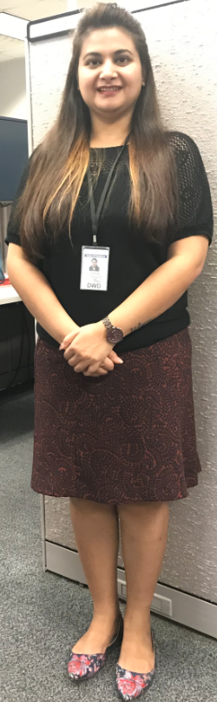
Shruti Shrivastava
Program Coordinator
Sshrivastava@dwd.in.gov
“I am very excited to be a part of the Adult Education Team. I am looking forward to participating and contributing in the various projects focusing on workforce development.”
Fun Facts!
Came to the United States in 2015
Started her Master’s degree (Master of Public Affairs, MPA) in 2016
Joined DWD in August 2018
Enjoys cooking, painting, books, documentaries, and decorating

Slide 63
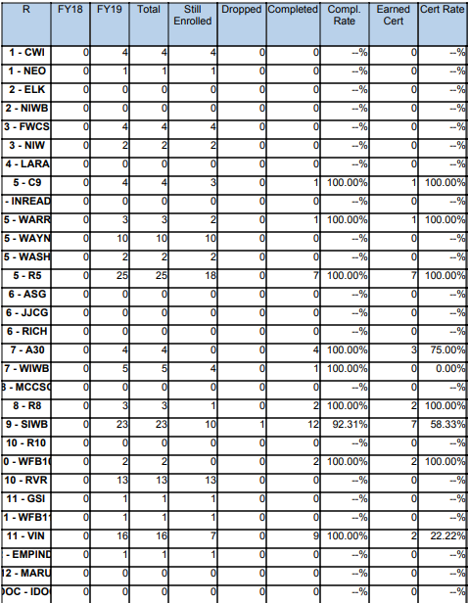
STATEWIDE | Goal | To-Date
Enrollment | 1,800 | 124
Enrollment Rate | ---
Still Enrolled | --- | 84
Completers | 1,440 | 39
Completion Rate | 80% | 97.5%
Dropped | --- | 1
Dropped Rate | 10% (or below) | .03%
Certifications issued | 1,065 | 25
Certification Rate | 74% | 64.1%
Employment | 640 | 16
Employment Rate | 60% | 56%

Slide 64


Slide 65


  Jessica Gray
  WorkINdiana Program Manager
  jgray1@dwd.in.gov
  WorkINdiana@dwd.in.gov
  (317) 503-1006
Policy Feedback
Please submit feedback on the WorkINdiana policy by 09.06.18 to policy@dwd.in.gov
Available WorkINdiana Funds
$900,000 available funds to be disbursed
  First come, first serve
  No more than 15% of available funds will be allocated out per request
Get to know us!
Notes:
JG

Slide 66
Indiana ADULT EDUCATION
Basic Skills. High School Equivalency. Short-term Training. Certifications and More.
Professional Development
NEXT
STEPS
Moving Forward
2018-2019
► Regionally Delivered Professional Development
► Locally Delivered Professional Development
► State Initiatives
Professional Development Team*
South – Nancy Karazsia
Central – Dan DeVers
North – Jose Torres
*Continue as Adult Education Coordinators (AECs)

Slide 67
Indiana ADULT EDUCATION
Basic Skills. High School Equivalency. Short-term Training. Certifications and More.
Professional Development
NEXT
STEPS
Moving Forward
2018-2019
PDF – Adult Education Director Statewide Meetings
August 17, 2018 - Elkhart
August 24, 2018 - Indianapolis
August 31, 2018 – Bedford
Reflections

Slide 68
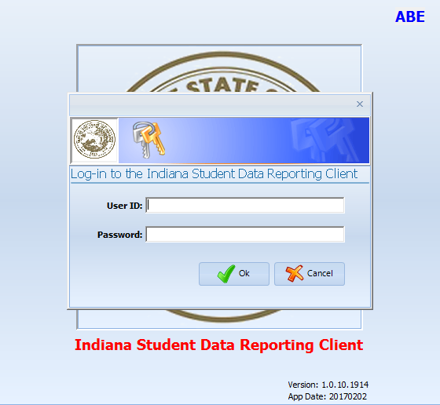
program is open to anyone age 16 or older who is not attending a high school. It helps people prepare for the equivalency test, earn workforce
certification and even learn English as a second language.
“It’s really all about getting people into career training and employment,” said Robert Moore, director of the program.
The program serves about 500 people each year. Historically, there has been one ceremony in May to recognize their accomplishments. A second
ceremony was added in December this year.
“- 1
InTERS
ADULT EDUCATION UPDATES, TRAININGS
Matt Crites
mcrites@dwd.in.gov
Brin Sisco
bsisco@dwd.in.gov

Slide 69
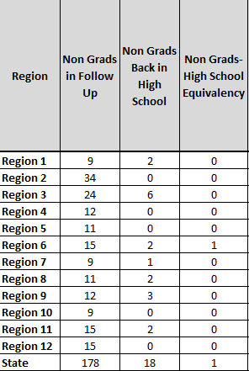

program is open to anyone age 16 or older who is not attending a high school. It helps people prepare for the equivalency test, earn workforce
certification and even learn English as a second language.
“It’s really all about getting people into career training and employment,” said Robert Moore, director of the program.
The program serves about 500 people each year. Historically, there has been one ceremony in May to recognize their accomplishments. A second
ceremony was added in December this year.
“- 1
Youth Initiatives Updates
2017-2018 Non-Grads in Follow Up
  178 total
  Only 18 are back in High School
  GREAT opportunity to re-engage
  Young Adult Services Summit
    October 30th
    Valle Vista Golf Club
Notes:
LH
The 2018-19 school year is in full swing, and the class of 2017-18 is in follow up. Currently, as you can see on the grid, there are 178 non graduates from the previous school year’s class that did not graduate but are still in follow up. Only 18 non grads from the previous year are back in high school, so that leaves a lot of potential students who could find success in HSE classes. This is a great time to engage those students, because in many cases they still will have a strong connection to their JAG Specialist. We encourage you to reach out as soon as possible to your regions and find out ways to connect with these students. It’s also a great opportunity to potentially form a relationship where you can go into the current JAG classes as a guest speaker and discuss the benefits of the WorkINdiana program.
The annual Young Adult Services Summit is coming up so we wanted to get the information for it on your radar. Anyone from the AE team is welcome to attend. We will have more details – such as times, workshops, and events – closer to the date, but please let a youth team member know if you would like to attend. It will take place on October 30th and will once again be held at the Valle Vista Golf Club in Greenwood Indiana.

Slide 70

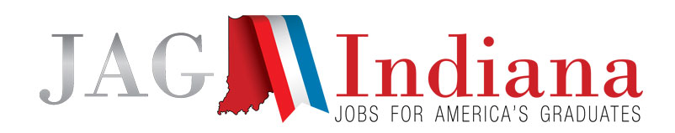
program is open to anyone age 16 or older who is not attending a high school. It helps people prepare for the equivalency test, earn workforce
certification and even learn English as a second language.
“It’s really all about getting people into career training and employment,” said Robert Moore, director of the program.
The program serves about 500 people each year. Historically, there has been one ceremony in May to recognize their accomplishments. A second
ceremony was added in December this year.
“- 1
Youth Initiatives Updates
JAG Language Changes
  At Risk = High School Students of Promise
  135 total programs = 133 total programs
  JAG will add 250 programs over the next several years
  Dropout prevention = Helping achieve success through graduation
JAG Indiana students at Scottsburg High School recently got a visit from U.S. Rep Trey Hollingsworth, who stressed to them the importance of being involved in their communities.

Slide 71
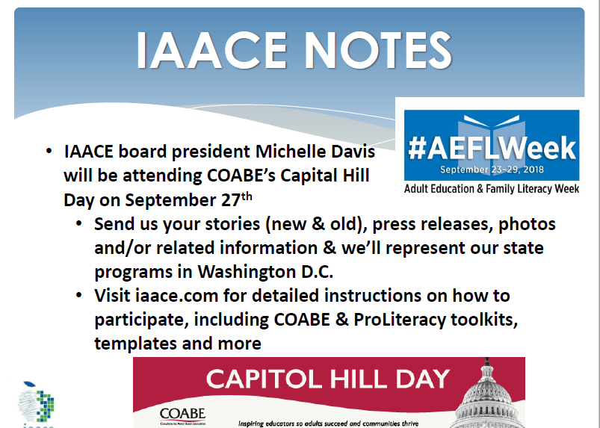

Slide 72
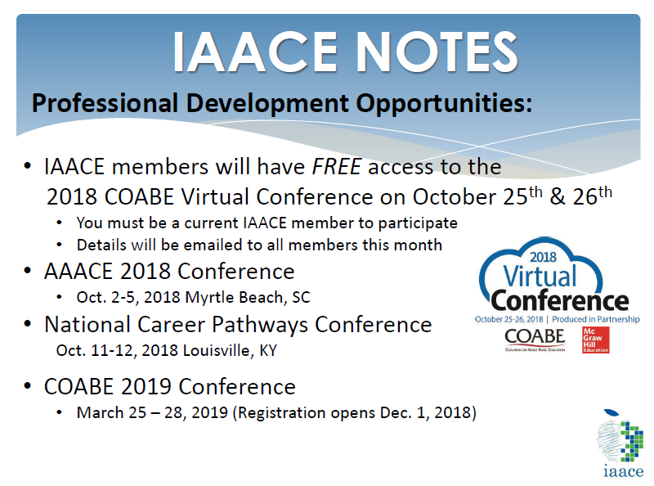

Slide 73
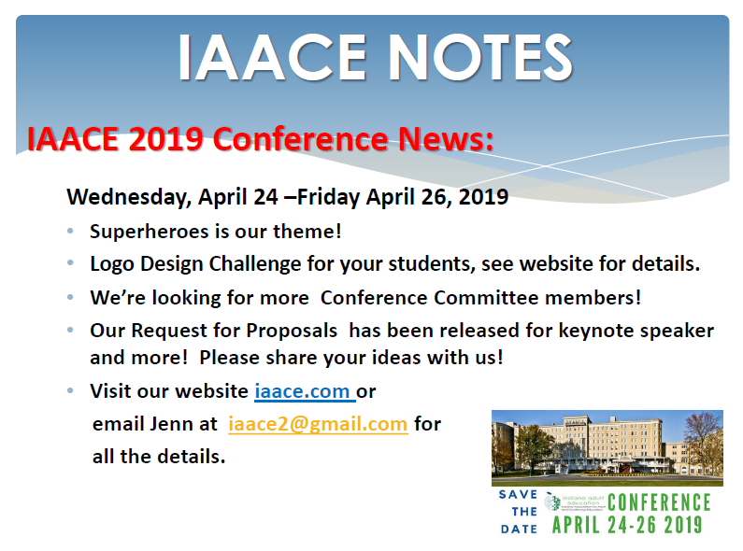

Slide 74
program is open to anyone age 16 or older who is not attending a high school. It helps people prepare for the equivalency test, earn workforce
certification and even learn English as a second language.
“It’s really all about getting people into career training and employment,” said Robert Moore, director of the program.
The program serves about 500 people each year. Historically, there has been one ceremony in May to recognize their accomplishments. A second
ceremony was added in December this year.
“- 1
Next Adult Education & Workforce Development Statewide Webinar
10.3.18
10 to 11:30 a.m. ET
The right skills, at the right time, in the right way. Indiana’s Demand Driven Workforce

