Slide 1
Indiana Department of Veterans Affairs

Slide 2
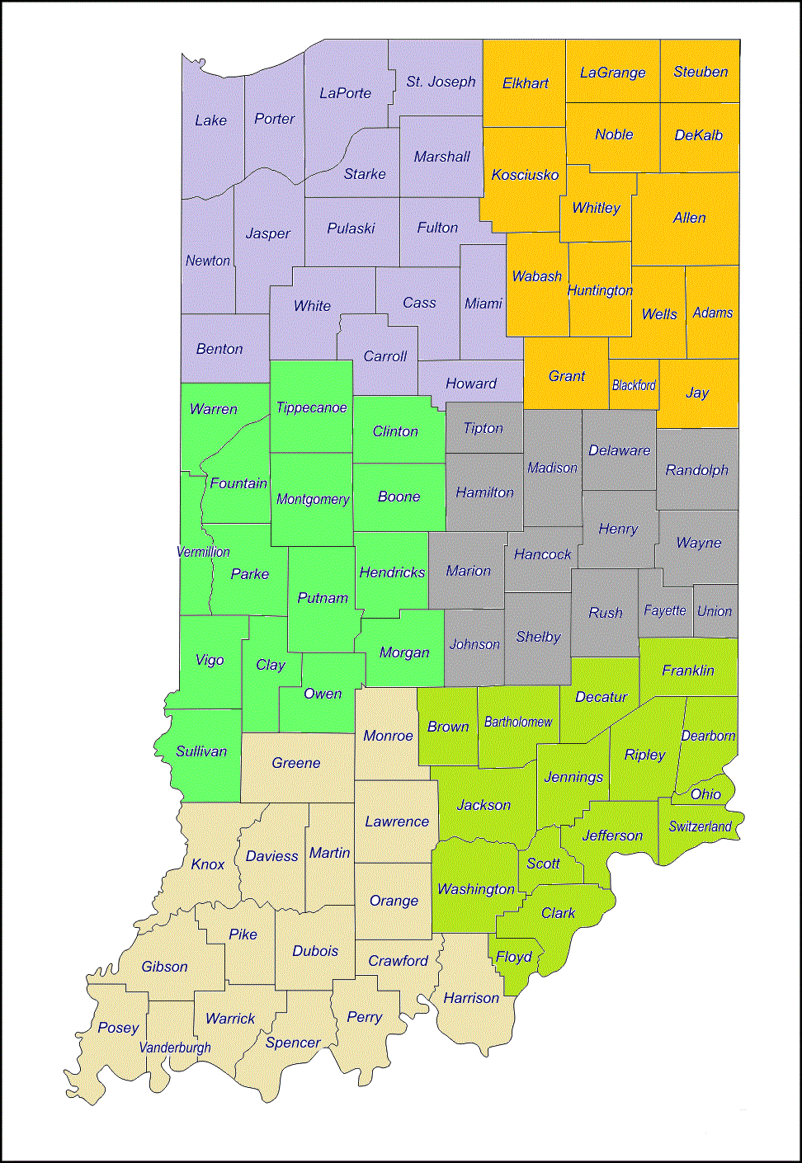
District Service Officers
(92) Counties
(92) CVSOs
(6) IDVA Districts
North
West
Tom White
North
East
Cam Lochner
Central
West
Kevin Hinton
Central East
Mark Smith
South
West
Desley Snyder
South
East
Joe Devito

Slide 3
Indiana Department of Veterans Affairs
IDVA & County Veteran Service Officers
Currently there are 89 accredited CVSOs
& 9 accredited Assistant CVSOs.

Slide 4
Indiana Veteran Benefits
Tuition and Fee Exemption
Reduced fee Hunting and Fishing License
Property Tax Deduction
Disabled Hoosier Veteran License Plate
Military Family Relief Fund
Discounted Golden Hoosier Passport
Free Peddlers Vendors and Hawkers License
All benefits require eligibility verification from CVSO/IDVA

Slide 5
Tuition and Fee Exemption
Who is Eligible:
VETERAN who received:
Purple Heart recipients (entered HOR Indiana)
CHILDREN OF VETERAN who are:
Purple Heart recipient - Former POW/MIA - Disabled Wartime Veteran
VETERAN/VETERAN’S Children Former Students of:
Morton Memorial H. S. for the Indiana Soldiers and Sailors Home (closed in 2009)

Slide 6
Tuition and Fee Exemption
Purple Heart Medal
VETERAN must:
Been Awarded the Purple Heart Medal
Received Honorable Discharge
Qualify for Indiana in-state tuition
Must have entered active duty w/ Indiana as Home of Record

Slide 7
Tuition and Fee exemption
Child of Veteran
Veteran Criteria:
Served on Active Duty during recognized war time dates or received a service or campaign medal for equally hazardous duty.
Have a VA disability rating 0%-100%
Student Requirements:
Be a Biological child of the veteran.
Be a legally Adopted child of the veteran.
Qualify for Indiana in-state tuition.
Maintain satisfactory academic progress.
Marital status of the student does not effect benefit.

Slide 8
Tuition and Fee exemption
Child of Veteran
Old Law
Veteran initially entered military on or before June 30, 2011
ADOPTED CHID of VETERAN:
Must have been adopted prior to reaching age 18 as July 1, 2019.
Must become eligible prior to age 32
PROGRAM PAYS FOR:
124 semester hours of tuition and mandatory fees paid at 100%
VETERAN RESIDENCY REQUIREMENTS:
Must have designated Indiana as HOR at the time of entry into the military OR
Been a resident of Indiana at least 5 years prior to first application of benefit as of July 1, 2019.
New Law
Veteran initially entered military on or after July 1, 2011
ADOPTED CHID of VETERAN:
Must have been adopted prior to age 18
Must become eligible prior to age 32
PROGRAM PAYS FOR:
124 Semester hours of tuition and mandatory fees paid up to the veteran disability percentage + (20)
VETERAN RESIDENCY REQUIRMENTS:
Must have designated Indiana as HOR at the time of entry into the military OR
Been a resident of Indiana at least 5 years prior to first application of benefit.

Slide 9
Tuition and Fee exemption Child of Veteran cont.
All student must use the educational cost exemption within eight (8) academic years regardless of the veterans parent’s enlistment date.
HOWEVER, to minimize the impact student who first used the education cost exemption before July 1, 2011 until they use it again After June 30, 2017 will be grandfather. Once they use the exemption after June 30, 2017 they will have eight (8) academic years to use the remaining exemption.
Exemption rates have not changed “old law/new law” rules
Veteran with initial active duty prior to July 1, 2011 the student is 100% exempt.
Veteran with initial active duty after to July 1, 2011 the student is exempt at 20% plus the Veteran’s combine service connected disability rating.

Slide 10
Tuition and Fee exemption
Approved schools
Indiana University
Purdue University
Indiana State University
Ball State University
U of Southern Indiana
Vincennes University
Ivy Tech (all locations)
Western Governor’s Univ. (INDIANA ONLY)

Slide 11
Tuition and Fee exemption
Application process
All application are done on Scholar Track
https://scholartrack.che.in.gov
Create a user profile in “Scholar Track”
Documents Required
Birth Certificate
Proof of veterans wartime service (DD 214)
Proof of VA Disability Award

Slide 12
SCHOLAR TRACK
Application process
https://scholartrack.che.in.gov/Login?ReturnUrl=%2f

Slide 13
Reduced Fee Hunting and Fishing License for Disabled Veterans
$2.75 per year
$27.50 for 10 years
Qualification:
Resident of Indiana
Served in the Armed Forces
Been awarded a service connected disability by:
Department of Veterans Affairs
Disability retirement benefits from DOD

Slide 14
Property Tax Deduction
Veteran and Surviving Spouse
Certain Hoosier Veterans and their Surviving Spouses qualify for a property Tax Abatement of:
$24,960
or
$12,480 ($14,000 2019 Assessment Year)
or
A Combination of Both - $37,440 (38,960 2019 Assessment Year)
Surviving Spouses can carry over the benefit upon the veterans death on the existing address or transfer to another home address in Indiana.
Surviving Spouse can be a first-time applicant if the veteran has
all the qualification.

Slide 15
Property Tax Deduction
Section 13- $24,960
WARTIME SERVICE is REQUIRED
To Qualify:
Served at least one day on Active duty during a recognized WARTIME period
AND
Service Connected by VA with a combined rating of at least 10%

Slide 16
Property Tax Deduction Section 14 - $12,480 ($14,000 2019 Assessment Year)
WARTIME SERVICE not REQUIRED
To Qualify:
Must have served honorably on Active Duty for at least 90 consecutive days
AND
Have a total disability
(100% SCD or VA Pension Award or IDVA approved disability award)
Or:
Served in the armed forces for at least 90 days
AND
Over age 62
AND
combined SCD rating of at least 10%.
*The assessed property value limit is $175,000.00
($200,000 2019 Assessment Year)

Slide 17
Property Tax Deduction Combination - (13&14) - $37,440 (38,960 2019 Assessment Year)
WARTIME SERVICE is REQUIRED
Served at least one day on Active duty during a
recognized WARTIME period
AND
Have a total disability
(100% SCD or VA Pension Award or IDVA approved disability award)
OR
Over age 62
AND
Rated at least 10 % service connected disabled.
*The assessed property value limit is $175,000.00 ($200,000 2019 Assessment Year)

Slide 18
Property Tax Deduction Non Property Owners
If a veteran, or surviving spouse, does not own any real property then the lesser of the following can be applied: The amount owed for vehicle excise tax or $70 can be applied per vehicle. Maximum of 2 vehicles.
Eligibility is the same as if property is owned
Situation: Veteran does not own any property and lives in an apartment but is eligible for the property tax deduction.
Example 2: Veteran owns this vehicle and excise tax owed is more than $70. Veteran would get a $70 credit and pays the remaining excise.
Example 1: Veteran owns this vehicle and the excise tax owed is under $70. Excise tax is waived.

Slide 19
Property Tax Deduction Disabled Veteran with homestead conveyed without consideration by a nonprofit organization
Qualification:
Veteran served at least 90 days
Received Honorable discharge
Awarded at least a 50% disability
Homestead conveyed at no expense to veteran by a tax exempt organization

Slide 20
Property Tax Deduction Disabled Veteran with homestead conveyed without consideration by a nonprofit organization
Deductions are as follows:
Veteran is totally disabled, deduct 100% of assessed value
Veteran is 90% disabled, deduct 90% of assessed property value
Veteran is 80% disabled, deduct 80% of assessed property value
Veteran is 70% disabled, deduct 70% of assessed property value
Veteran is 60% disabled, deduct 60% of assessed property value
Veteran is 50% disabled, deduct 50% of assessed property value
NOTE: the veteran cannot claim a deduction under sections 13-14 AND Section 14.5
But can claim sections 13 and 14 together if eligible.

Slide 21
Income Tax Deduction Retired Military
Deduction for retired military pay.
Military retirement, and Survivor benefits received during the taxable year from service in the active Armed Forces of the United States Including Reserve and Indiana National Guard components
The amount of the deduction is the lesser of: (A) the benefits in the adjusted gross income of the individual or the individual’s surviving spouse; or (B) six thousand two hundred fifty dollars ($6,250) plus the following:

Slide 22
Income Tax Deduction Retired Military
For taxable years beginning in 2019, twenty five percent (25%) of the amount of the benefits in excess of $6,250
For taxable years beginning in 2020 fifty percent (50%) of the amount of the benefits in excess of $6250
For taxable years beginning in 2021, seventy-five percent (75%) of the amount of the benefits in excess of $6,250
For taxable years beginning after 2021, one hundred percent (100%) of the amount of the benefits in excess of $6,250

Slide 23
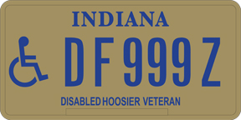
Disabled Hoosier Veteran License Plate
CURRENT Plate New Plates with Branches of Service are in the Works
Eligibility IC 9-18.5-5
Lost sight in both eyes or suffered permanent impairment of vision in both eyes with S/C compensation
Suffered loss of one or both hands or feet or permanent loss of use of one or both hands or feet
A United States Department of Veterans Affairs (USDVA) disability rating for a physical condition that precludes the individual from walking without pain or difficulty OR been rated by the USDVA as being at least 50% disabled and receiving compensation. At least 60% of the 50% rating must be attributed to a mobility disability
Eligibility for this plate also entitles the veteran for a reduced fee Golden Hoosier Passport for use at State Parks, museums, and DNR facilities

Slide 24
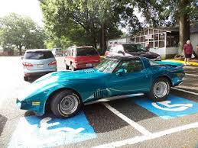
Disabled Hoosier Veteran License Plate
Don’t be this person
Serves as a handicapped plate
Allows for parking in legal metered spaces in Indiana at no charge and allows for parking longer than the allotted time normally permitted
No other individual is authorized parking privileges (the eligible veteran must be present when parking privilege is used)
This plate is not authorized for commercial vehicles
IC 9-18.5-5

Slide 25
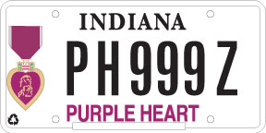
Purple Heart License Plate
Request must be accompanied by DD 214 or orders showing Purple Heart award
The Purple Heart license plate allows free parking in legal metered spaces and for longer than the allotted time permitted
PH plates available for passenger vehicle, truck (less than 11,000 lbs), RV, and motorcycle and are available for 1 OR more vehicles
IC 9-18.5-6

Slide 26
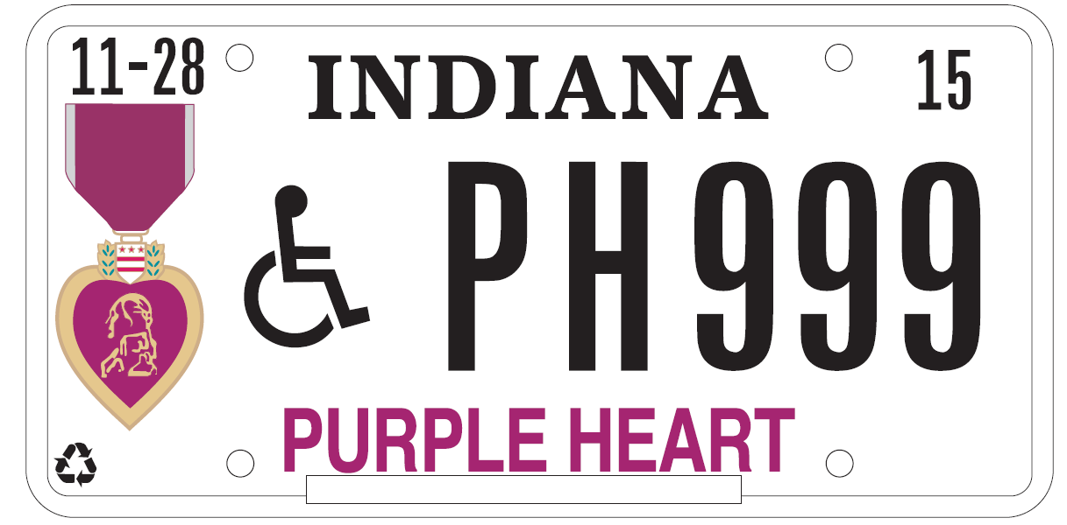
Purple Heart Disabled Veteran License Plate
A Purple Heart Plate with the universal handicap symbol is also now available. Use the same form as for the Disabled Hoosier Veteran, POW/ MIA, Purple Heart Recipient Plate.
The applicant must be eligible for either a Disabled Hoosier Veteran plate OR be authorized a handicapped placard in Indiana

Slide 27
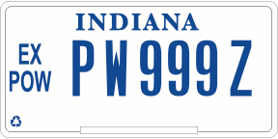
Prisoner of War Veteran Plate
A Prisoner of War Plate is authorized by former Prisoners of War and the bureau may issue 1 or more former prisoner of war plates to the veteran or the surviving spouse of a former prisoner of war.
Parking is authorized in any legal metered space at no charge and for longer than the allotted time

Slide 28
Veteran Plates
The only veteran plates that are authorized metered parking with no fee are the:
Former POW plate
Purple Heart Plate
Purple Heart Handicapped Plate
Disabled Hoosier Veteran Plate
NOTE: To legally park in a handicapped space a universal handicapped emblem must be on the plate or a placard must be displayed in the vehicle.

Slide 29
Permanent Parking Placard
When requested by a Disable Veteran that meets the following:
(A) has been issued; or
(B) is otherwise eligible to receive;
a disabled Hoosier veteran license plate under IC 9-18.5-5
New Law as of July 1, 2019
I.C. 9-18.5-8-4

Slide 30
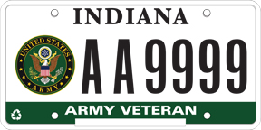
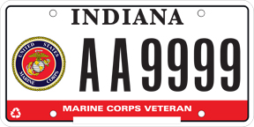
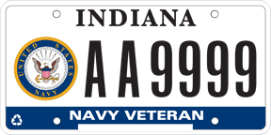
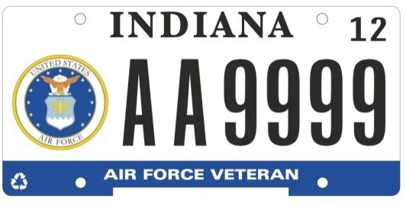
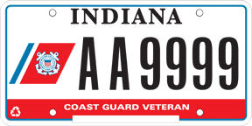
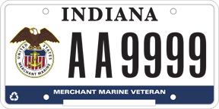
Veteran License Plates
NO
Veterans simply take their DD214 to the licenses branch to purchase these plates. Proceeds go to the
Military Family Relief Fund.

Slide 31
Support our Troops License Plates
These plates are available for purchase to anyone
Additional Fees support the
Military Family Relief Fund.

Slide 32
Military Family Relief Fund
Purpose:
To assist Veterans/families who are having financial difficulties.
Example of what the fund can be used for are:
Utility bills, needed auto repairs, mortgage/rent payments, current medical bills, and groceries etc.

Slide 33
Military Family Relief Fund
Eligibility:
Grants may be awarded to Indiana residents who is serving or has served in the Armed Forces of the United States or the National Guard on
active duty during national
conflict or wartime for a
minimum of 12 months.

Slide 34
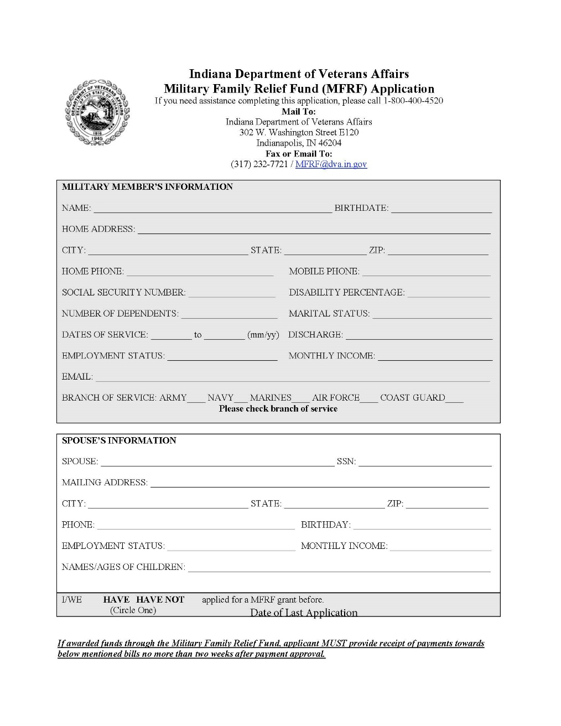
MFRF Application
SAMPLE FORM - Download all applications from:
https://www.in.gov/dva
To ensure an up to date application!

Slide 35
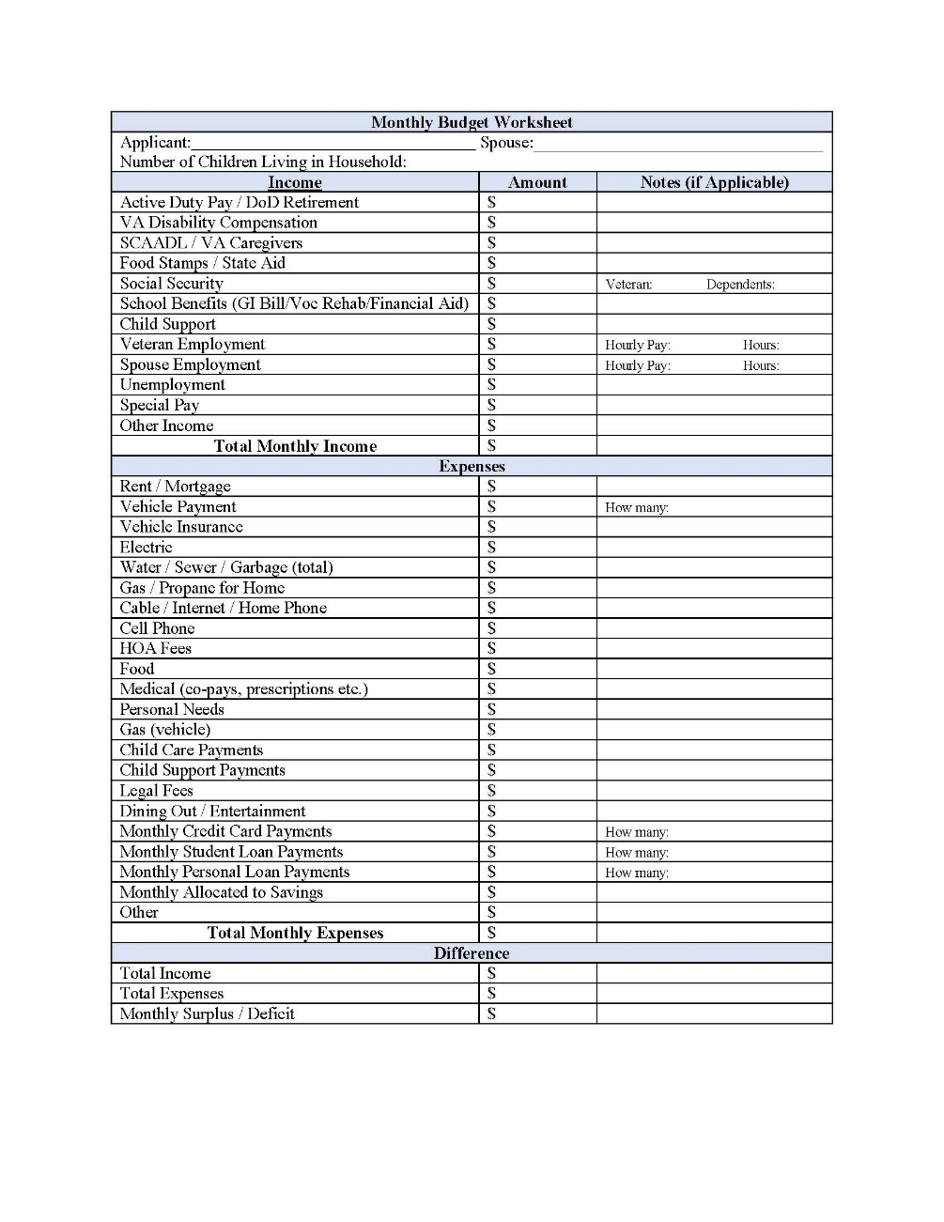
MFRF Application
SAMPLE FORM - Download all applications from:
https://www.in.gov/dva
To ensure an up to date application!

Slide 36
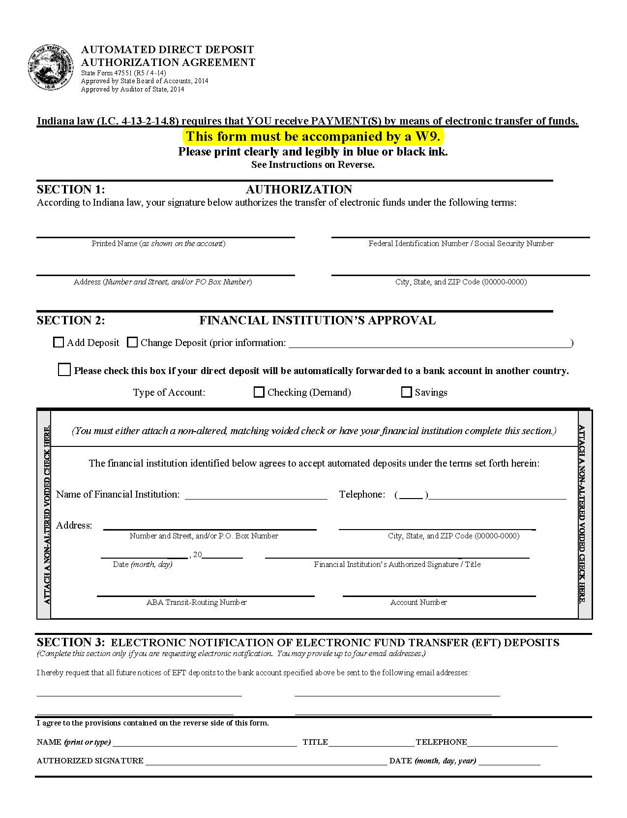
MFRF Application
SAMPLE FORM - Download all applications from:
https://www.in.gov/dva
To ensure an up to date application!

Slide 37
MFRF Application
SAMPLE FORM - Download all applications from:
https://www.in.gov/dva
To ensure an up to date application!

Slide 38
Other Indiana Benefits for Veterans
Delayed High School Diploma (WWII, Korea, and Vietnam veterans)
Copies of DD 214’s for Veterans who left active duty in 1989 or later kept at IDVA (Indiana HOR)
IC 6-3-2-4

Slide 39
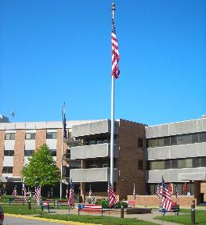
Indiana Veterans Home West Lafayette, Indiana
Eligibility for admission to the Indiana Veterans Home:
An honorably discharged member of the armed forces from
any period of service.
The spouse or surviving spouse of an
honorably discharged member of the
armed forces.
An eligible person who has a disability
or is destitute.
Has been a resident of Indiana for at
least one (1) year immediately
preceding application for admission
to the Home.

Slide 40
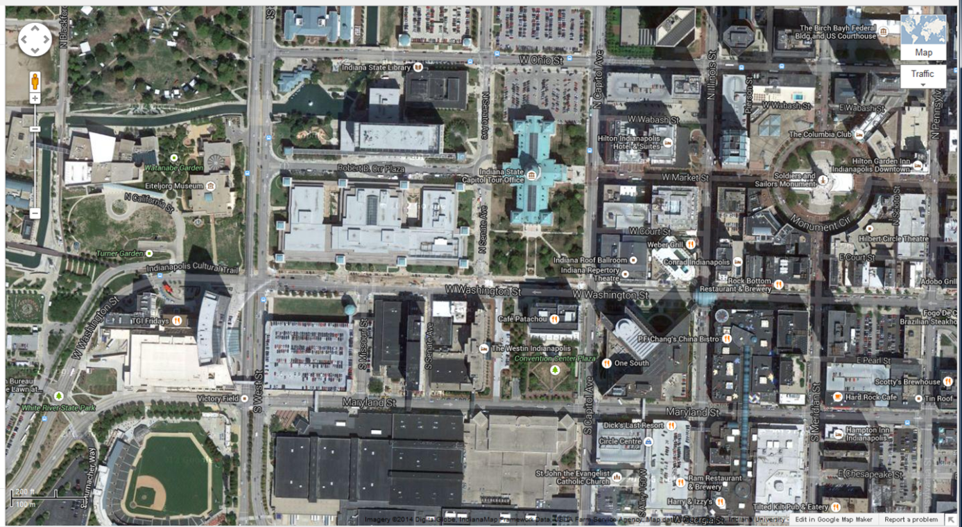
Indiana Department of Veterans Affairs
Indiana Government Center South
302 West Washington Street, Room E120
Indianapolis, IN 46204
www.in.gov/dva
317-232-3190
Toll Free: 800-400-4520

Slide 41
Questions?

