Slide 1
Indiana Department of Veterans Affairs

Slide 2
Indiana Department of Veterans Affairs
STAFF
Director- Dennis Wimer
Operations and Assistant Director- Mike Thompson
General Counsel- Gabrielle Owens
Legislative Director- Mike Aichele
Outreach Director- Joe DeVito
Training and Service – Tim Dyke & Phil Krumm
District Service Officers Tom White, Cameron Lochner, Kevin Hinton, Mark Smith,
Bryan Schmidt
State Service Officer- Mike Hamm
Office Manager - Kelly Cherry Reception and Public Relations : Kirsten Clark
Military Family Relief- Lynn Dickey, Key Ross, & Nicole Van Dyke
Women Veteran Coordinator- Laura McKee

Slide 3
Indiana Department of Veterans Affairs
IDVA & County Veteran Service Officers
Currently there are 88 accredited County Veteran Service Officers (CVSO) and 7 accredited Assistant CVSOs.
The four that are not accredited are training with their District Service Officers and Taking the on line T.R.I.P. course.

Slide 4
Indiana Veteran Benefits
Tuition and Fee Exemption state sponsored schools*
Reduced fee Hunting and Fishing License*
Property Tax Deduction*
Disabled Hoosier Veteran License Plate*
Military Family Relief Fund*
Discounted Golden Hoosier Passport for Veterans with Current registered Disabled Hoosier Veteran plate
Peddlers Vendors and Hawkers License free to wartime veterans (see County Auditor)
* Requires eligibility verification from IDVA

Slide 5
Tuition and Fee Exemption
Eligible beneficiaries:
Purple Heart recipients who entered Military from IN
Child of a Purple Heart recipient, Former POW/ MIA, or Child of a Disabled Wartime Veteran
Veteran initially entered the Armed Forces on or
before June 30, 2011 100% exemption
Veteran initially entered the Armed Forces on or
after July 1, 2011 20% exemption plus the Veteran’s combined rating percentage
Former students of Morton Memorial High School for the Indiana Soldiers and Sailors Home (closed in 2009)

Slide 6
Tuition and Fee Exemption
State supported schools are:
Indiana University
Purdue University
Purdue Global
IUPUI
Indiana State University
Ball State University
University of Southern Indiana
Vincennes University
Ivy Tech (all locations)
Western Governor’s Univ. (INDIANA ONLY)
Note: This state aid program can only be used at state supported colleges and Universities. Private schools will not exempt tuition under this program.
Undergraduate rate only

Slide 7
Tuition and Fee exemption for Child of a Disabled Wartime Veteran
To qualify for Tuition and Fee Exemption, the Veteran Parent must meet the following criteria:
Served on Active Duty during recognized war time dates or received a service or campaign medal for equally hazardous duty.
Have a VA disability rating 0%-100%
Must have designated Indiana as HOR at the
time of entry into the Armed Forces OR has resided in Indiana at least 5 years prior to first applying for this benefit.

Slide 8
Tuition and Fee Exemption for Child of a Disabled Wartime Veteran
Student Requirements:
Be a biological or adopted child of the veteran.
Must have been adopted prior to reaching age 18 AND Student cannot be older than 32 years of age when first applying for and becomes eligible for this benefit per Indiana Code 21-14-4-1.
An applicant must not have reached their 33rd birthday at the time of initial application.
Attend a state sponsored school.
Qualify for in-state tuition rate.
Maintain satisfactory academic progress.
Marital status of the student does not effect benefit.

Slide 9
Tuition and Fee Exemption for Recipient of the Purple Heart Medal
124 semester hours at any state-supported college or university
Undergraduate level cost only
Must have entered active duty from a permanent address in Indiana
IC 21-14-10

Slide 10
New Tuition and Fee Exemption application process
All Applications are submitted through Scholar Track
Students who meet the eligibility criteria will have to create a user profile in Scholar Track and submit and online application with all documents. (i.e. birth certificate, proof of veterans wartime service, and VA disability rating.
Note: parents cannot apply for the student logged into the parent account. Applications can only be completed on the student’s log in.

Slide 11
SCHOLAR TRACK
https://scholartrack.che.in.gov/Login?ReturnUrl=%2f

Slide 12
TUITION & FEE EXEMPTION
Since October of 2017, IDVA no longer accepts any paper applications.
The online application in Scholar Track puts the CVO program on line with all the other Indiana State Aid programs and streamlines the process within the IDVA office.
This eliminates the constant reapplication of students who are already qualified for the benefit. All participating educational institutions can look-up the student information in Scholar Track once they are approved and FAFSA information has been transmitted to their account.

Slide 13
Reduced Fee Hunting and Fishing License for Disabled Veterans
Reduced Fee Hunting & Fishing License
$2.75 per year
$27.50 for 10 years
The Veteran must be a resident of Indiana,
served in the armed forces of the United States, and been awarded a service connected disability, as evidenced by: (A) records of the United States Department of Veterans Affairs; or disability retirement benefits awarded to the individual under laws administered by the USDOD
IC 14-22-12-1.5

Slide 14
Property Tax Deduction
for veteran and surviving spouse
Section 13- $24,960
IC 6-1.1-12
To Qualify
Served on Active duty during a recognized Wartime period
service connected combined rating of at least 10%
Note: There is no assessed property value limit attached to this deduction.

Slide 15
Property Tax Deduction
Section 14 - $14,000*
IC 6-1.1-12
To qualify the veteran must meet one of these two options:
Served honorably in the armed forces least 90 days and has a total disability
Or:
Served in the armed forces for at least 90 days, is over age 62, and has a combined rating of at least 10%.
*The assessed property value limit is $200,000.00 for the 2020 assessment date and all dates thereafter.

Slide 16
Property Tax Deduction
Both Sections (13&14)- $37,440*
IC 6-1.1-12
To qualify the veteran must have served honorably on Active Duty during wartime and be
Totally disabled
OR
Over age 62
Rated at least 10 % service connected disabled.
The assessed property value limit is $175,000.00 for the 2017 assessment date and all dates thereafter.

Slide 17
Property Tax Deduction
If a veteran, or surviving spouse, does not own any real property then the lesser of the following can be applied: The amount owed for vehicle excise tax or $70 can be applied per vehicle. Maximum of 2 vehicles.
Eligibility is the same as if property is owned
IC 6-6-5-5.2
Example 2: Veteran owns this vehicle and excise tax owed is more than $70. Veteran would get a $70 credit and pays the remaining excise.
Situation: Veteran does not own any property and lives in an apartment but is eligible for the property tax deduction.
Example 1: Veteran owns this vehicle and the excise tax owed is under $70. Excise tax is waived.

Slide 18
Property Tax Deduction
NEW from the 2016 Legislative Session
IC 6-1.1-12-14.5
Deduction for disabled Veteran; homestead conveyed without consideration; nonprofit organization
Veteran served at least 90 days
Received Honorable discharge
Awarded at least a 50% disability
Homestead conveyed at no expense to veteran by an organization exempt from income taxation under the federal Internal Revenue Code

Slide 19
Property Tax
Deductions are as follows:
Veteran is totally disabled, deduct 100% of assessed value
Veteran is 90% disabled, deduct 90% of assessed property value
Veteran is 80% disabled, deduct 80% of assessed property value
Veteran is 70% disabled, deduct 70% of assessed property value
Veteran is 60% disabled, deduct 60% of assessed property value
Veteran is 50% disabled, deduct 50% of assessed property value
NOTE: the veteran cannot claim a deduction under sections 13-14 AND Section 14.5
But can claim sections 13 and 14 together if eligible.

Slide 20
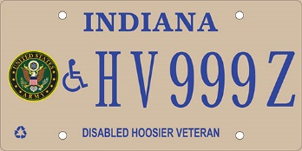
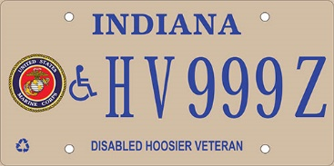
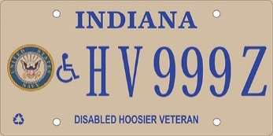
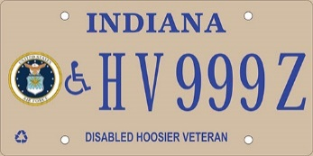
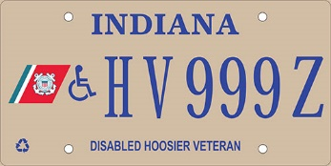
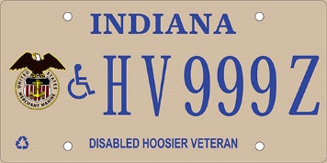
Disabled Hoosier Veteran License Plates /Placard
Serves as a handicapped plate
Allows for parking in legal metered spaces in Indiana at no charge and allows for parking longer than the allotted time normally permitted
No other individual is authorized parking privileges (the eligible veteran must be present when parking privilege is used)
This plate is not authorized for commercial vehicles
IC 9-18.5-5

Slide 21
Disabled Hoosier Veteran License Plates /Placard
Eligibility IC 9-18.5-5
Lost sight in both eyes or suffered permanent impairment of vision in both eyes with S/C compensation
Suffered loss of one or both hands or feet or permanent loss of use of one or both hands or feet
A United States Department of Veterans Affairs (USDVA) disability rating for a physical condition that precludes the individual from walking without pain or difficulty OR been rated by the USDVA as being at least 50% disabled and receiving compensation. At least 60% of the 50% rating must be attributed to a mobility disability
Eligibility for this plate also entitles the veteran for a reduced fee Golden Hoosier Passport for use at State Parks, museums, and DNR facilities

Slide 22
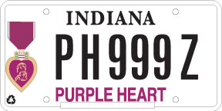
Purple Heart License Plate
Request must be accompanied by DD 214 or orders showing Purple Heart award
The Purple Heart license plate allows free parking in legal metered spaces and for longer than the allotted time permitted
PH plates available for passenger vehicle, truck (less than 11,000 lbs), RV, and motorcycle and are available for 1 OR more vehicles
IC 9-18.5-6

Slide 23
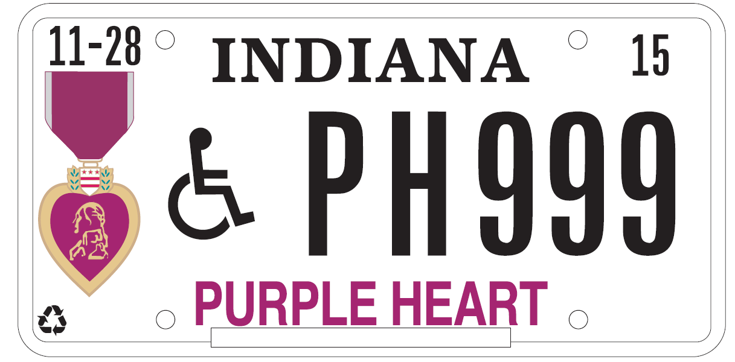
Purple Heart Disabled Veteran Plate
A Purple Heart Plate with the universal handicap symbol is also now available. Use the same form as for the Disabled Hoosier Veteran, POW/ MIA, Purple Heart Recipient Plate.
The applicant must be eligible for either a Disabled Hoosier Veteran plate OR be authorized a handicapped placard in Indiana

Slide 24
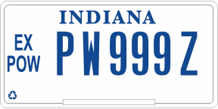
Prisoner of War Veteran Plate
A Prisoner of War Plate is authorized by former Prisoners of War and the bureau may issue 1 or more former prisoner of war plates to the veteran or the surviving spouse of a former prisoner of war.
Parking is authorized in any legal metered space at no charge and for longer than the allotted time

Slide 25
Veteran Plates
The only veteran plates that are authorized metered parking with no fee are the:
Former POW plate
Purple Heart Plate
Purple Heart Handicapped Plate
Disabled Hoosier Veteran Plates
NOTE: To legally park in a handicapped space a universal handicapped emblem must be on the plate or a placard must be displayed in the vehicle.

Slide 26
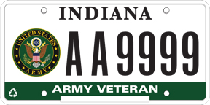
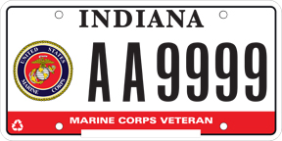
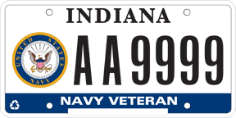
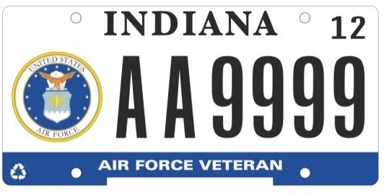
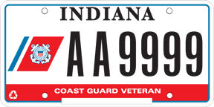
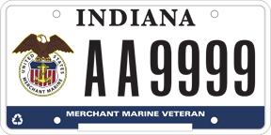
Veteran License Plates
Veterans simply take their DD214 to the licenses branch to purchase these plates. Proceeds go to the
Military Family Relief Fund.
NO

Slide 27
Support our Troops License Plates
These plates are available for purchase to anyone
Additional Fees support the
Military Family Relief Fund.

Slide 28
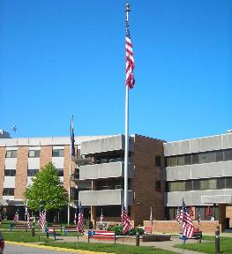
Indiana Veterans Home West Lafayette, Indiana
Eligibility for admission to the Indiana Veterans Home:
An honorably discharged member of the armed forces from
any period of service.
The spouse or surviving spouse of an
honorably discharged member of the
armed forces.
An eligible person who has a disability
or is destitute.
Has been a resident of Indiana for at
least one (1) year immediately
preceding application for admission
to the Home.

Slide 29
Other Indiana Benefits for Veterans
Delayed High School Diploma (WWII, Korea, and Vietnam veterans)
Copies of DD 214’s for Veterans who left active duty in 1989 or later kept at IDVA (Indiana HOR)
Active duty service members and Indiana Veterans who are military retirees are eligible for a $6250 deduction on their state income tax beginning the 2018 tax year.
IC 6-3-2-4

Slide 30
District Service Officers Areas

Slide 31
District Service Officers Purpose/Function
Assist the CVSOs in their district as needed
On site training for new CVSOs
Coordinate 2 district meetings per year to address training needs, disseminate information, and allow CVSOs to interact and share ideas
Coordinate outreach events within the district
Establish good working relationships with county, state, and federal employees and offer updates to state veteran benefits

Slide 32
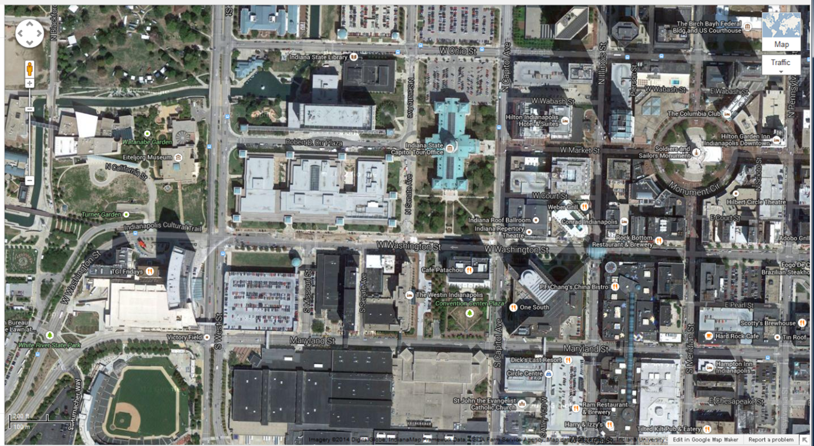
Indiana Department of Veterans Affairs
Indiana Government Center South
302 West Washington Street, Room E120
Indianapolis, IN 46204
www.in.gov/dva
317-232-3190
Toll Free: 800-400-4520

Slide 33
Military Family Relief Fund
Purpose: To assist Veterans/families who are having financial difficulties. Some things the fund can be used for are: utility bills, needed auto repairs, mortgage/rent payments, current medical bills, and groceries to name a few.
Grants may be awarded to Indiana residents who is serving or has served in the Armed Forces of the United States or the National Guard on
active duty during national
conflict or wartime for a
minimum of 12 months.
Additional requirements must also be met but everyone’s
Case is different. Allow the case workers to look into the case
before you assume you do not qualify.

Slide 34
MFRF Application
Please only use the application forms recently downloaded from the IDVA web site. These are updated frequently and using an updated form will result in delays processing the application.
www.in.gov/dva

Slide 35
Questions?

