Slide 2
Indiana Department
OF Veterans Affairs
Outreach division

Slide 3
Indiana Department
OF Veterans Affairs
Outreach division
DIVISON
DIRECTOR
Joe DeVito
WINVets
COORDINATOR
Laura McKee
MEDIA MANAGER
Kirsten Clark
INTERNAL
COMMS MANAGER
Current Intern

Slide 4
Indiana Department
OF Veterans Affairs
Outreach division Project highlights
GVS – Recipient Outreach/marketing/promotion
Local/State/National Media Requests
Veterans Virtual Resource Hub
Legislation Day
Communicate IDVA Benefits to Partners/Collaborate with state and private agencies
Coordinates with Training & Services to/from CVSOs
Create Media Policy for IDVA
IDVA Annual Report – Commission Reports – Website & Social Media Management and expansion
Establish Video creation/editing program

Slide 5
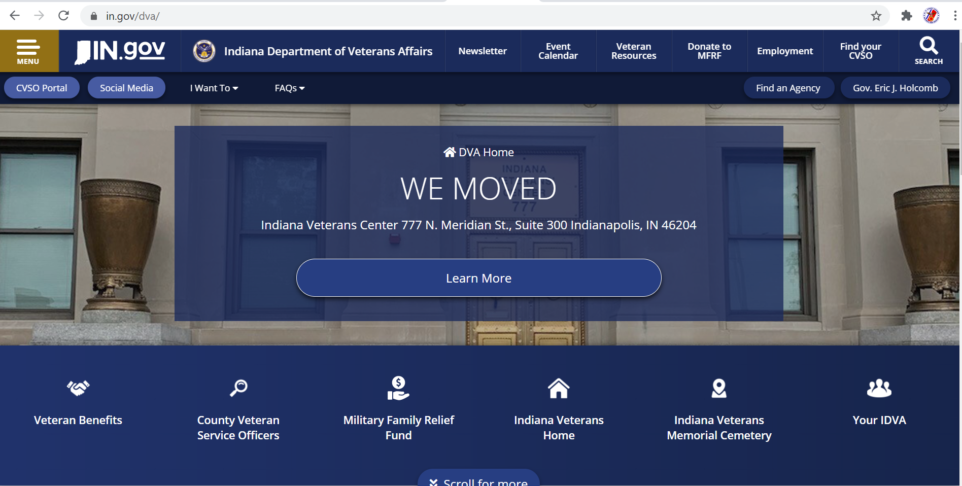
Indiana Department
OF Veterans Affairs
New Home Page

Slide 6
Indiana Department
OF Veterans Affairs
New IDVA PUBLICATIONS

Slide 7
Indiana Department
OF Veterans Affairs
New IDVA PUBLICATIONS

Slide 8
Indiana Department
OF Veterans Affairs
New IDVA PUBLICATIONS

Slide 9
Indiana Department
OF Veterans Affairs
New IDVA PUBLICATIONS

Slide 10
Indiana Department
OF Veterans Affairs
New IDVA PUBLICATIONS

Slide 11
Indiana Department
OF Veterans Affairs
WINVets
WINVets
Annual
Conference
WINVets
District
Teams
Annual Theme – “Wellness”
Featured Theme – Annual
Fully Interactive for Statewide participation
Regional Lead Up Events
Create (6) District Teams
Regular Meetings with WINVet Coordinator
Identify Regional Issues/Topics
Recruitment and Comradery

Slide 12
Indiana Department
OF Veterans Affairs
Partnership Highlight
DVOPs
LVERs
CVSOs
DSOs
County Recorder Discharge Request Process
County Commissioner Board, Continuing the Information Train…
Regular Team Meetings and referral training.
Break Time for Benefits
Employer allows short break
Employee run the VetraSpec Gauntlet
Return to Work with a good start
Continue virtually
DSO and CVSO(s) team up for the size of employee population.

Slide 13
Indiana Department
OF Veterans Affairs
Veteran Service Center Update
Floor One: DAV
American Legion
VFW
INVETS
VA Homeless Voc Rehab
VBA
Floor Two: VA HUD_VASH Clinic
Floor Three: IDVA
DWD (DVOP & LEVR)
Fourth Floor: Auditorium
Accessible rentable* space for veteran organizations and Non-Profits

Slide 14
Indiana Department
OF Veterans Affairs

Slide 15
Indiana Department
OF Veterans Affairs
CVSO Position – New Code
IC 10-17-1-9County service officer, city service officer, and assistants
Sec. 9. (a) A county executive:
(1) shall designate and may:
(A) appoint a county service officer for a four (4) year term; or
(B) employ a county service officer; and
(2) may employ service officer assistants;
to serve the veterans of the county.
(b) The mayor of a city may employ a service officer and may employ service officer assistants to serve the veterans of the city.
(c) If the remuneration and expenses of a county or city service officer are paid from the funds of the county or city employing the service officer, the service officer shall:

Slide 16
Indiana Department
OF Veterans Affairs
CVSO Position – New Code
(1) be:
(A) an honorably discharged veteran who has at least six (6) months of active service in the armed forces of the United States; or
(B) a service officer assistant with not less than two (2) years of experience;
(2) be a resident of Indiana or become a resident of Indiana not more than six (6) months after the service officer's start date; and
(3) serve under the supervision of the director of veterans' affairs.
(d) A service officer assistant must be a resident of Indiana or become a resident of Indiana not later than six (6) months after the service officer assistant's start date and:
(1) satisfy the requirements specified in subsection (c)(1); or
(2) be the spouse, surviving spouse, parent, or child of a person who satisfies the requirements specified in subsection (c)(1).
(e) A rule contrary to subsection (c) or (d) is void.
(f) County and city fiscal bodies may appropriate funds necessary for the purposes described in this section.
[Pre-2003 Recodification Citation: 10-5-1-11.]
As added by P.L.2-2003, SEC.8. Amended by P.L.144-2007, SEC.9; P.L.105-2014, SEC.1; P.L.108-2016, SEC.2; P.L.42-2020, SEC.4

Slide 17
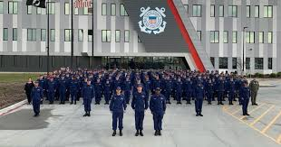
Indiana Department
OF Veterans Affairs
Co. Recorder DD214 Tracking – New Code
Separate Power Point Presentation

Slide 18
Indiana Department
OF Veterans Affairs

Slide 19
Indiana Department OF Veterans Affairs
www.in.gov/dva
(317) 232-3910
(800) 400-4520

Slide 20
Questions?

