Slide 1
Determining Processor Pounds from the Coop Perspective

Slide 2
POWER IN VOLUME
Coops/General Purchasing Organization Provide Benefits
Coop/School: Pricing, Higher quality items for best price
Manufacturers: Large volume in skus
Distributor: Warehouse slots
IDOE: USDA 6 month rule, volume for trucks

Slide 3
BEFORE FORECASTING
Product Selection for 2024-2025 School Year Begins Now
Coop Meetings
Food Shows (Distributor, ISNA, …)
Student Testing
Distributor
IDOE

Slide 4
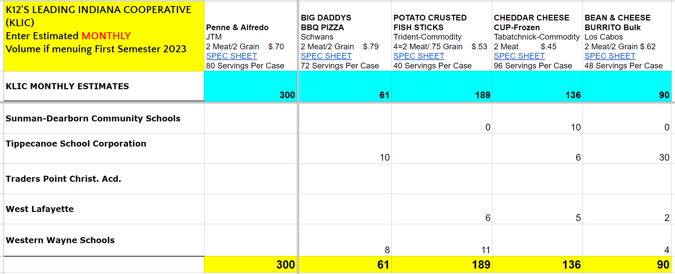
USDA FOODS BID
Collect monthly estimated volumes from members
Give members all information needed
Request historical volume from Distributor

Slide 5
USDA FOODS BID
Release USDA Foods bid by January 1
Allow 3-4 weeks response time
Have Distributor or Manufacturer complete all info needed for IDOE Survey
Be sure to send results to members (before IDOE Survey due date), distributors and manufacturers
Assist members with Survey to assure they are giving commodity pounds & correct USDA commodity code to manufacturers

