Slide 1
2021-2022 VOCA Special Projects RFP Webinar
July 14th, 2021

Slide 2
Thanks for joining us today: Please keep your lines muted during the presentation. Webinar is being recorded. It will be posted on the ICJI website. Questions and Answers at the end. Feel Free to utilize the chat box during the webinar.

Slide 3
Accessing the RFP
Located on ICJI Website
CJI.in.gov → Victim Services → Bottom of the Page: VOCA Special Projects Grant “Learn More”→ Request for Proposal
https://www.in.gov/cji/victim-services/voca/

Slide 4
2021-2022 VOCA Special Projects Grant Application
Application opened: Wednesday, July 7th at 9 AM
Application closes: Wednesday, August 4th at 11:59 PM
Applicants are strongly encouraged to submit applications 48 hours prior to the deadline.
Award Period for VOCA SP: October 1, 2021 to September 30, 2022 (12-month award period)
Projects should begin on October 1, 2021 and must be in operation no later than 60 days after this date. Failure to have the funded project operational within 60 days from October 1, 2021 will result in the cancellation of the grant and the de-obligation of all awarded funds.

Slide 5
Overview:
The purpose of VOCA is to support the provision of services to victims of crime throughout the nation. “Crime Victim” is defined as a person who has suffered physical, sexual, financial, and/or emotional harm as the result of the commission of a crime. Services are defined as those efforts that (1) respond to the emotional, psychological, and/or physical needs of crime victims; (2) assist victims to stabilize their lives after victimization; (3) assist victims to understand and participate in the criminal justice system; and (4) restore a measure of safety and security for the victim.

Slide 6
Areas of Emphasis
As part of the review of the 2021 VOCA Special Projects Applications, we will be prioritizing applications that provide services for the following OVC Areas of Emphasis:
Diverse and frequently marginalized communities
Equity, Civil Rights, Racial Justice, and Equal Opportunity
Underserved communities
Including isolated rural areas and communities affected by persistent poverty or inequality

Slide 7
Funding Eligibility:
Eligible entity types include:
State Agencies
Units of local government
Nonprofit organizations
Faith-based organizations
Other Requirements include:
Registered DUNS number
Active and current registration with SAM.gov
Good standing with the Department of Revenue (DOR), Department of Workforce Development (DWD), and Secretary of State (SOS)

Slide 8
Other Requirements / Trainings
Determination of suitability to interact with participating minors
Every 5 years additional background checks (fingerprinting, etc.) must be run on any grant/match funded employees (including volunteers) that interact with anyone under the age of 18
This is a required condition of any DOJ grant- for more details about the required checks please visit https://www.ojp.gov/funding/explore/interact-minors
Civil Rights Training
The DOJ requires all recipients and subrecipients of federal funds to comply with a variety of Federal civil rights laws. ICJI has a checklist that each subgrantee needs to complete on an annual basis to remain in compliance
CJI Grantee Training and Resources Link-
https://www.in.gov/cji/grantee-training-and-resources/
These requirements along with other trainings can be found at:

Slide 9
Initiating an application in IntelliGrants
https://intelligrants.in.gov

Slide 10
Steps to initiating an application in IntelliGrants (ICJI’s Grant Management system):
Log into your IntelliGrants account
If you do not have an account, then you can obtain one on the home screen of intelligrants (New User?)
On the “MY HOME” page access the “VIEW AVAILABLE PROPOSALS” section
Click on VIEW OPPORTUNITIES
Intelligrants will take you to the My Opportunities page
Access the 2021 VOCA Special Projects Grant Application
Select “Apply Now”

Slide 11
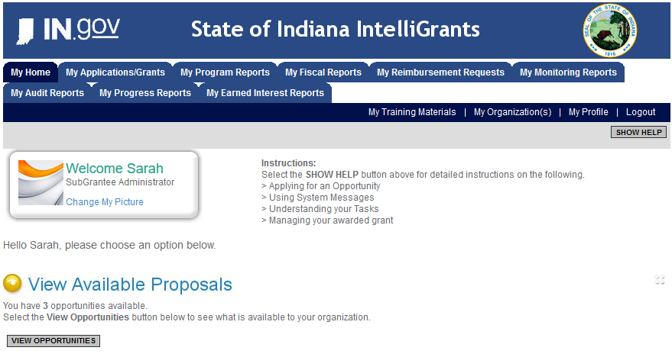

Slide 12
VOCA Special Projects Application

Slide 13
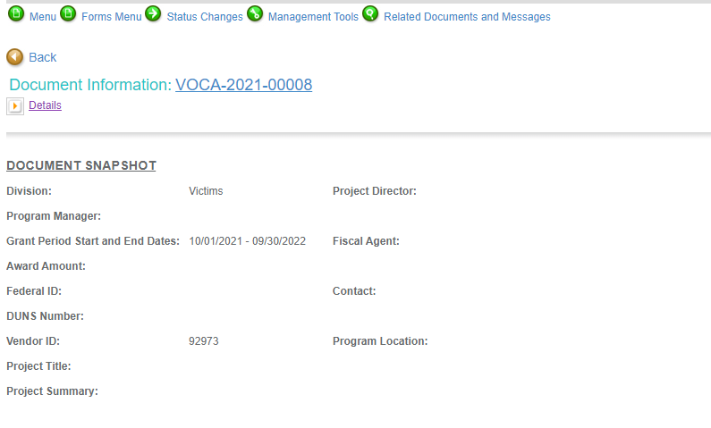
Notes:
To access the different components of the application you will need to navigate to the forms menu.

Slide 14
Forms that need to be completed:
Contact
Project Information
Programmatic Information
Problem Statement & Analysis
Goals, Objectives, & Outcomes
Program Descriptions
Evidence Based/Best Practices
Use of Volunteers
Budget
Budget Narrative
Attachments

Slide 15
Contact
Points of Contact for the grant (CJI will notify these individuals of your award notice)
Project Information
SAMs Registration must be up-to-date
Audit
If you receive more than $750,000 in federal grant funds, you are required to have an audit. This will be requested if CJI is aware that you receive more than $750,000.
Programmatic Information
Information about your proposed VOCA Special Projects grant
Problem Statement & Analysis
All government agency’s audits are included in the County audit and should all have one attached
Forms to be Completed (continued)

Slide 16
Goal, Objective, and Outcomes
The goal should directly address the problem identified in the Problem Statement.
Objectives are the steps needed to achieve goals. Objectives should be concrete, action-oriented, measurable and Specific, Measurable, Achievable, Realistic, Timely (SMART).
Example of Objective: By September 2022, a minimum of 50 culturally and linguistically appropriate support groups for survivors of domestic violence will be provided.
Outcomes measure objectives and are criteria for how the program is deemed to be effective.
Example of Outcome: 85% of participants will indicate that they have learned ways to act in their own best interest.
Program Description
What? Who? Where? Why? When? How?
Evidence Based/Best Practice
Use of Volunteers
Forms to be Completed (continued)

Slide 17
All grants from ICJI Victim Services are reimbursement grants, which means that agency must first incur the expense prior to CJI reimbursing for the expense. Verification of expenses along with verification of payment of expenses must be provided to ICJI on a monthly or quarterly basis prior to reimbursement of expenses by ICJI.
Match Requirement for VOCA is 20%
Important Notes

Slide 18
Eligible Budget Items
All projects must (1) be for one-time nonrecurring costs, and (2) support the expansion or enhancement of delivery of direct service to crime victims. Applicants must be able to demonstrate how these one-time expenditures will support the expansion or enhancement of the delivery of direct services to crime victims. VOCA funds may support only the prorated share of an item that is not used exclusively for victim-related activities. If an expense is not used exclusively for VOCA eligible victim services, you may apply only for the prorated items that serve crime victims

Slide 19
Examples of Eligible Costs
Public awareness campaigns that raise awareness about crime victimization
Education presentations in schools, community centers, and other public forums that are designed to inform crime victims of specific rights and services and provide them with or refer them to services
Emergency Assistance to victims
ADA facility accessibility (ramp, wheelchair lift)
Braille, TTY/TDD Equipment, or other auxiliary aids for deaf and hard of hearing clients
Translation of materials and website for direct service, awareness, outreach, or education
Development of a database for client services
Skills training of service providers, allied professionals, and volunteers to enhance quality of services to crime victims
Project evaluations that determine the effectiveness of victim services and services provided to marginalized communities
Training materials such as books, training manuals and electronic training resources for direct service providers
Website design or redesign (prorated for ineligible activities such as fundraising, lobbying, etc.)

Slide 20
Ineligible Budget Items
Administrative costs over 10% of the total grant budget
(2) Direct financial assistance to a client such as cash, gift cards, or checks
(3) Food and beverages
(4) Lobbying and/or fundraising
(5) Immigration fees
(6) Purchase of real estate,
(7) Construction,
(8) Physical modification to buildings, including minor renovations (such as painting or carpeting),
(9) Vehicles,
(10) Fuel
(11) Overtime is allowed but to claim the increased rate, there must be a separate line item in the budget that includes the overtime rate of pay.

Slide 21
Supplanting
Federal funds must be used to supplement existing funds for program activities and cannot replace or supplant non-federal funds that have been appropriated for the same purpose.

Slide 22
Budget Narrative
Be sure all items in the Budget are included in the Budget Narrative.
Ex: Office Supplies (copy paper, pencils, pens)
Grant reviewers are not required to contact you for clarification.
Any missing information in this section may disqualify that budget item for funding.

Slide 23
Attachments Required:
Total Agency Budget
Found on ICJI’s website (https://www.in.gov/cji/victim-services/resources/) – Nonprofit Applicant Budget Form
Sustainability Plan
Your plan to maintain the program once the grant funds expire
Timeline
Outlining the completion of the project/ or expenditures of the grant funds
Letters of Endorsement
For this program specifically
Miscellaneous
Job Descriptions for any position listed in personnel
If applicable any contracts
Consultation Form – example on the last page of the RFP
EEOP Certification
Legal Services Certification Form – example also included in the RFP

Slide 24
For technical assistance contact the ICJI Helpdesk at CJIHelpDesk@cji.in.gov. Help Desk hours are Monday – Friday, 8:00 am to 4:30 pm ET, except state holidays.
ICJI is not responsible for technical issues with grant submission within 48 hours of grant deadline.
For assistance with any other requirements of this solicitation, please contact The Victim Services Division at ICJI.

Slide 25
Questions?

Slide 26
Thanks for attending!
Presenter:
Max Brown, Victim Services Program Specialist
maxbrown@cji.in.gov
317-232-2927

