Slide 1
Skills Infusion PRogram
Indiana Commission for Higher Education
August 9, 2018
Jennifer Wies,
Professor and Chair, Department of Anthropology
Jim McAtee, M.B.A, C,D.F.
Director for the Career Center

Slide 2



Agenda
Skills Infusion- One approach to closing part of the skills gap
Engage faculty across the curriculum
Connect to a larger talent development strategy (Career Infusion Strategy)

Slide 3
National Association for Colleges and Employers

Slide 4
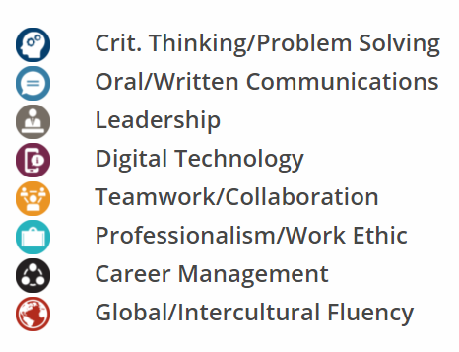
NACE Workplace Competencies
Critical Thinking / Problem Solving
Oral / Written Communication
Leadership
Digital Technology
Teamwork / Collaboration
Professionalism / Work Ethic
http://www.naceweb.org/career-readiness/competencies/career-readiness-defined/
Career Management
Global / Intercultural Fluency

Slide 5
BSU
Skills Infusion
Objectives, Structure,
Process, and Approach

Slide 6
Program Objectives
Students
Explain academic experiences using a common set of workplace competencies
Faculty and Employers/Alumni
Review student learning outcomes and assessment alignment
Integrate NACE competencies with student learning outcomes
Career Center
Establish employer and faculty connections and leverage synergies
Serve as the facilitator between academia and industry

Slide 7
Program Structure
Faculty Fellow Lead
Career Center Jim McAtee
Employer / Alumni

Slide 8
Program Structure
Faculty Fellow Lead
Faculty Fellow Participant
Faculty Fellow Participant
Faculty Fellow Participant
Career Center Jim McAtee
Employer / Alumni

Slide 9
Program Structure
Faculty Fellow Lead
Faculty Fellow Participant
Faculty Fellow Participant
Faculty Fellow Participant
Career Center Jim McAtee
Employer / Alumni
Employer / Alumni
Career Center Representative

Slide 10
Program Structure – The Pod
Faculty Fellow Lead
Faculty Fellow Participant
Faculty Fellow Participant
Faculty Fellow Participant
Career Center – Jim McAtee
Employer / Alumni
Employer / Alumni
Career Center Representative
Employer / Alumni
Career Center Representative
Employer / Alumni
Career Center Representative

Slide 11
Program Process
Step 1: Matching of faculty to employers/alumni
Step 2: Collaborative conversations between faculty member, career center partner, employer, and faculty lead/mentor
Step 3: Focused discernment, integration, and revisions led by faculty member
Step 4: Integration and feedback loop

Slide 12
Theoretical Approach
Support early adopting innovators
  Diffusion of innovation
Strengths-based
Participatory

Slide 13
OUTCOMES

Slide 14
Student Learning Outcome Alignment,
Time 1
Student Learning Outcome
The student will be able to recognize the importance of cultural diversity.
Assignment/Activity
Course readings
Measurement/Assessment
?

Slide 15
Student Learning Outcome Integration and Alignment, Time 2
Student Learning Outcome
Assignment/Activity
“Searching for Symbols” Homework Activity
Graded homework activity
Measurement/
Assessment
NACE Competency
Global/Intercultural Fluency
Students will explain cultures historically or in contemporary contexts with acknowledgement of power structures, demonstrating respectful interaction with varied cultures and worldviews.
Chapter 2: Culture Quiz
Graded quiz

Slide 16
Syllabus Integration
ANTH 101 Student Learning Objectives | Career Readiness Competency Alignment
1. The student will be able to explain culture as a central concept in anthropology including its primary elements such as the centrality of symbols and meaning, norms, values, beliefs, world view. | Critical Thinking/Problem Solving
2. The student will be able to explain how ethnographic fieldwork reflects the social scientific method and science in general. | Teamwork/Collaboration
3. The student will be able to explain ethical and field issues faced by ethnographers. | Critical Thinking/Problem Solving
4. The student will be able to identify and explain the objectives of cultural anthropology and the primary forms of cultural data. | Career Management
5. Students will explain cultures historically or in contemporary contexts with acknowledgement of power structures, demonstrating respectful interaction with varied cultures and worldviews. | Global/Intercultural Fluency
6. The student will be able to recognize the student will be able to relate cultural change to various factors such as population growth, environmental factors and the impact of colonialization. | Global/Intercultural Fluency

Slide 17
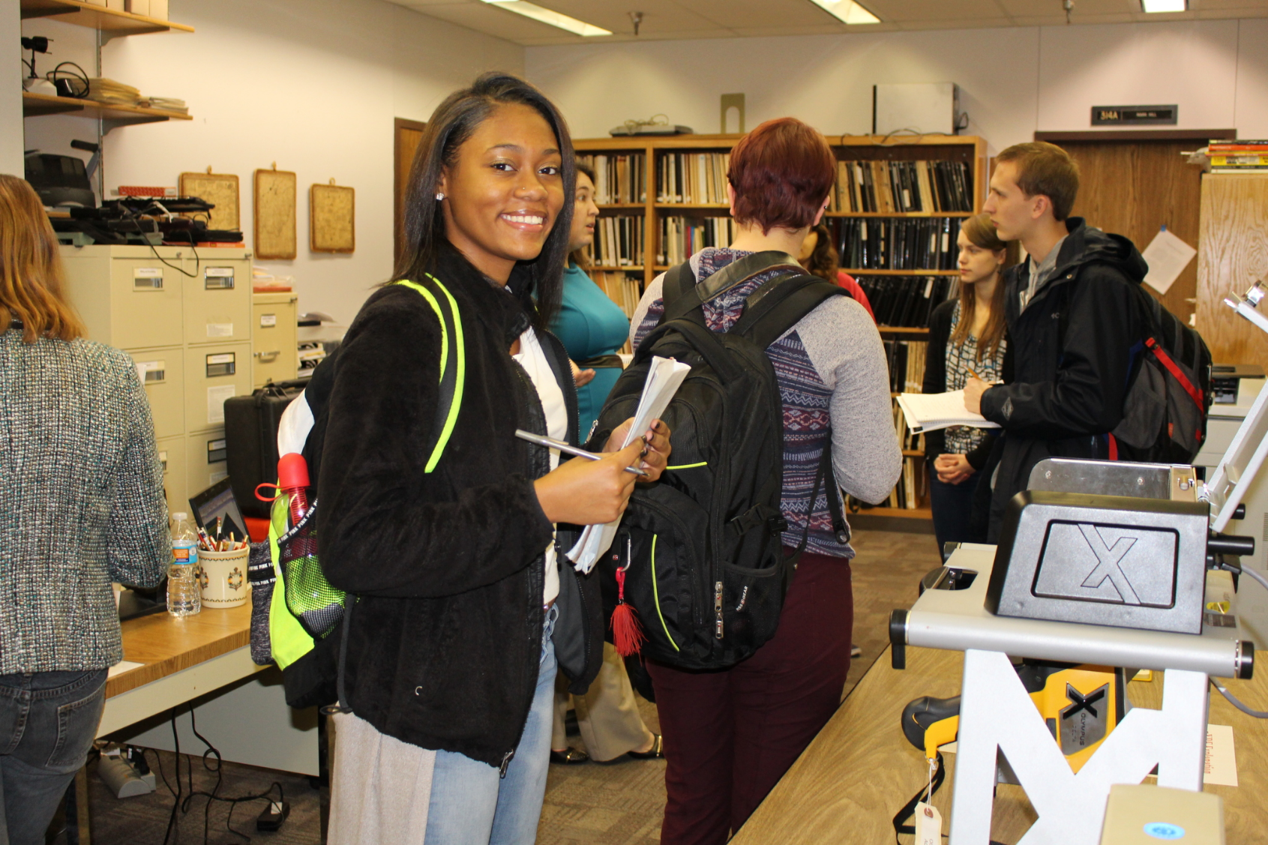
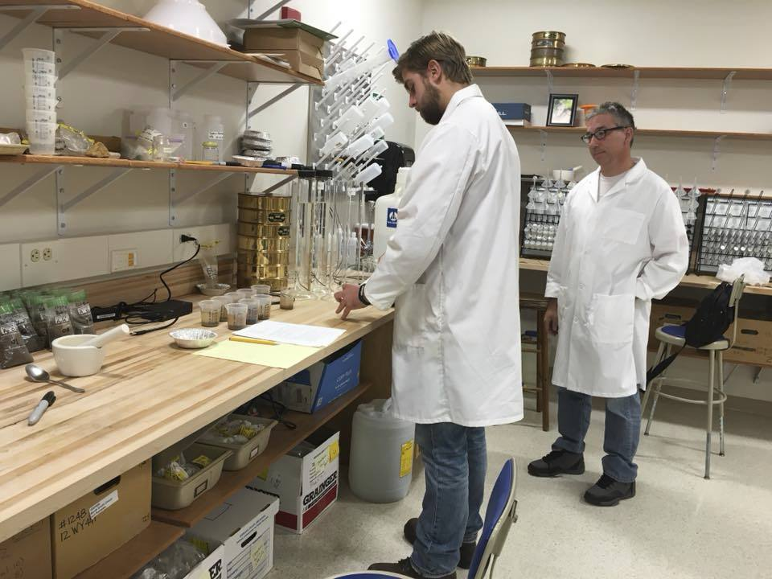
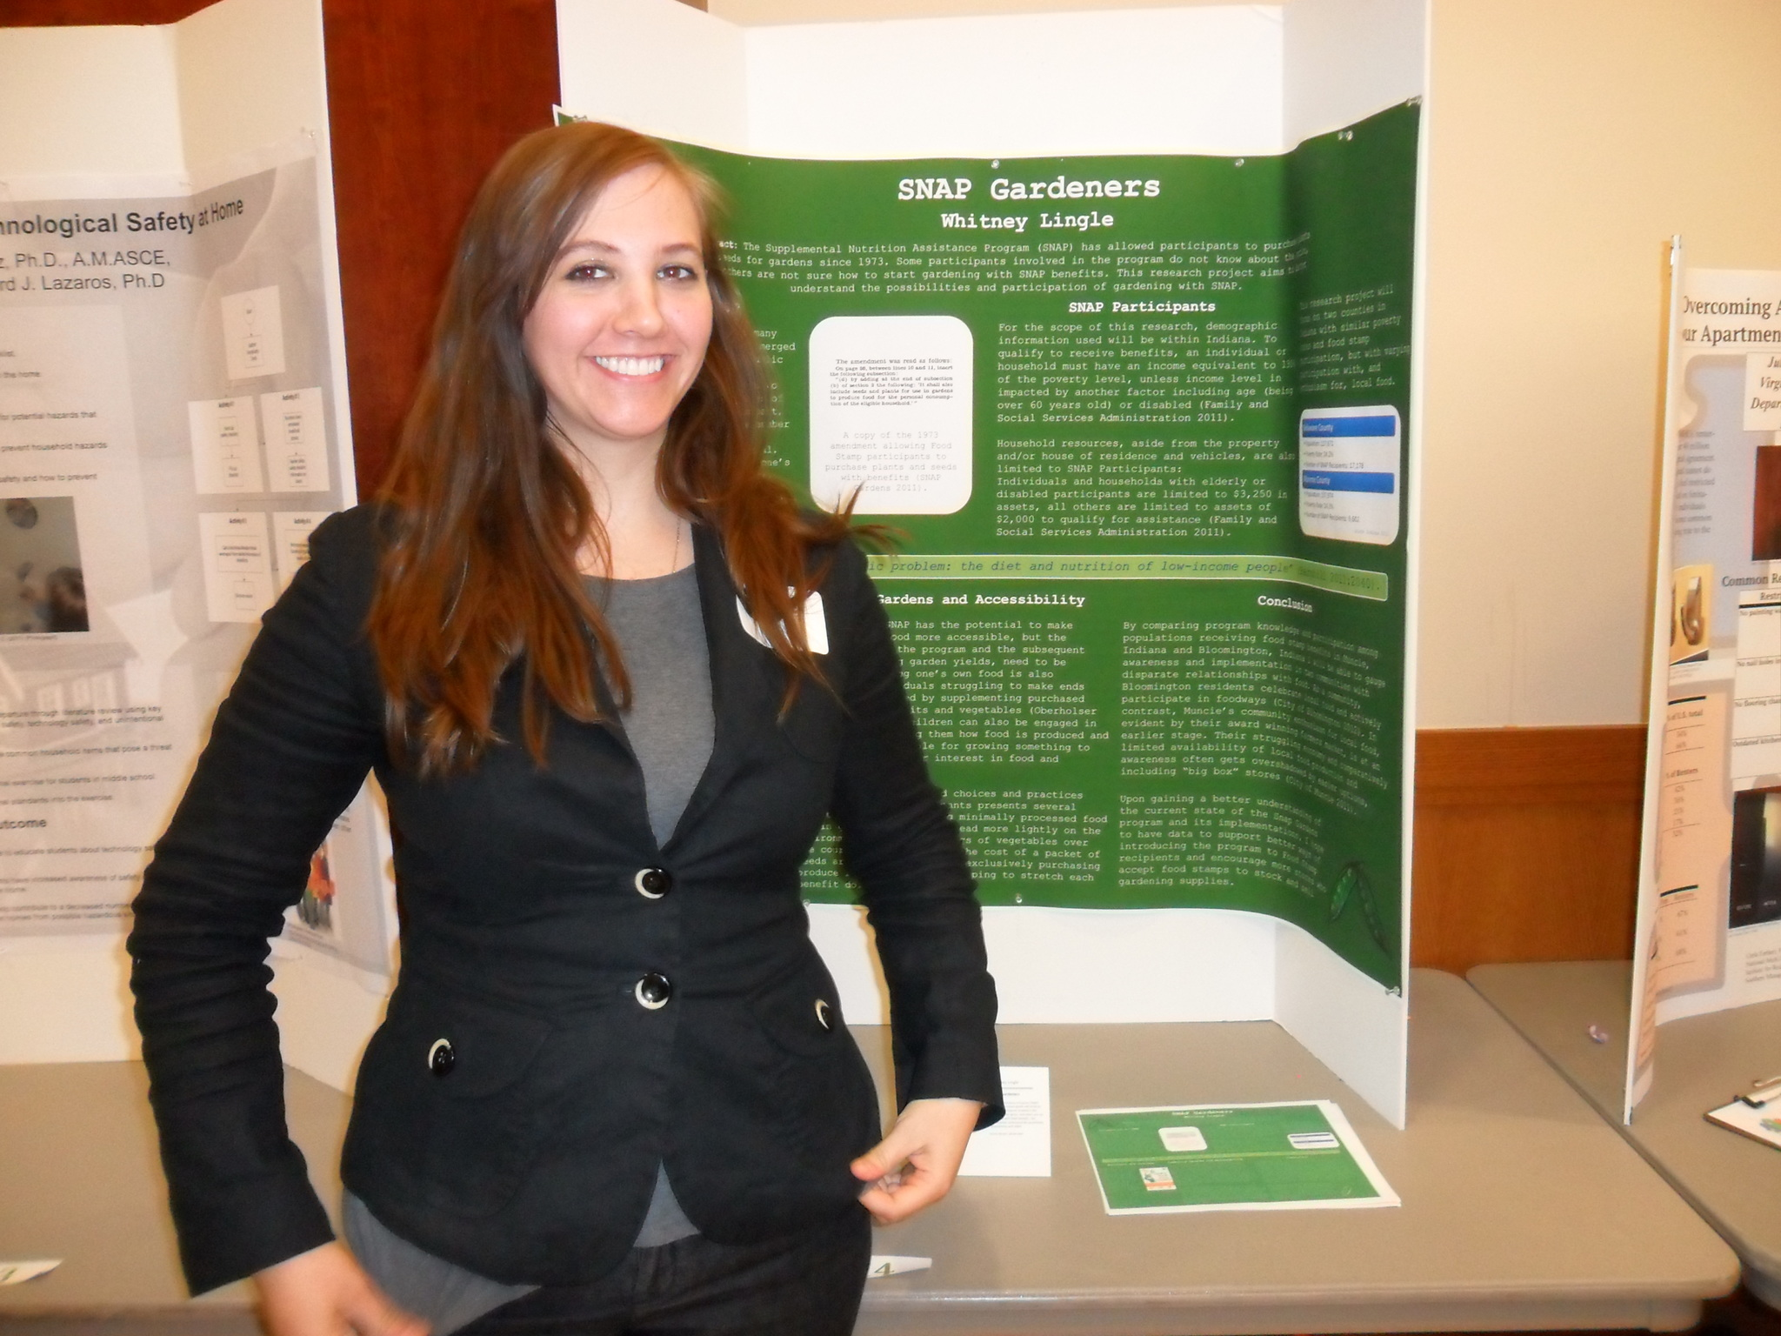
Case Examples

Slide 18
Assuring Student Learning and Success
Plan
Implement
Assess
Analyze
Use
Skills Infusion

Slide 19











Imagine – Across the Curriculum

Slide 20
Connecting to a Larger Workforce Strategy
Career Infusion Strategy Ball State University

Slide 21
Education Advisory Board (EAB)

Slide 22
Career Infusion Strategy
Career Infusion
Skills Infusion
Stars to Steer By
Info Interview
Visiting Practitioner
Immersive Learning
Experiential Learning
Escape Rooms
Faculty Externships
Practice Interview
Intentionally connect all our partners and create common space with a common purpose, to propel Ball State students to successful careers and meaningful lives.
Career Infusion

Slide 23
Discussion
Up Next: Video and Panel

Slide 24


Slide 25
Skills Infusion Program
Helping students articulate their
academic coursework
in concert with
workplace competencies

