Slide 1
Keynote Address
H. Kent Weldon Conference for Higher Education
April 14, 2015

Slide 2
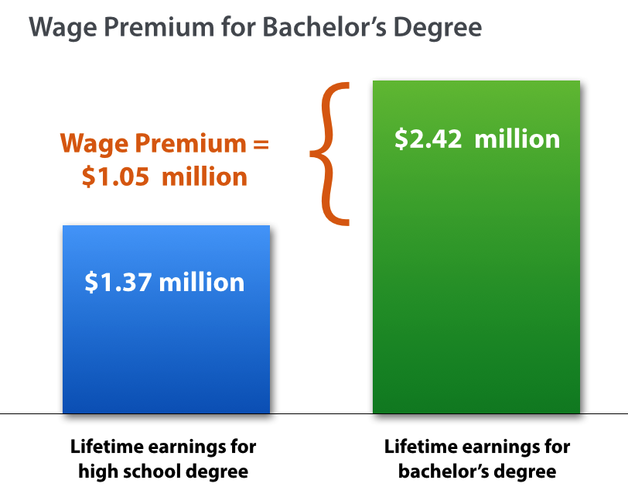

Slide 3
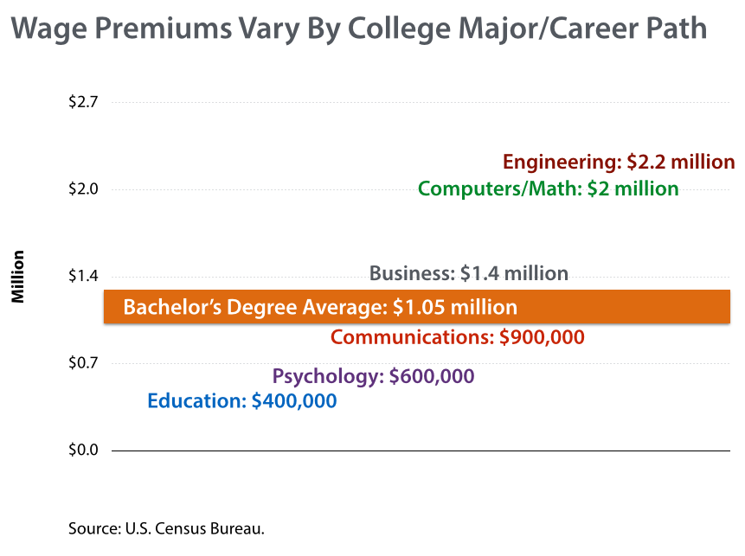

Slide 6
In 2013, 36.2 million
Americans in 25-64 age
group had some college
but no degree.
In Indiana, 761,726
working-age Hoosiers had
some college but no degree.
Source: U.S. Census Bureau.

Slide 7
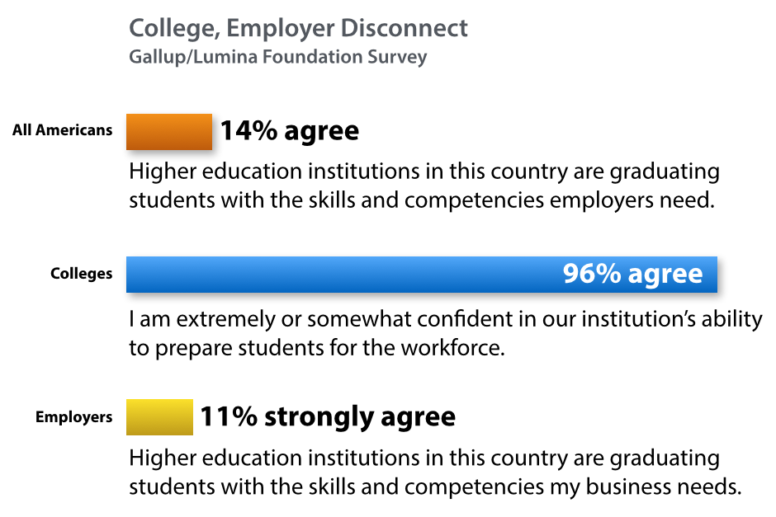

Slide 8
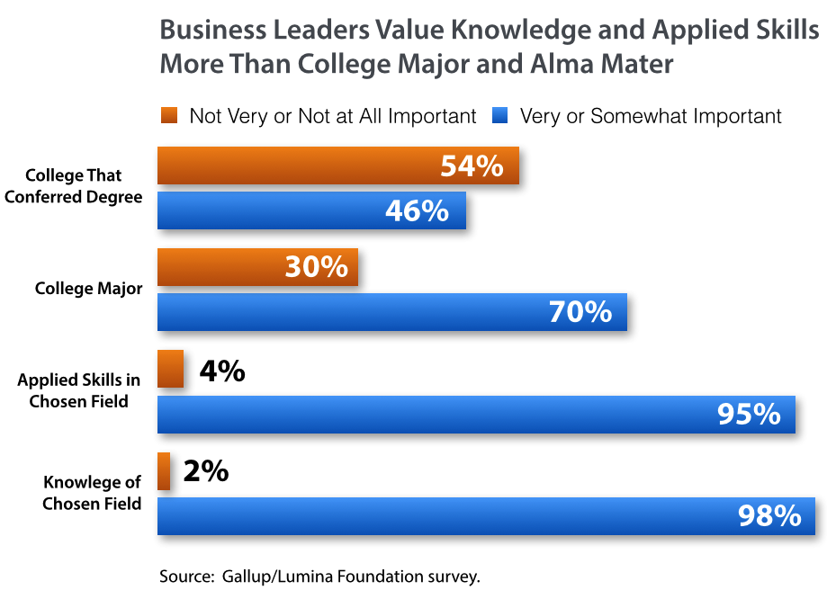

Slide 9
