Slide 3
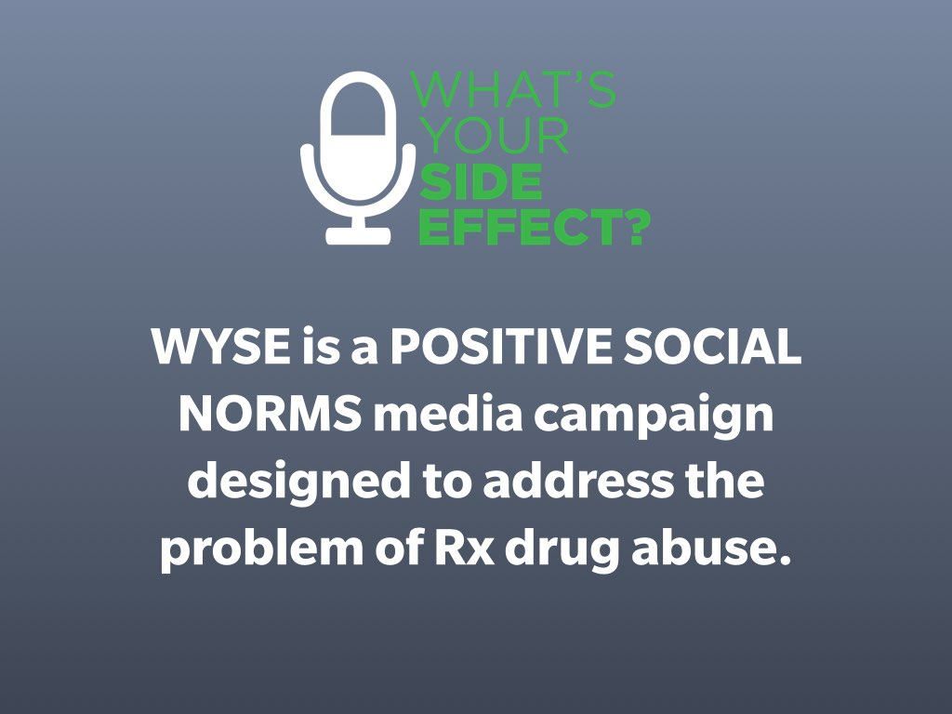

Slide 11
Notes:
http://whatsyoursideeffect.org/stories/

Slide 19
