Slide 1
The Brain Disease of Addiction and Avoiding Iatrogenic Relapse
Jim Ryser, MA, LMHC, LCAC, CADAC II, ICDAC
Program Manager, Pain Services
IU Health Methodist
317.962.0651

Slide 2
Disease – Behavior and Stigma
STD’s
Obesity
Tobacco assisted CV
HIV – coming around
Alcoholism
Iatrogenic Relapse?
Chemical coping vs Chemical Coddling

Slide 3
Lifetime Prevalence of Addiction
12-15% of Americans
30% of children of alcoholics
35% of people with chronic pain on opioids
NIDA; Boscarino JA et al. J Addictive Dis 2011; 30:185-194

Slide 4
But…
N = 48 hospitalized for addiction to OxyContin
77% – prior non-opioid substance use problems
15 (31%) began OxyContin via legitimate rx
Conclusion: Most with addiction to OxyContin had prior substance use disorder.
Potter JS et al., Drug and Alcohol Dependence; 2004

Slide 5
We treat, but do we help?
Aggressive use of opioids and interventional technologies has been brought to bear between 1997 and 2005 (~ 65 % increase in expenditures) without evidence of improvement in self-assessed health status and pain. Many outcomes were worse.
JAMA. 2008; 299(6):656-664

Slide 6
Our Part as Chemical Coddlers
We want to help.
Immediate “help” may exacerbate past problem.
Even conservatively, if there was a 5% chance of a person developing a fatal complication based on adding hydrocodone, would we still prescribe it?
Shift of thought process for pain types – acute, acute on chronic, EOL, CNCP, Palliative, Cancer.

Slide 7
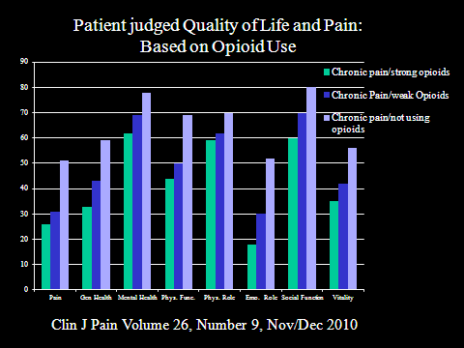
Quality of Life with CNCP

Slide 8
Addiction Assessment
CAGE
INSPECT (Indiana)
PCP
Pain agreement?
Address addiction as an illness – it IS one!
Address addiction and pain disease as multi-factorial – mind, body & spirit
We are team players!

Slide 9
What Happens to the Person Who Is Addicted and Has Acute Pain?
“In the addicted patient, concurrent neurophysiologic changes related to active chemical dependency or pre-existing biogenetically mediated neurophysiologic idiosyncrasies associated with the disease of addiction, also may shape the experience of pain”
“Principles of pain treatment in the addicted patient”
Seddon Savage, M.D., FASAM

Slide 10
What Is Our Role in Treating Acute on Chronic Pain/Active Addiction?
Treat the pain
Watch for observed intoxication and refer
If on chronic opioids, these are considered baseline – use additional short acting for BTP
Opioid Rotation
Know your own reaction
Other clinician challenges

Slide 11
Barriers and Two Cases – Our Reaction
MVA patient arrives in ER and is impaired
Treated with kindness by staff and family
Hospitalized and is visited by friends and family
Returns home with good support
MVA patient arrives in ER and is impaired
Treated disrespectfully by staff, no family
Hospitalized and classified as “frequent flyer”
Returns home with little support

Slide 12
What Gives?
Non-compliant diabetic
Untreated Alcoholic

Slide 13
Iatrogenic Addiction – Typical History
Approximately 2/3 of the addicted pain patients we see had a substance use problem before the pain but were not assessed properly and developed addictive disease over time.
Early life episodes of fractures, wisdom tooth extractions, Caesarian section, MVAs
    Treated with a few days/weeks of Vicodin or Percocet without problems
Age 45 develops low back pain
    A few months of Vicodin /Percocet
    A few years of extended release opioids
    Develops craving, preoccupation, loss of control
Never had euphoria, never abused
Conclusion: It is not necessary to abuse drugs to become addicted

Slide 14
Iatrogenic Relapse
Clinicians worry whether or not they will create addiction
They rarely worry if they will cause relapse
They should
    Many of our patients had prior history of addiction but no proper assessment before opioid trials. In our 5 year sample it was 2/3 of the pain population with concurrent addiction.

Slide 15
Responsible Opioid Prescribing
Insist on objective benefit – Focus on FUNCTION
Informed consent (agreement) – avoid “dropping” a non-compliant patient.
Urine toxicology – YES EVEN THE “LITTLE OLD LADIES!”
Collateral information (family, pharmacy)
INSPECT

Slide 16
Avoiding Iatrogenic Relapse
NEVER drug of choice
Long acting
Scheduled
Avoid IVP and Short acting PO (limited time basis with agreement of team)
Sponsor/recovery community contact
Somebody other than patient responsible for any take home medications
Treatment agreement

Slide 17
Sample Letter for Post Op

Slide 18
Universal Precautions Dr. Gourlay
Diagnosis with reasonable differential.
Detailed psychological assessment including risk of addictive disorders.
Rational non-opioid therapeutic trial, including PT, OT, psychological counseling, pain anesthesia and other referrals.
Pre trial assessment of pain and function.

Slide 19
Universal Precautions Dr. Gourlay
Informed consent (signed)
Treatment agreement (signed)
Careful, time limited trial of opioid therapy if failure in multidisciplinary modalities

Slide 20
Universal Precautions Dr. Gourlay
Reassessment of pain/function and diagnosis (if pain <, function >, continue opioid therapy along with all other modalities - if pain >, function <, rotate medications and/or stop opioids)
Regular assessment of aberrant behavior
Document

Slide 21
Remember…
Every patient is an N = 1.
Opioids are useful.
Opioids can be harmful.
Accountability and multidisciplinary are key.

Slide 22
Like Flying an Airplane
If you don’t know how to land…
DON’T TAKE OFF

Slide 23
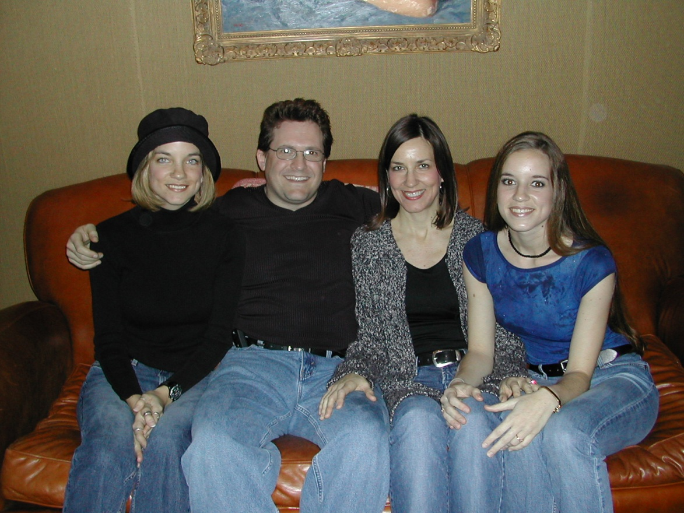
Pain is inevitable, misery is optional…

