Slide 1


Community Outbreak of HIV Infection Linked to Injection Drug Use of Oxymorphone —
Indiana, 2015
Joan M. Duwve, MD, MPH
Chief Medical Officer, Indiana State Department of Health;
Associate Dean for Public Health Practice,
Indiana University Richard M. Fairbanks School of Public Health
jduwve2@isdh.in.gov

Slide 2
Indiana HIV Outbreak Overview
In late 2014: 3 new HIV diagnoses in Austin IN
  DIS learned 2 had a common-needle sharing partner
  Contact tracing → 8 more new infections by January 23
  Only 5 HIV infections had been reported 2004-2013
As of August 31: 181 individuals diagnosed with HIV infection
  All linked to Austin IN
  Infections were recent and from a single strain of HIV
  92% co-infected with Hepatitis C
Source of infection: injection of the prescription opioid, oxymorphone (Opana)

Slide 3
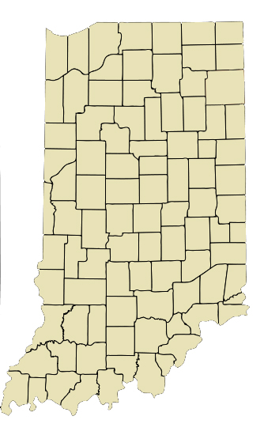
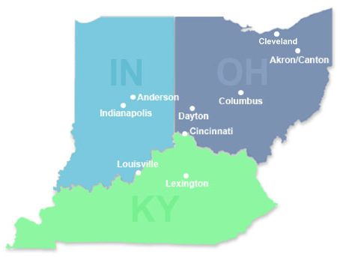
Indiana HIV outbreak: geographic distribution
Scott County pop. 24,000; Austin, IN pop. 4,200
Scott County: Among the state’s 92 counties, ranked 92nd in a variety of health and
social indicators, including life expectancy

Slide 4
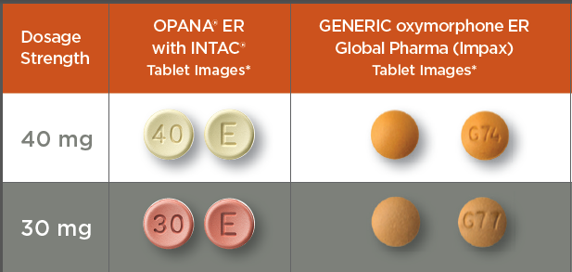
Drug Use among of HIV-infected cases
Primarily Opana (some methamphetamine and heroin)
Multigenerational
Sharing of injection equipment common
Daily injections: 2-20
Number of partners: 1-6 per injection event
Early Release, MMWR Morb Mortal Wkly Report 2015, April 24, 2015

Slide 5
Persons diagnosed with HIV infection: Descriptive Epidemiology (n=181)
Demographics
  Median age 33 years, range 18-60 years
  57% male
  100% non-Hispanic white
High poverty (19.0%) and unemployment (8.9%)
Low educational attainment (21.3% no high school)
High proportion without health insurance

Slide 6
What We Needed to Control the Outbreak
Get all HIV-infected individuals on ARV
Expand HIV/HCV testing and capacity for early detection
  Routine HIV testing at venues with high-risk persons (jails, addiction services, ERs)
  Active outreach testing to at-risk population
Develop systems to keep at-risk individuals uninfected
  Systematic retesting and education of high-risk persons
  SSP and HIV PrEP (Pre Exposure Prophylaxis)
Increase addiction treatment services
  Medication-assisted treatment
  Behavioral Health
  Recovery Support
Notes:
We knew what we needed to do to control the outbreak: treat those with HIV to prevent ongoing transmission, expand testing for HIV and Hep C, Introduce prevention services like Pre exposure prophylaxis and syringe exchange, and increase access to addiction treatment services.

Slide 7
What We Were Able to Do Initially
  HIV testing was offered to all located contacts, but:
    Not enough DIS on the ground
    Stigma surrounding HIV and Addiction
HIV-positive persons referred to Care Coordination, but:
  No HIV treatment provider in community
  Syringe exchange illegal
  No MAT available to treat Substance Use Disorder (SUD)
  Most uninsured (Indiana’s Medicaid Expansion Waiver just approved)
HIV-negative PWID/partners advised re: risk and retesting, but:
  All of the above
  PrEP not available
All person tested for HIV were also tested for HCV, but:
  Primary Care providers not authorized to prescribe Hep C meds under IN Medicaid
Notes:
(Read from Slide)
As you can see, there were barriers to our response every step of the way.

Slide 8
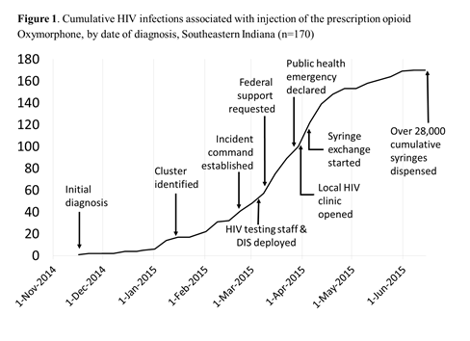
Adult prevalence as of Jun-14-2015
Scott County (14,559): 1.1%
Austin (2,841): 5.9%
Credit: Philip Peters, MD; NCHHSTP/DHAP/Epidemiology Branch; CDC
Notes:
The number of individuals diagnosed with HIV infection increased rapidly as contacts were traced, quickly outpacing our capacity to respond effectively. Federal, state, and local partners were asked to help with the response, and the Governor declared a PH emergency on March 26, permitting a limited Syringe Exchange program in Austin, and providing fiscal and agency resources to respond.

Slide 9
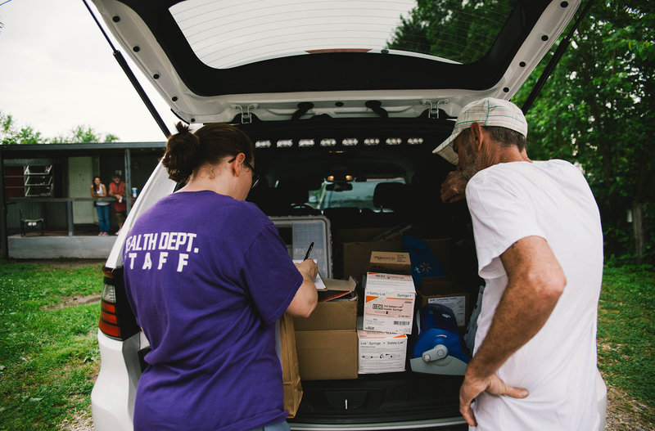
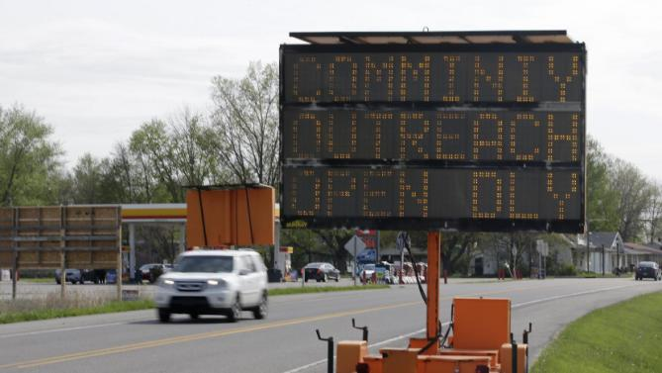
Community Outreach Center with One-Stop Shop
Insurance enrollment
Care coordination
Syringe service program (provided base for mobile unit)
HIV and Hep B/C testing
Immunizations
Notes:
Vital records – birth certificates, and BMV – ID cards. Also job training.

Slide 10

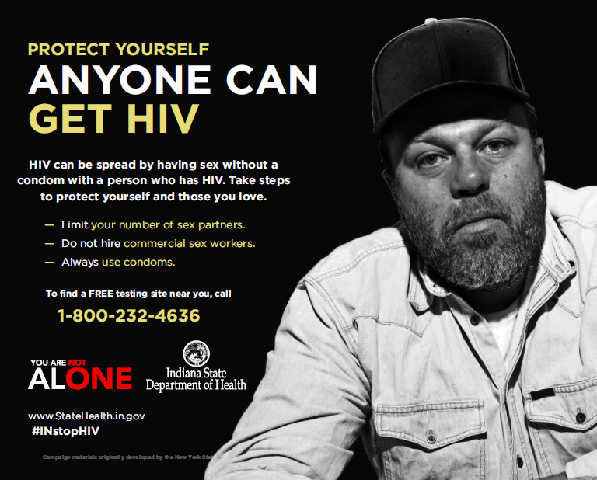
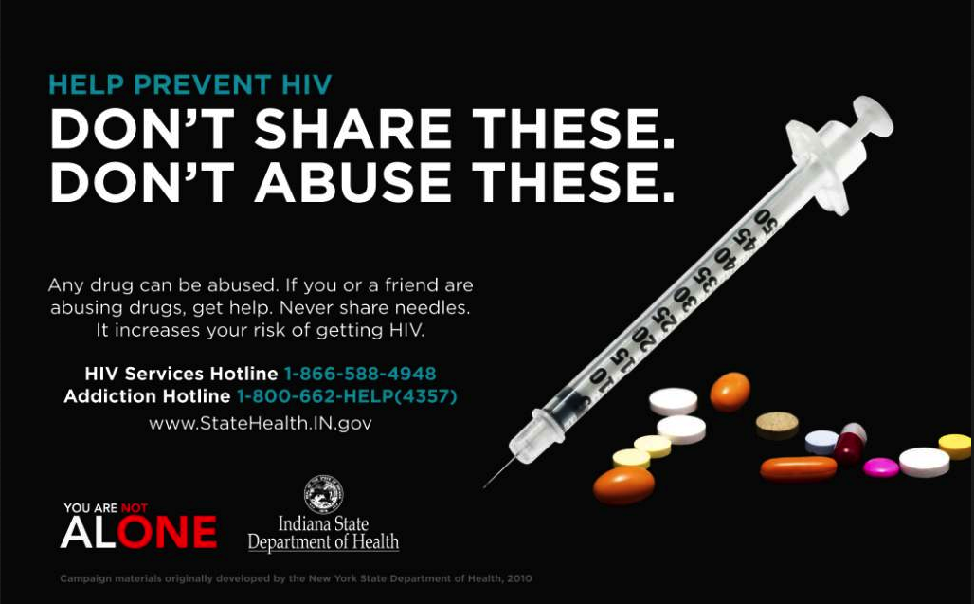
Communications
Notes:
Because of the low HIV awareness in this community, the Indiana State Health Department initiated a media campaign in mid-March called “You Are Not Alone” which included Newspapers, billboards, TV, radio, and social media.

Slide 11
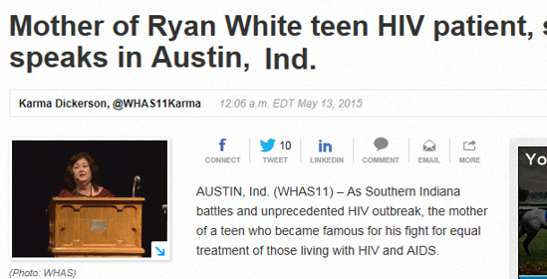
Communications
Notes:
Jeannie White Ginder, the mother of Ryan White, came to Austin HS to help educate the community, dispelling myths about HIV, how it’s spread, and treatment.

Slide 12
Clinic-Based Interventions to Prevent HIV Transmission
Focused attention on local family doc (Dr. Cooke) and the jail
Provided assistance increasing capacity to provide
  HIV testing
  HIV care for infected persons (Treat to Prevent)
  Medication-assisted therapy for opioid addiction
  PrEP
Collaborative effort
  Academic clinical partners
  Local, state and federal U.S. HIV agencies (Local Public Health, DMHA, CDC, HRSA, SAMHSA)
  Private sector (LifeSpring, AHF)

Slide 13
Continuum of HIV care in Austin, Indiana, October 26, 2015
86%
N=176
N=152
N=130
N=106
N=56
Total diagnosed=181 (181 confirmed). Persons were ineligible if deceased (n=1) or outside of the jurisdiction (n=4); estimates are based on the number of eligible persons (n=176); ** Patients engaged in care if have at least one VL or CD4 *** Percent on ARVs increases to 70% and virally suppressed increases to 37% when denominator changed to number engaged in care. Clinical services were initiated 3/31/15. ART data updated through 10/26/15.
Notes:
When this three-part target is achieved, at least 73% of all people living with HIV worldwide will be virally suppressed – a two- to three-fold increase over current rough estimates of viral suppression. Modelling suggests that achieving these targets by 2020 will enable the world to end the AIDS epidemic by 2030, which in turn will generate profound health and economic benefits.

Slide 14
Why Indiana?
Percent Change in Leading Causes of Injury Death*— Indiana, 1999–2009
*Age-adjusted rates
Source: WISQARS
Notes:
In 2012, the injury prevention epidemiologist at the Indiana State Department of Health presented this slide showing over a 500% increase in the rate of unintentional poisoning deaths in Indiana between 1999 and 2009. This unprecedented increase in poisoning deaths mirrored the increase we were witnessing nationally, largely due to the increase in prescription opioid prescribing and misuse.

Slide 15
Drug Poisoning Rates/Year, Indiana vs. US
CDC/WISQARS
Notes:
Rates of drug poisoning deaths in Indiana overtook those of the United States in 2006, and in 2013, Indiana ranked 16th nationally for drug overdose fatalities.

Slide 16
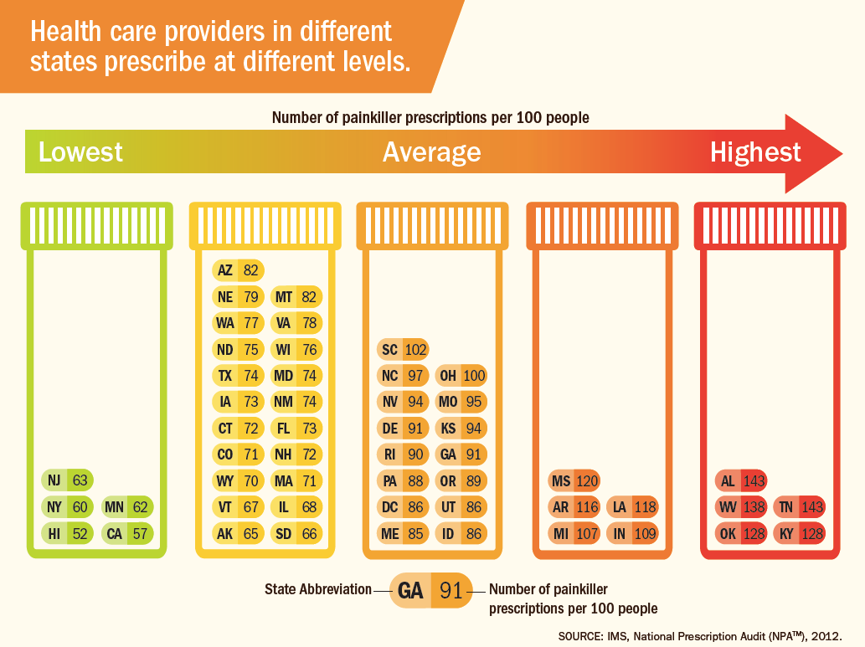
Geographic Variation in Opioid Prescribing in the U.S.
Notes:
In 2012, Indiana prescribers were the 9th highest opioid prescribers in the nation, prescribing 109 painkiller prescriptions for every 100 people in the state.

Slide 17
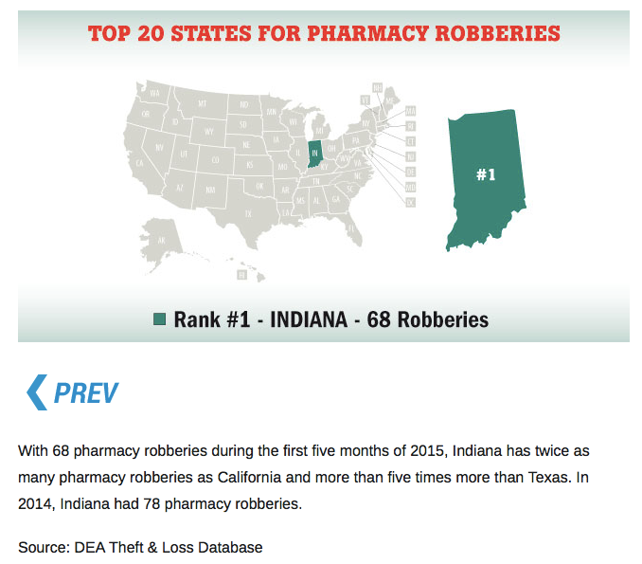
Notes:
In 2015, Indiana again leads the nation in the number of pharmacy robberies, with twice as many robberies during the first half of the year as California, and five times more pharmacy robberies than Texas.

Slide 18

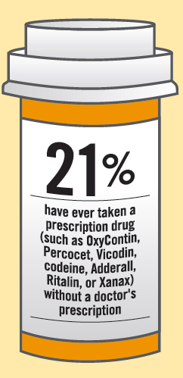
Youth and Controlled Substances
Notes:
The 2011 Indiana Youth Risk Behavior Survey found that 1 out of 5 HS students had ever taken a controlled substance without a prescription from a doctor, a finding that isn’t surprising given the number of pills available, and that most teens believe that prescription drugs are much safer than illegal street drugs.
60-70% say that home medicine cabinets are their source of drugs.

Slide 19
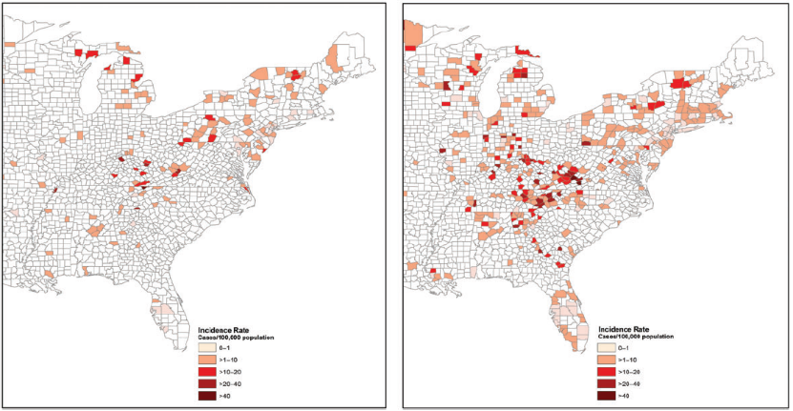
Emerging Epidemic of Hepatitis C Virus Infections Among Young Non-Urban Persons who Inject Drugs in the United States, 2006–2012
2006
2012
Suryaprasad Clin Infect Dis; 2014, 59(10):1411-1419
Notes:
Increasing rates of acute Hepatitis C virus infection among young suburban and rural persons who inject drugs were a foreshadowing of eventual HIV transmission in Indiana and across much of the Midwest and Appalachia

Slide 20
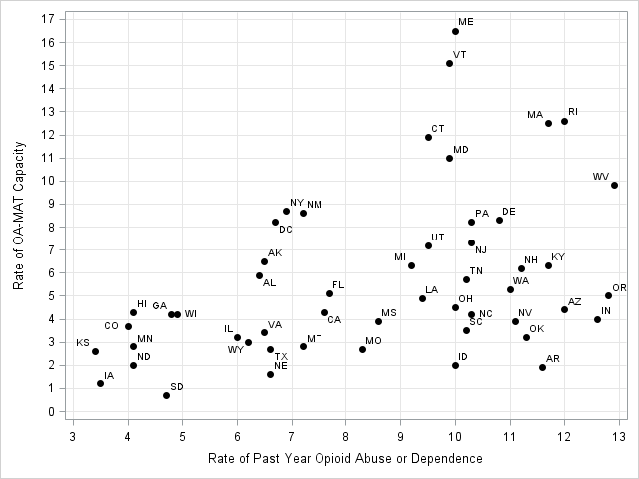
Gaps in Treatment Capacity, 2012
(2012 rates per 1,000 people ≥12 years of age)
Rate of OA-MAT capacity
Rate of past year opioid abuse or dependence
Jones, CM, et. al. National and State Treatment Need and Capacity for Opioid Agonist Medication-Assisted Treatment. AJPH 2015 2015 Aug;105(8):e55-63
Notes:
Like many states, Indiana’s capacity to treat its increasing population of people who inject drugs is inadequate. Indiana ranked among the highest states for rate of past year opioid abuse or dependence with a rate of Medication Assisted Treatment capacity falling far short of its need.

Slide 21
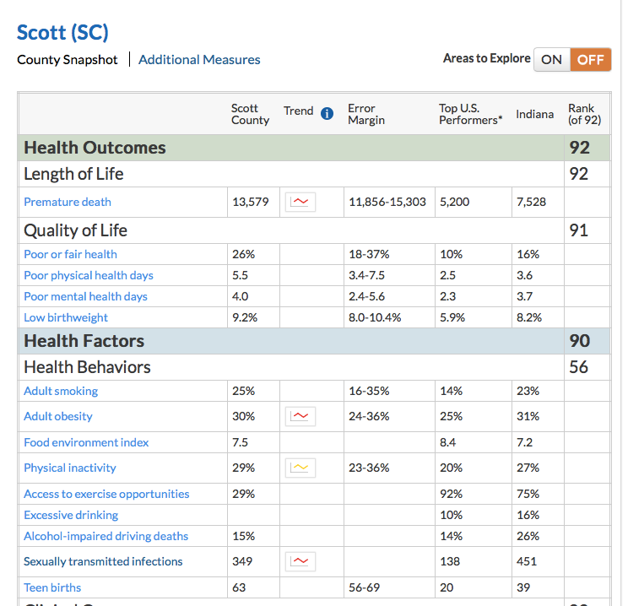
Why Austin?
Notes:
Against that backdrop, Scott County, Indiana has the poorest county health outcomes ranking in a state which consistently ranks in the bottom 10 of all states.

Slide 22
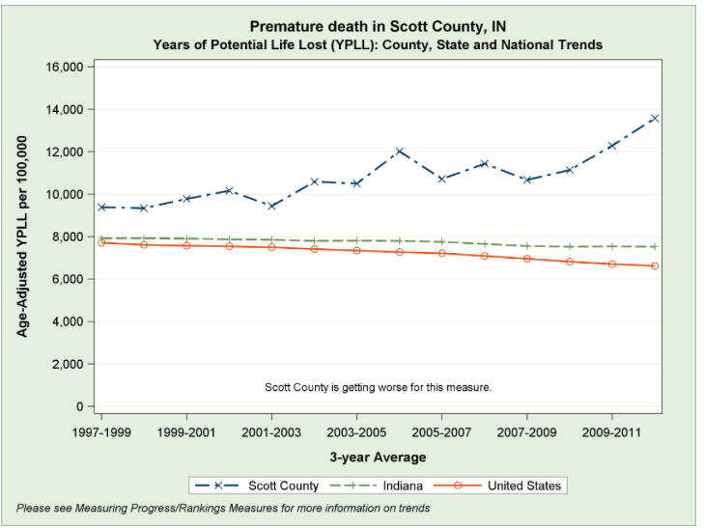
Notes:
Since the early 2000’s, Scott county has had a significant increase in years of potential life lost while Indiana has remained about the same, and the rest of the country has trended downward.

Slide 23
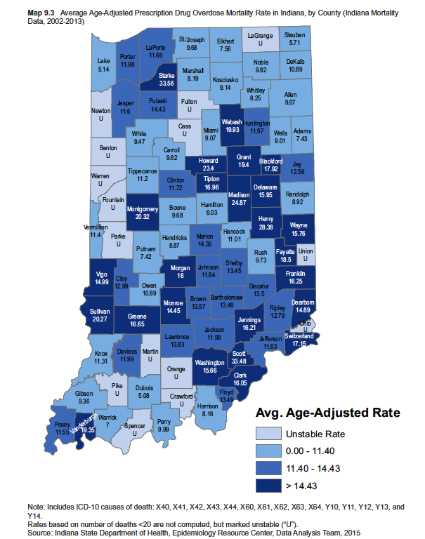
Notes:
This is due in large part to drug overdose deaths. Scott county had the second highest average age adjusted prescription drug overdose mortality rate in the state between 2002 and 2013, more than twice as high as surrounding counties.

Slide 24
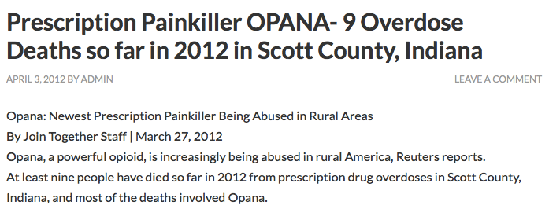
April 3, 2012
Notes:
In 2012, Reuters reported an increase in the use of Opana in rural America, including 9 deaths in Scott County, during the first quarter of that year.

Slide 25
Why Austin? Opana™ ER
2010 - reformulation of Oxycontin
Opana quickly replaced OC - snorted, injected
2012 –of Opana™ ER reformulated, impossible to crush/snort
Short half-life 3-4 hours when injected = multiple injections/day
Cost $160/40 mg tablet = pill sharing
Higher MED than heroin
You know what you’re getting
Notes:
After the 2010 reformulation of Oxycontin made it impossible to crush and snort or inject, Opana quickly filled the void. Highly addictive, Opana is stronger than morphine and heroin, and especially potent when injected. Many snorters became injectors when Opana was reformulated in 2012, and overdoses were common. The short half-life of the dissolved ER pill necessitated multiple injections per day and the High cost of ER tablets lead to pill sharing to avoid withdrawal. All of these factors increased the risk of Hepatitis C and HIV transmission in Scott county.

Slide 26
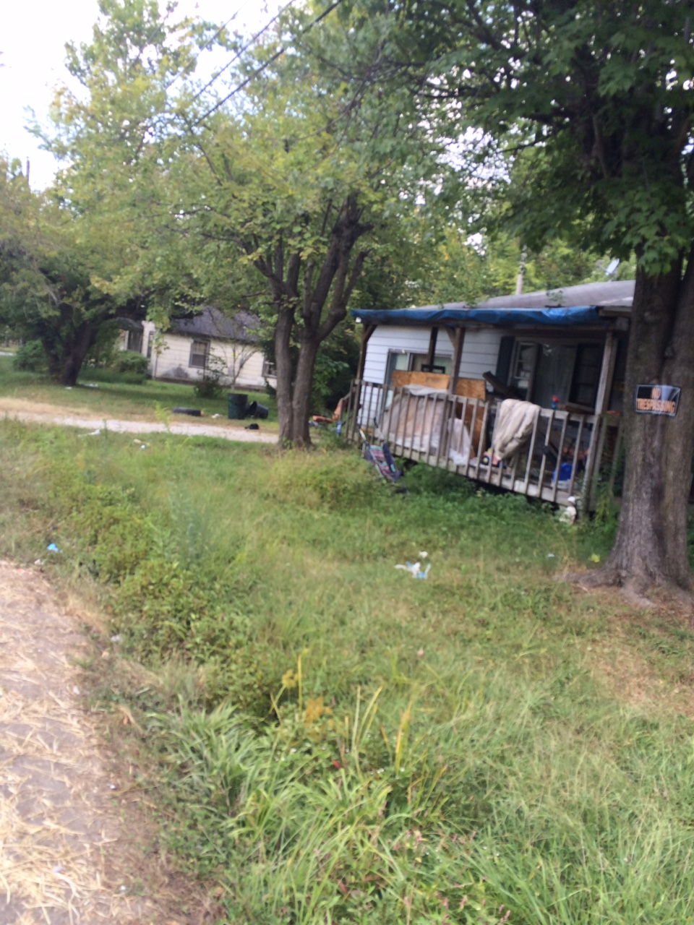
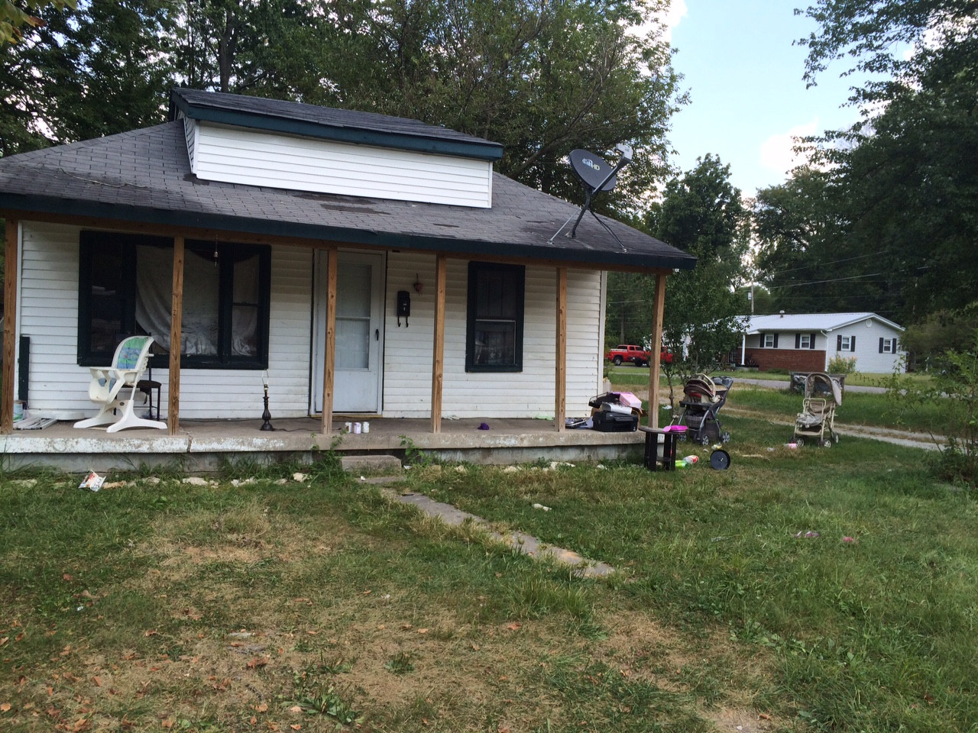
Geomapping of 89 HIV positive individuals identified a hotspot in Austin.
44% live within a ½ mile square area where 27% of Austin’s population resides.
The estimated infection rate within this hotspot is 34 cases/1,000 people.
Notes:
Geomapping of 89 HIV positive individuals identified a hotspot in Austin, where
44% live within a ½ mile square area where 27% of Austin’s population resides.
The estimated infection rate within this hotspot is 34 cases/1,000 people. If all other counts remain stable, PWID will account for 26% of the new HIV diagnoses in Indiana in 2015, compared with < 2% of new HIV diagnoses in 2014.

Slide 27
Moving Forward
Long-term solutions to improve public health infrastructure and socioeconomic disparities
Appropriate HIV and substance abuse prevention education beginning in elementary school
Decrease the STIGMA of addiction and HIV
Notes:
Moving forward, we must focus on prevention efforts, including long-term solutions to improve public health infrastructure and socio-economic and health disparities, age appropriate HIV and substance abuse prevention education, and reframing the way we think and talk about addiction and HIV in order to reach individuals who have historically been marginalized.

Slide 28
Moving Forward
IncreaseD testing, especially in high risk communities- field testing, ERs, jails, provider offices, health departments
Streamline reporting of HIV and HCV cases
Options to assist rural docs with treatment (ECHO)
Increased access to addiction treatment services, including Medication Assisted Treatment (MAT), and PrEP
Notes:
We have to take our HIV and Hep C testing efforts into communities affected by substance abuse, including testing in the field, and in Emergency Departments, jails, and addiction treatment programs. Reporting individuals with newly diagnosed HIV and Hep C must be streamlined to prevent delays in case investigation and contact tracing, and to keep local health departments informed.
We have to think creatively about options to increase the capacity of rural primary care providers to treat individuals with HIV, Hepatitis C, and Substance Use Disorder. The ECHO project created at the University of New Mexico exemplifies the kind of “force multiplication” effort needed to serve these traditionally medically underserved populations.
We must destigmatize MAT and increase opportunities for individuals with substance use disorder to access effective treatment.

Slide 29
Moving Forward
Continued focus on evidence-based opioid prescribing (and decrease in over-prescribing)
Continue increasing access to naloxone (first responders and lay savers)
Improve access to local data (including PDMP, EMS registry, coroner’s reports) so increases are easily identified
Increase our understanding of drug injection practices to provide better education to PWID
Notes:
We must continue to focus on evidence-based opioid prescribing. The Indiana State Prescription Drug Abuse Prevention Task Force has had multiple legislative and educational initiatives, many of them focused on prescribers. In 2013, the Indiana Medical Licensing Board passed rules for physicians prescribing opioids for chronic, non-terminal pain management. We have seen a 10% decrease in prescribing overall over the past year.
This hasn’t translated to a decrease in overdose fatalities. All first responders were permitted to administer naloxone in 2014, and this past legislative session, the legislature allowed distribution of naloxone by lay entities under a physician’s standing order.
Indiana has multiple registry databases housed in different state agencies. There is no centralized access to coroner reports. Accessing and using data for public health prevention remains a challenge which we hope to surmount.
Finally, legislating a pathway to syringe exchange for at risk counties was a tremendous leap forward, but not a perfect solution. We need to better understand risk, but also ensure complimentary services for infectious disease prevention and treatment, and an array of treatment options for substance use disorder are available when our prevention efforts have fallen short.

Slide 30
Acknowledgements
Scott County Health Department
Clark County Health Department
Disease Intervention Specialists (EMAC states)
Foundations Family Medicine
Indiana University, Division of Infectious Diseases
University of Louisville, Division of Infectious Diseases
CDC
  Division of STD Prevention
  Division of HIV/AIDS Prevention (DHAP)
  Division of Viral Hepatitis (DVH)
  Epidemic Intelligence Service (EIS) Program Office
Indiana Department of Mental Health and Addiction (DMHA)
Indiana State Department of Health (ISDH)

Slide 31

Austin Update
Will Cooke, MD
October, 2015

Slide 32
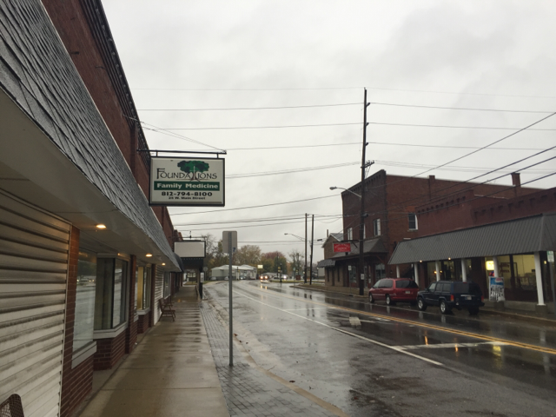

Slide 33
What we've done…
No medical provider in Austin prior to opening practice.
Opened solo practice in 2004.
Worked with ISDH to get Scott and Washington Counties HRSA designated as underserved.
Converted to RHC in 2006.
Seen many services come and go.

Slide 34
What we've done…
My staff has remained open and nonjudgemental.
We understand the local subculture.
We were serving the poor, underserved, and hurting people of Austin long before the lights and cameras came.
We've EARNED the trust of our community.

Slide 35
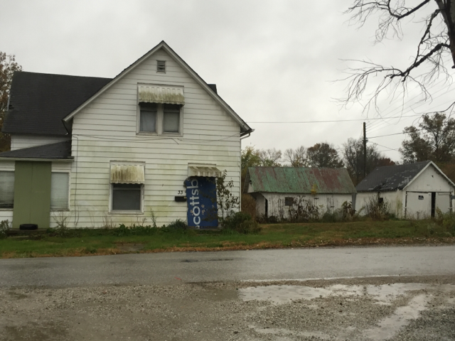

Slide 36
What we've done…
When the HIV outbreak hit, we knew what needed to happen.
Met with ISDH early on and described what we needed from the state:
  Local response, integrated with trusted local services
  Patient centered–we need to listen to the needs of those we are trying to help. We cannot help by making isolated decisions on what people need without engaging them.
  Sustainable– access to insurance and not dependent on emergency funding.
  The concept of a "One-Stop-Shop"

Slide 37
What we've done…
Many diverse groups came together to develop a comprehensive, local response.
  ISDH
  AIDS Healthcare Foundation
  IU Health
  Lifespring
  Centerstone
  SAMHSA
  Scott Co Health Department
  Attorney General's office
  MATEC
  American Academy of Addiction Medicine
City of Austin
Mental Health America Indiana
Hope 2 Others Ministry
Oasis of Hope
Southern Indiana Treatment Center
The ECHO Project
  DMHA
Many others

Slide 38
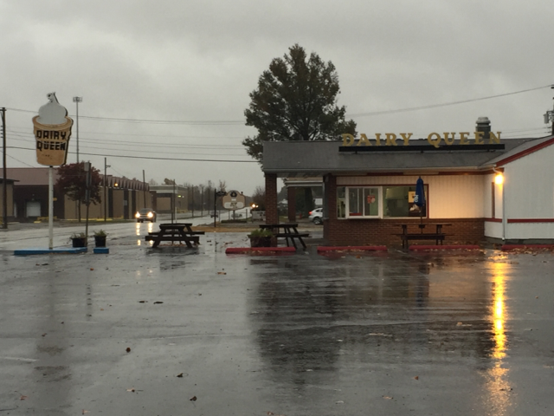

Slide 39
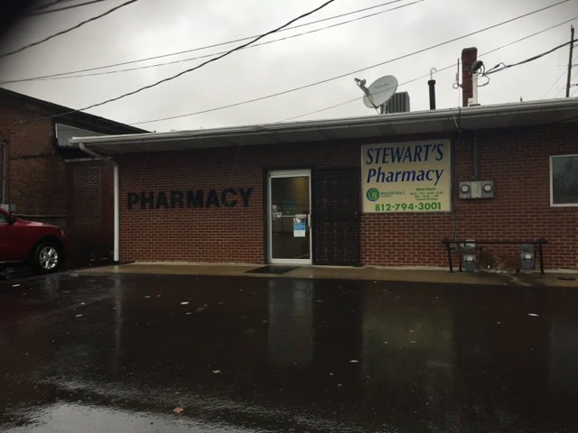

Slide 40
What we are doing…
Primary care based and integrated HIV/HCV care
  MATEC clinical scholar program
  The ECHO Project
  Mobile outreach, testing, and linkage to care
On site behavioral health integrated into our practice
SBIRT
On site PEER Recovery Couch group sessions for addiction
Full spectrum primary care including enhanced specialized services in several areas including Woman's health, obstetrics, endocrinology, and HIV/HCV care

Slide 41
What we are doing…
Partnership with AIDS Healthcare Foundation
  Mobile clinic
  Food assistance in the community and local ministries
  Expanded staffing to better engage patients
  Staff training
  Commitment to using and supporting local resources
  Support for my training and consulting needs
  Establishment of a medication access point

Slide 42
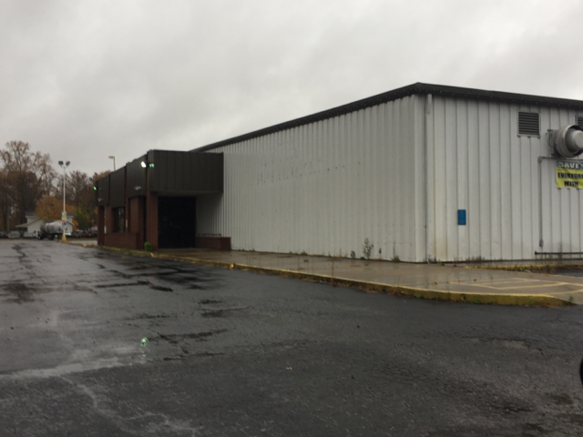

Slide 43
What we are doing next…
Access to care:
  Better care coordination
  More insurance navigation
  Medication access point
More addiction services
  Partnerships: Scott County coalition, DMHA, SAMHSA
  Enhanced access and training for Narcan
  More access to mental health services and MAT
  Stigma reduction
  Greater integration of prevention and treatment

Slide 44
What we are doing next…
Address the underlying root cause issues
  Childhood trauma
  Access to support services vs criminalization
  Generational poverty
  More access to education and job training
  More free time options and community support
  Better housing including transitional housing and shelters

Slide 45
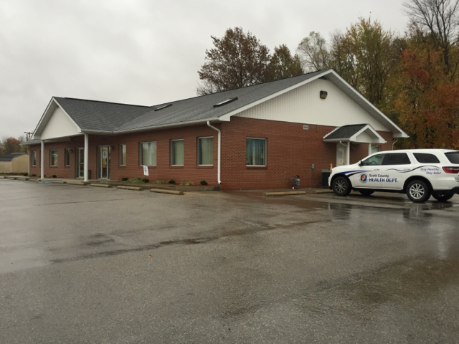

Slide 46
What we are doing next…
Can seem overwhelming. I've had journalists start crying while talking about the level of generational pain and hopelessness witnessed in the lives of our patients.
There is always hope.
  Former sex worker with AIDS. Nearing being virally suppressed with a significant rebound of her CD4 count. She has gone through rehab and is now being connected with resources. She has hope now. You can see it in her eyes. But we need more to offer her.
  Young man virally suppressed and healthy. Using a lot less, mostly suboxone he can buy on the street. He is holding down a job now. And feels hopeful for the first time in a very long time. He needs support and access to addiction services to achieve full, sustained recovery.

Slide 47
What we are doing next…
Austin high school
  Has gone from a less than 70% graduation rate to a 90% graduation rate.
  Has enhanced educational opportunities with access to career ready training and college credit.
We are making a difference. Over a decade of work, we have become our patients’ medical home. We are in many ways the only family some have. We are a safe place that accepts them wherever they are in life. We are a place of hope.

Slide 48
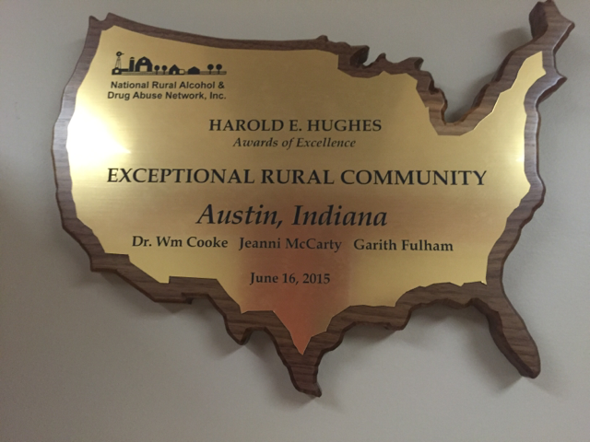

Slide 49
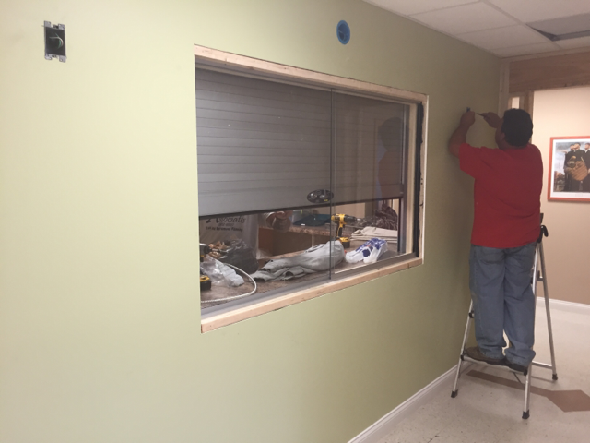

Slide 50
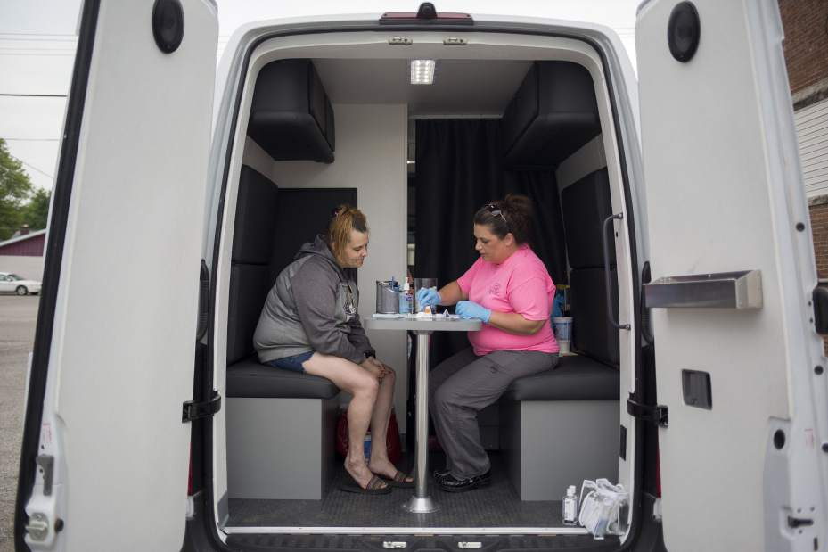

Slide 51
What we are doing next…
Yes, we have been knocked down many times over the years. But, we keep moving forward. 2015 has been the hardest blow yet and my office was truly shaken. But, we are still here and have much more to do.
We obviously need help and are willing to work with anyone willing to work with us.
Listen to the mustn'ts, child. Listen to the don'ts. Listen to the shouldn'ts, the impossibles, the won'ts. Listen to the never haves, then listen close to me... Anything can happen, child. Anything can be. –Shel Silverstein.

Slide 52


Slide 53
Lessons Learned and Novel Investigation Techniques in Response to a Large Community Outbreak of HIV-1 infection
Philip J. Peters MD
HIV Testing and Biomedical Interventions Activity Leader,
HIV Epidemiology Branch
Division of HIV/AIDS Prevention
Disclosures: I have no actual or potential conflict of interest in relation to this presentation
The findings and conclusions in this report are those of the authors and do not necessarily represent the official position of the Centers for Disease Control and Prevention.
National Center for HIV/AIDS, Viral Hepatitis, STD, and TB Prevention
Division of HIV/AIDS Prevention

Slide 54
Lessons Learned
Disease Investigation Specialists and Public Health Nurses are Critical to Public Health Prevention and Responses
Hepatitis C Virus Infections indicate Unsafe Injection Drug Use and Vulnerability to HIV Infection in a Community
Emergency Responses are Challenging

Slide 55
Lessons Learned
Disease Investigation Specialists and Public Health Nurses are Critical to Public Health Prevention and Responses
Hepatitis C Virus Infections indicate Unsafe Injection Drug Use and Vulnerability to HIV Infection in a Community
Emergency Responses are Challenging
… Preparedness is also Difficult

Slide 56
Disease Investigation Specialists –
Contact Tracing

Slide 57
Disease Investigation Specialists –
Contact Tracing

Slide 58
Disease Investigation Specialists –
Contact Tracing

Slide 59
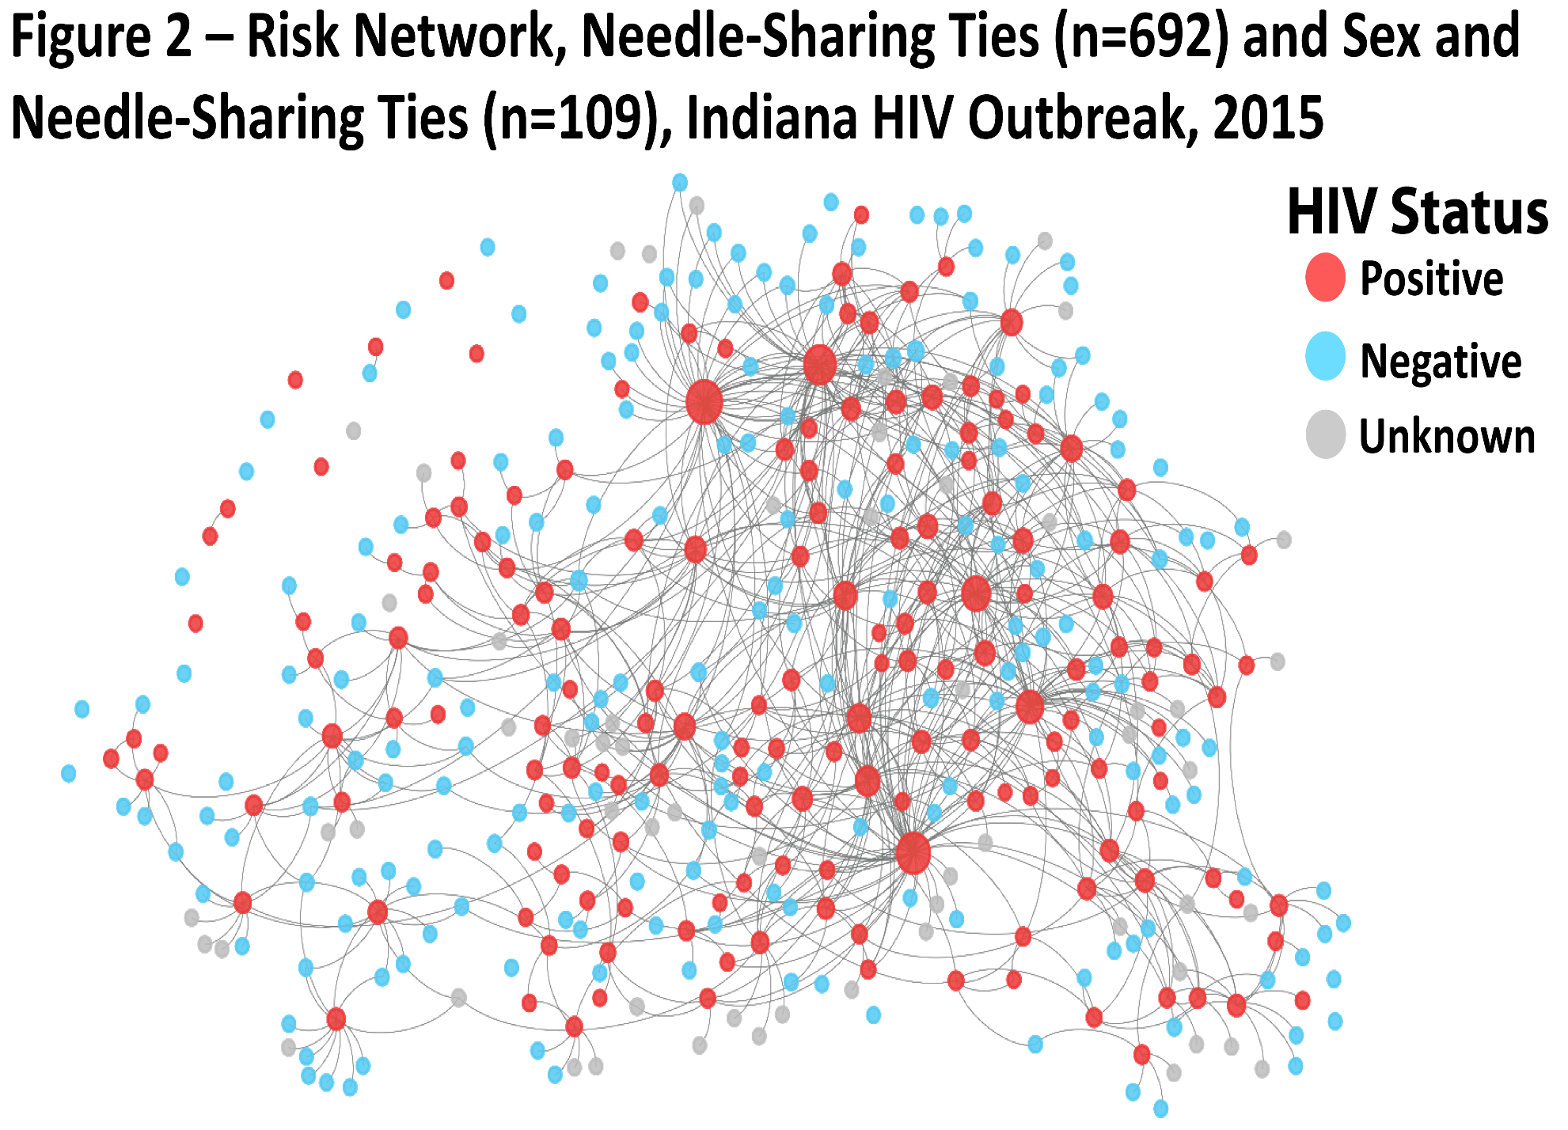

Slide 60
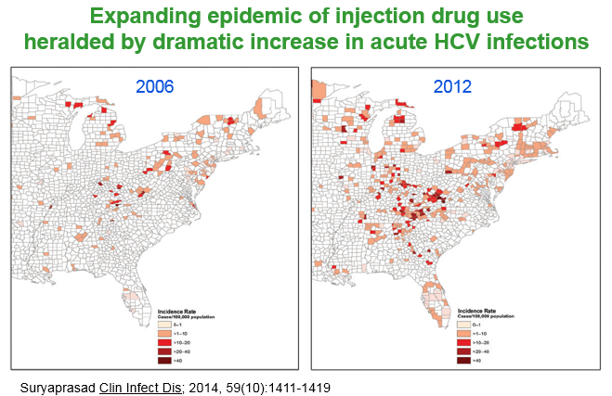
The epidemiology of IDU is changing
The communities affected are not typical of those affected historically by HIV infection or injection drug use

Slide 61
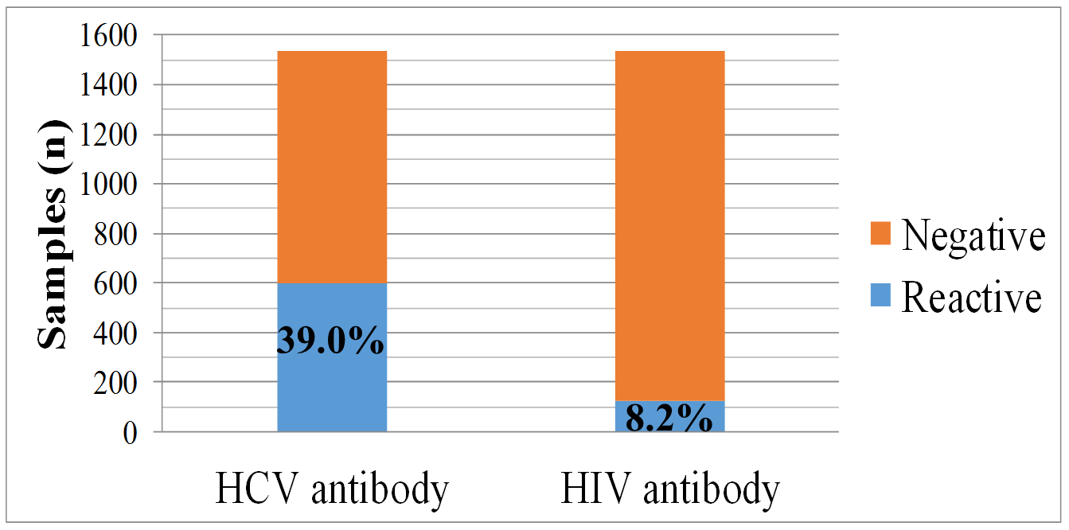
Outbreak-associated specimens tested for HIV and HCV, February - September 2015, n=1,534 specimens
Of HCV reactive specimens,19.4% co-infected with HIV
Ref: SJ Blosser, KA Backfish, M Cross, et al. ID Week 2015

Slide 62
Phylogenetic Analysis – Molecular Epidemiology
Phylogenetics: evolutionary relationships among organisms
  Molecular phylogenetics uses nucleotide sequences
Computational algorithms compare sequences and infer the most likely evolutionary relationship
  Phylogenetic tree displays these evolutionary relationships
  Clusters defined as viruses highly likely in transmission network
  Usually cannot determine directionality of transmission
Despite relevance to HIV and HCV transmission, these analyses are rarely used in real-time to inform interventions

Slide 63
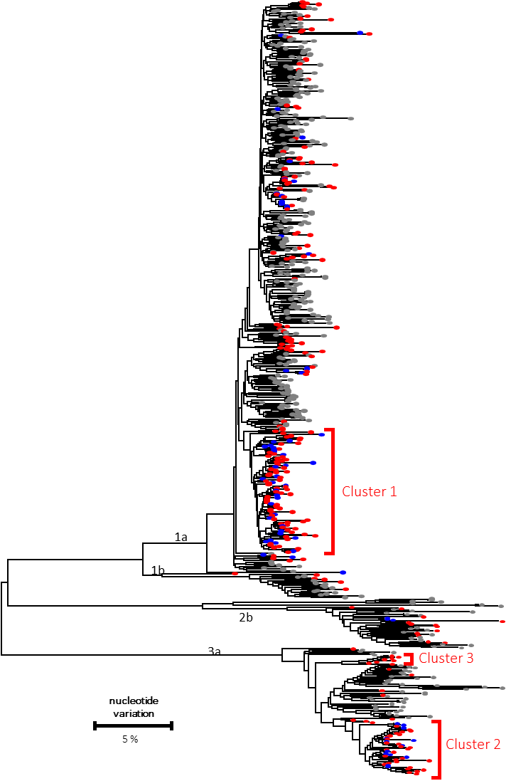
Maximum likelihood phylo-genetic tree of HCV NS5b consensus sequences
HCV mono-infected isolates
HIV/HCV coinfected isolates
North America References
24%
N=70
76%
N=227

Slide 64
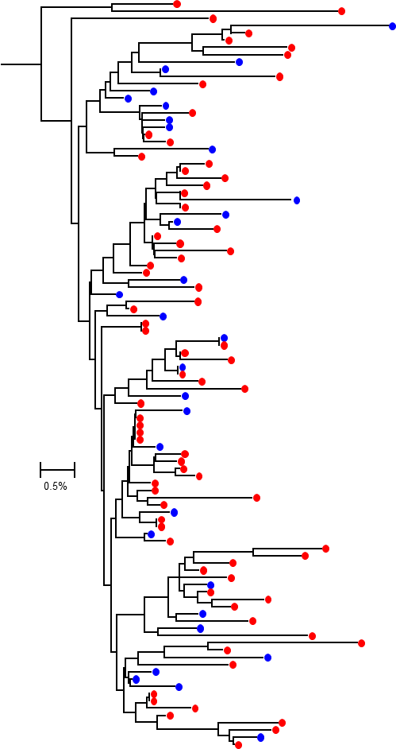
HCV Cluster 1:
Maximum likelihood phylogenetic tree of HCV NS5b consensus sequences
HCV mono-infected isolates
HIV/HCV coinfected isolates
North America References

Slide 65
HCV Phylogenetic Analysis – Molecular Epidemiology
Extensive and Molecularly Diverse Hepatitis C Viruses
  Multiple strains of HCV have been introduced into this network of people who inject drugs (PWID) over a long period of time
  HCV treatment is curative – Treat and Prevent
Large Clusters of Hepatitis C Viruses
  HCV transmission is on-going
  HCV networks involve HIV-infected and HIV-uninfected persons
  Despite high burden of HCV infection – HCV prevention is needed
Novel, Direct HCV Evaluation
  Detect the leading edge of HCV transmissions
  Indications for syringe exchange
  Prioritize contact tracing and HCV curative treatment

Slide 66
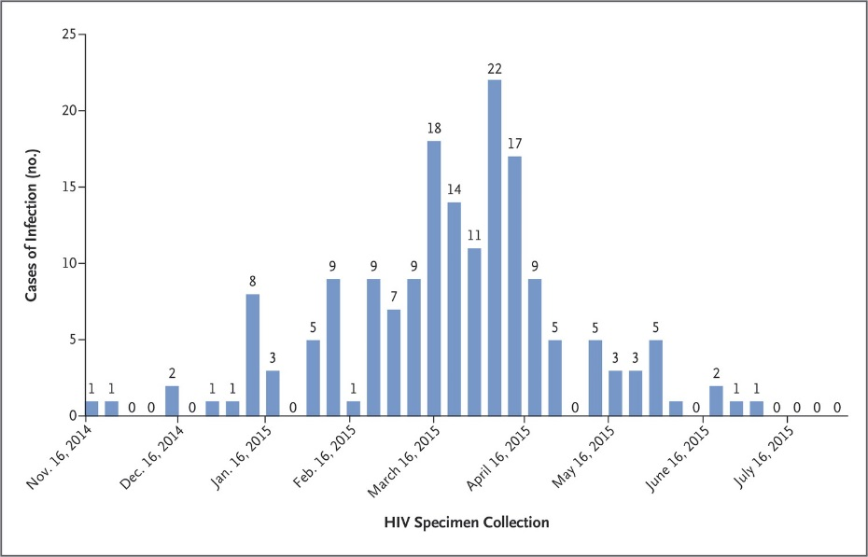
A Sentinel Event has Occurred
Outbreak of 181 HIV infections spread rapidly in a network of people who inject drugs (PWID) in a rural community in Indiana with only five previous HIV infections in the past 10 years
Other U.S. jurisdictions may be at risk for similar event
Unique rural health challenges
  Large populations of PWID (annual testing) without access to testing
  HIV prevention interventions not available (e.g., syringe services)
  Shortage of public health and medical care providers

Slide 67
Preparedness Recommendations
Determine if unsafe injection of drugs is occurring
  Monitoring data sources including acute HCV and overdoses
  Deliverable: dashboard to facilitate on-going monitoring
Enhance testing for HIV and HCV infections
  Providers for persons with substance use disorder
  Jails and prisons
  Emergency departments and in-patient settings
  Metric: HIV and HCV testing
Prepare an action plan for a potential HIV outbreak
  Identify state preparedness partner and develop a response plan
  Metric: HIV health services access

Slide 68
Enhanced PWID HIV Prevention
Access to sterile syringes
  As permitted by federal, state, and local laws
  Communities without operational experience
Provision of pre-exposure prophylaxis (PrEP)
  Nurse mentored program
  Embedded in other services
Expand access to medication assisted therapy (MAT)
  Naloxone, buprenorphine, and methadone

Slide 69
Lessons Learned
Disease Investigation Specialists and Public Health Nurses are Critical to Public Health Prevention and Responses
  Core activity but applied with novel technologies – network analysis
  Can be leveraged for related activities – HCV, overdose
Hepatitis C Virus Infections indicate Unsafe Injection Drug Use and Vulnerability to HIV Infection in a Community
  HIV prevention interventions will also prevent HCV infections
  Need for direct HCV response – treatment, contact tracing
Emergency Responses Challenging; Preparedness Difficult
  Requires resources and local champions
  Necessary after this sentinel event HIV outbreak

Slide 70
Acknowledgements
Scott County Health Department
Clark County Health Department
Indiana State Department of Health
Foundations Family Medicine
Indiana University School of Medicine and Physicians
550 Clinic at University of Louisville
CDC Division of HIV/AIDS Prevention
CDC Division of Viral Hepatitis
CDC Division of STD Prevention
CDC EIS Program Office
Notes:
We would like to acknowledge the many persons who have been integral to the outbreak investigation and response in Indiana. We cannot list everyone by name, but would like to generally acknowledge the Scott County Health Department, Clark County Health Department, Indiana State Department of Health, Foundations Family Medicine, Indiana University School of Medicine and Physicians, The 550 Clinic at University of Louisville and CDC’s Division of Viral Hepatitis, Division of HIV/AID Prevention, Division of STD Prevention, and the EIS Program Office.

Slide 71
HIV Prevention Interventions with Injection Drug Use and Time to Implement
Contact tracing
Antiretroviral therapy
Reduction in risk
of HIV infection
from IDU
Syringe exchange
56%
HIV testing
Opioid substitution therapy
64%
HIV prevention education
Pre-exposure prophylaxis
49%
Immediate
Long-Term
Timeline
Notes:
First, I’ll discuss the comprehensive package of HIV prevention interventions that were implemented as a part of the outbreak response. This diagram shows each of the interventions and I’ll take some time to talk through each one in-depth. No one of these interventions is 100% effective, but together they can help to reduce HIV transmission. Note, that at the onset of the outbreak, these interventions were NOT available in Austin and had to be newly established. Making these interventions available in Austin was essential given that most people in the community don’t have cars or other means to travel outside of the town. Second, I’ll present the findings from an analysis of the early impact of one of these interventions, the syringe exchange program. Third, our end by discussing the next steps for prevention of HIV transmission.

