Slide 1
Medication Compliance & ERAM
An Innovative Approach to Behavioral Health

Slide 2
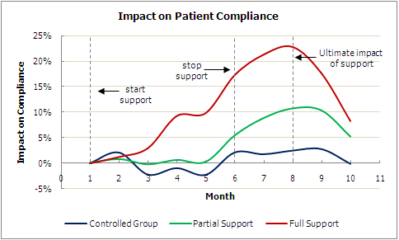
Medication Compliance
In medicine, compliance describes the degree to which a patient correctly follows medical advice. Most commonly, it refers to medication or drug compliance
Major barriers to compliance are thought to include the complexity of modern medication regimens and poor communication
Efforts to improve compliance have been aimed at:
Simplifying medication packaging
Providing effective medication reminders
Improving accountability & patient education
The graph to the right illustrates a study that was done
recently regarding compliance and patient support.
Of nearly 200,000 patients, there is a 15 to 23
percent shift in compliance based
on full, partial and no support.

Slide 3
Behavioral Health
One of the keys to effectively dealing with behavioral health issues is making sure one is compliant with their medication intake
According to Stanford Medicine and the U.S. National Library of Medicine - National Institute of Health, roughly 55% of patients do not take their medication as prescribed. Half of the individuals who were non-compliant in their medication intake did so because they did not believe they were sick (anosognosia)
The single most significant reason why individuals with schizophrenia and bipolar disorder fail to take their medication is due to a lack of awareness that their illness exists. Once prescribed, often the medication will work properly, however, the feeling or idea that they no longer feel sick or need to take their medication is proven to lead to regression which can thus burden our healthcare and criminal justice system
Studies show that those struggling with psychiatric illness, who are taking antipsychotic medication, drives down the risk of engaging in criminal violence. If we were to implement a measure of accountability to assure that those at risk are taking said medication, we can provide a safe and effective alternative to incarceration

Slide 4
Cost
Overdosing, underdosing, and erratic dosing intervals can diminish drug action or cause adverse effects such as criminal behavior and increased hospital or patient care visits. This cycle is unhealthy for the participant and is far more costly to the county and state
CVS and NEHI report that medication non-adherence cost the U.S. roughly 290 Billion dollars annually or roughly 13% of health spending
Poor medication adherence results in 33% to 69% of medication-related hospital admissions in the United States, at a cost of roughly $100 billion per year
Medication non-adherence is linked to roughly 50 percent of treatment failures and leads to nearly 125,000 deaths annually
It can cost the state upwards of $50,000 a year or nearly $135 a day to provide and administer medication for a mentally ill inmate. Those with more severe mental illnesses can be much higher
In 2010, roughly 65 percent of incarcerated adults in prisons or jails met the medical criteria for an mental illness, alcohol or drug use disorder. Inmates were seven times likelier than individuals in the community to have such a condition

Slide 5
ERAM “Telemedicine”
First thought of in the mid 1920’s, telemedicine is considered to be the use of telecommunication and information technology to provide a medical service remotely
Similar to this concept, our motivation behind ERAM is to offer an innovative telehealth service for those struggling with substance abuse and behavioral health issues by providing increased accountability and proactive monitoring
In doing so, we will have an effective alternative to incarceration, all from a smartphone

Slide 6
ERAM (Electronic Remote Accountability Monitoring)
ERAM has been developed as an evidence-based compliance and red flag technology
We provide the client with a locked down smartphone that is side-loaded with our patented software. The device is completely stripped of any functionality other than that used by our administers through ERAM’s specialized tests (no games / calls / texts)
Our Remote Medication Compliance division utilizes web-based secure software that is both HIPAA compliant and “telehealth” billable
Through this software, we are able to generate live client interaction and 2-way communication to provide the following:
Prescription Validation
Proper Dosage & Intake Confirmation
Instantly Result Notification

Slide 7
ERAM & Medication Compliance
When overseeing those who take medication, especially individuals whom you suspect may be abusing them, it is important to be able to identify and confirm drug compliance, diversion or abuse.
Thanks to ERAM, we are able observe medication intake in real-time. There are a number of different ways that we can monitor this process:
***Pre-Packaged Medication Monitoring***
Medication Referencing
Intake Utilizing Pill Crusher

Slide 8
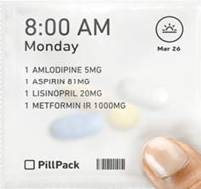
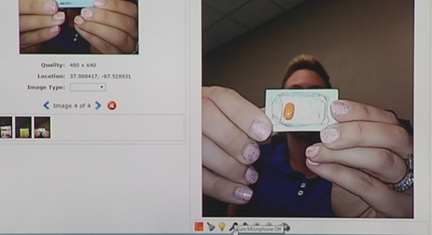
Pre-Packaged Medication
Pharmacies have the capability and resources to package medication(s) based on daily requirements. Pre-packaged medication will reduce preventable medication errors and eliminate the risk of missed medications or incorrect dosing
The package generally illustrates the client’s name, date and time of day for which the medication is to be taken. Some packaging can be less or more detailed based on need for the agency
The client is instructed to hold the package up to the ERAM camera, and an administrator will take a snapshot of the package and its content validating the prescription intake. The client will then open the package in front of the camera, and continue to take the medications orally with water. Once the medication has been taken, the client will then guide the ERAM camera to their mouth from which they are instructed to lift their tongue, open their cheeks and lips to confirm that the medication has not been tampered with

Slide 9
ERAM & Behavioral Health
As mentioned earlier, one of the key components in maintaining a good sense of behavioral health is making sure you are adhering to your medication regimen
ERAM provides a non-invasive mobile tool to assure that those who are required to take medication in fact are complying. By eliminating excuses such as transportation, travel, work and weather, ERAM can confirm medication compliance anywhere, anytime
Another unnoticed benefit to ERAM is its proactive monitoring of behavioral health. If someone were to attempt to falsify a test, or not show up at all, any number of supervising officers (which can include family members) are instantly notified. This allows our behavioral health community and public safety officials to react in real time
90% of recent school shootings dating back over a decade have been commonly linked to those having been subscribed antidepressants but failing to take them according to regimen. It is not confirmed to be believed that it is the sole contributor

Slide 10
ERAM & Cost
ERAM provides a solution to saving our state, county and taxpayers a substantial amount of money
HE1006 and the Mental Health Reform Act of 2015 are just two forms of legislation that have been written to support these programs. By helping facilitate funds to these alternatives, we can successfully keep those who qualify out of our criminal justice system and on a strict treatment regimen while saving the state money
In addition, ERAM can greatly save on administrative costs for those ACT or Medicated Assisted Treatment (MAT) teams across the state that utilize licensed clinical workers to make daily visits to those who struggle to take medication. Although this isn’t their sole role, ERAM can be used as a resource to help them become more efficient in their tasks

Slide 11
ERAM
From legislation to local behavioral health agencies, the collective consensus is that ERAM’s remote medication compliance program could instantly revolutionize the behavioral health field
The key, like most things, is the ability to fund it and make it readily available
As of today, the funding is available and ERAM is ready to prove its worth in innovation. Please feel free to reach out to me for any information or questions you may have!
Jake Hillgoth
jhillgoth@abkkcc.com
812-598-2351

