Slide 1
Medication Assisted Therapy as a Means to Reduce Relapse to Opioid Use and Improve HIV Outcomes Sandra Springer, M.D. Associate Professor of Medicine
Yale University School of Medicine
Department of Internal Medicine
Section of Infectious Diseases
Yale AIDS Program

Slide 2
Outline
Overview of opioid addiction world & U.S.
Overview of coalescing epidemics in U.S.: Opioid addiction, HIV and the CJS
MAT to treat opioid addiction and improve HIV outcomes
XR-NTX as a possible way to improve HIV treatment outcomes and reduce relapse

Slide 3
Opioid Addiction, Injection Drug Use and HIV

Slide 4
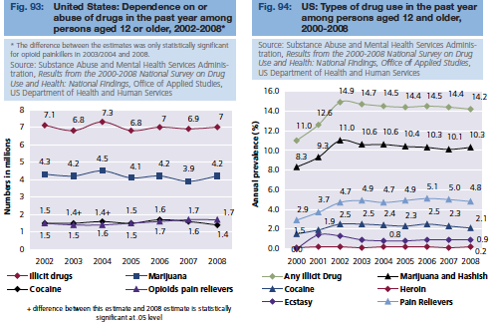
World Drug Reports, 2010
Notes:
Would use JAMA 2015 article instead for these data as newer and for U.S. 2 weeks ago so October 2015.

Slide 5
Prevalence of nonmedical use of RX opioids ⬇ since 2003 (5.4% to 4.9%)
Prevalence of RX opioid use disorders ⬆ (0.6% to 0.9%)
Mortality from OD⬆ 4.5/100 000 to 7.8/100 000
Saloner & Karthikey
⬆ in heroin use (2004-2008 vs 2009-2013)
⬇ insurance (private)
No difference in those with OUDs receiving treatment , remained low (18.8% vs. 19.7%)
⬆ in-patient treatment 37.5% to 51.9%
⬆ office-based treatment 25.1% to 34.8%
JAMA October 13, 2015.
Notes:
First study: NIDA, Will compton, evaluation of data
Second, also in same issue of JAMA, used National survey of drug use and Health (NSDUH) data, cross sectional ages 12 and older, 43- 40% females

Slide 6
What does it mean if we are not getting people into treatment?
Increase in deaths due to overdose &
Increase in HIV transmission

Slide 7
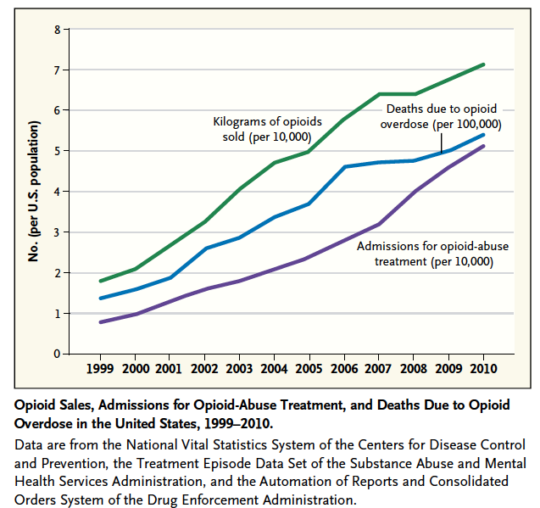
Increase in deaths due to overdose
Volkow N, et al. NEJM, 2014.

Slide 8
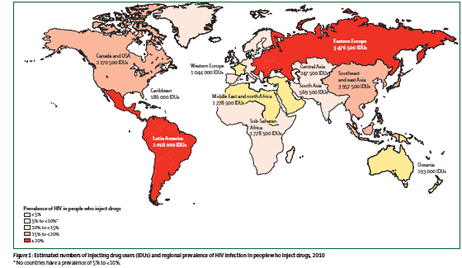
Global estimated number of PWID and Prevalence of HIV among PWID
Globally there are 12.7 million PWID
13%, 1.7 million PWID have HIV
In US , approximately 1.5 million PWID and 22% have HIV
1.Beyer et al. Lancet 2010; 2.Global AIDS Report, UNAIDS, 2014

Slide 9
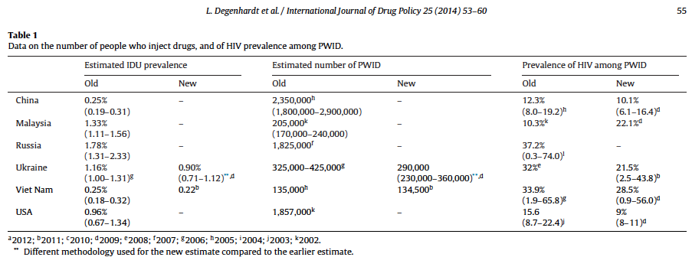
US is one of the top 6 countries who have PWID Globally and PWID with HIV

Slide 10
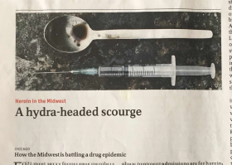
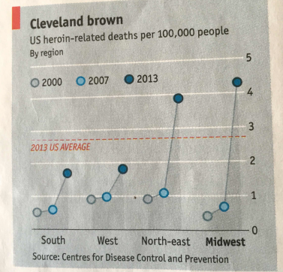
The Economist.
September 19, 2015

Slide 11
January, 2015: Indiana State Health Department started an investigation of an outbreak of HIV (11 patients reported; normal 5/yr)
One rural community, linked to syringe sharing partners injecting opioid oxymorphone
As of April,2015: 135 HIV diagnosed
45.2% girls/ women: few pregnant; 7.4%, N=10 females CSWs
HCV diagnosed N=114 (84.4%)
Risk exposure: N=108, 80% IDU; average of 9 syringe sharing partners, sex partners or other at risk for HIV
230 / 373 contacts tested 47.4% HIV+
Notes:
Initially 11 cases reported when this rural community had only had 5 cases reported annually

Slide 14
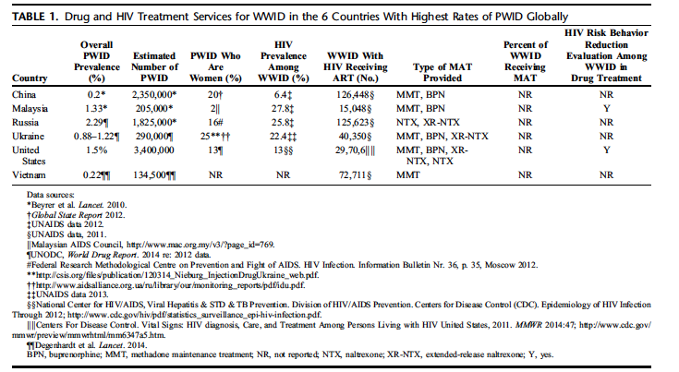
Women who use drugs receive little drug treatment globally

Slide 15
50-90% of PWID will be incarcerated at some time during their lifetime…
Global AIDS Report, UNAIDS, 2014

Slide 16
Coalescing epidemics (a Syndemic): HIV, Opioid Addiction and the U.S. Criminal Justice System

Slide 17
US ranks Number 1 in the World for Incarceration
1 in 31 under CJS supervision
1:18 men ; 1:11 black

Slide 18
HIV Infection in Prisons and the General Population (2008)
HIV prevalence in prisons
HIV: 3 times the general population
AIDS: 4 times the general population
Prevalence of HIV-infected inmates
1.5% (n=22,144)
Males: 1.5% (n=20,231)
Females: 1.9% (n=1913)
16% of HIV+ prisoners are released to the community every year
HIV Prevalence
All Prisoners (State and Federal)
Prevalence (%)
General Population
98 99 00 01 02 03 04 05 06 07 08
Year
Maruschak LM. Bur Justice Stat Bull. December 2009.
Available at: http://bjs.ojp.usdoj.gov/content/pub/pdf/hivp08.pdf.
Spaulding AC, et al. PLoS One. 2009;4:e7558
Notes:
Slide: HIV Infection in Prisons and the General Population (2008)
In 2008, the HIV and AIDS prevalence among the prison population (state and federal) was 3 and 4 times that of the general population, respectively. At year end 2008, 1.5% of inmates were HIV positive (n=22,144; estimated).^{1,2}
Males: 1.5% (n=20,231; reported).
Females: 1.9% (n=1913; reported).
References
Maruschak LM. HIV in prisons, 2007-2008. Bur Justice Stat Bull. December 2009. Available at: http://bjs.ojp.usdoj.gov/content/pub/pdf/hivp08.pdf.
Spaulding AC, Seals RM, Page MJ, et al. HIV/AIDS among inmates of and releasees from US correctional facilities, 2006: declining share of epidemic but persistent public health opportunity. PLoS One. 2009;4:e7558.

Slide 19
AIDS-Related Mortality Achieves Parity in Prisons and the General Population
State inmates
General population
34.2%
HAART
(1996)
AIDS-Related Deaths
Relative to All Deaths (%)
10.2%
3.5%
3.4%
1995
2008
Maruschak LM. Bur Justice Stat Bull. December 2009.
Available at: http://bjs.ojp.usdoj.gov/content/pub/pdf/hivp08.pdf.
Notes:
Slide: AIDS-related Mortality Achieves Parity in Prisons and the General Population
AIDS-related mortality has declined dramatically in both the general population and the prison population since the introduction of HAART in 1996.¹
Reference
Maruschak LM. HIV in prisons, 2007-2008. Bur Justice Stat Bull. December 2009. Available at: http://bjs.ojp.usdoj.gov/content/pub/pdf/hivp08.pdf.

Slide 20
The Revolving Door…
97% of prisoners will eventually be released to the community
(10 million /year)
16% of HIV+ prisoners released yearly
Most reenter society after <2 years of incarceration
60% reincarcerated
The Report of the Re-Entry Policy Council.www.re-entrypolicy.org
Beck et al. BJS, US Dept of Justice; 1989, 1999.
Bonczar T. BJS, US Dept of Justice; 2003.

Slide 21
HIV Treatment Outcomes During and After Incarceration
HIV RNA Change
CD4 Change
59%
+1.14
+67
P<0.0001
P<0.0001
Viral Suppression (%)
Change (log₁₀ copies/mL)
CD4 Change (cells/mm³)
18%
-1.04
-80
Pre
Post
DURING
(n=292)
AFTER (3 Mo)
(n=292)
DURING
(n=292)
AFTER (3 Mo)
(n=292)
Springer S, Clin Infect Dis. 2004.
Notes:
Slide: HIV-Infect Recidivists and HIV-Related Outcomes
Springer and colleagues evaluated the effect of release from prison and subsequent re-incarceration on the viral loads of HIV-infected individuals receiving HAART.¹
292 prisoners who were treated with HAART in prison and re-incarcerated after having spent >3 months outside the correctional setting (medin duration 127 days).
Overall, HIV RNA was reduced 1.04 log₁₀ copies/mL during incarceration. After release to the community, however, the HIV-1 RNA level increased by 1.14 log₁₀ copies/mL by the time of re-incarceration (P<0.0001). In addition, there was a mean increase in the CD4 cell count of 67 cells/mm³ during incarcerations. Conversely, they had a mean decrease in the CD4 cell count of 80 cells/mm³ during the period of release into the community (P<0.0001).¹
Reference
Springer SA, Pesanti E, Hodges J, et al. Effectiveness of antiretroviral therapy among HIV-infected prisoners: reincarceration and the lack of sustained benefit after release to the community. Clin Infect Dis. 2004;38:1754-1760.

Slide 22
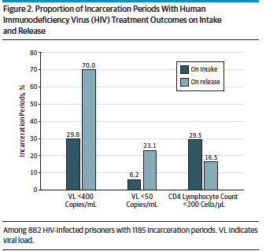
Meyer, Cepeda, wu, Trestman, Altice & Springer. JAMA Internal Medicine 2014

Slide 23
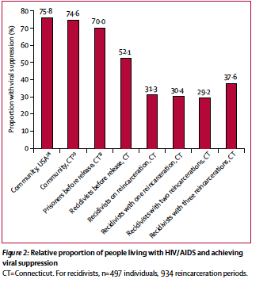
The Lancet HIV. October 2014.
Lancet HIV.
October 2014.

Slide 24
The Public Health Impact of Community Re-Entry for HIV+ Prisoners
Poor adherence with cART leads to significantly increased HIV RNA levels ^{1,2}
HIV RNA levels are associated with increased infectiousness to others ^{3,4}
Impressive return to high prevalence of HIV risk behaviors (unprotected sex, shared needles) with new and former partners^{5,6,7}
Interventions that promote adherence to cART are likely to have an impact on individual well-being and promote public health for society
Springer, CID, 2004
Stephenson, Public Health, 2005
Anderson, Nature, 1988
Hollingsworth, JID, 2008
MacGowan, Int J STD AIDS, 2003
Morrow, J Corr Health Care, 2007
Stephenson. Int J STD AIDS, 2006.

Slide 25
Reasons for Poor Post-Release HIV Treatment Outcomes
Insufficient access to medication refill centers^{1,7}
Under-treated mental illness^{3,7}
Lack of supervised care and social instability ^{4,7}
Lack of Medicaid and need to reenroll^{5,6,7}
Relapse to drug and alcohol use^{2,7}
1. Baillergeron, JAMA, 2009. 4. Thompson, J Community Health, 1998.
2. Kinlock, J Substance Abuse,2002. 5. Wakeman, AIDS Care, 2009
3. Baillergeron, Am J Psych 2009. 6. Morrissey. Psychiatr Serv. 2006
7. Springer et al. Clin Inf Dis 2011.
Notes:
These are some of the enabling resources or lack thereof that contribute to the increased health care utilization (e.g. ER use, hospital admission)

Slide 26
Prevalence of DSM-IV Diagnoses Among U.S. Prisoners
6%
3%
11%
2.5%
James, 2006
Baillargeon, 2009
Peters, 1998
Peters, 1998
James, 2006
Notes:
green is what is general population

Slide 27
Relapse to Drug and Alcohol Use occurs regardless of length of abstinence!
>85% relapse to opioid and alcohol use within 1 year after release to the community¹
Relapse to opioid and alcohol use is associated with:
↓ adherence to medical care and ART ^{2,5}
↑ acquisition of HIV ( and HCV)² (↑ transmission of HIV to public)
↑ increased recidivism ( cost to the public)³
↑ mortality⁴
¹ Kinlock J Subst Abuse Tx 2002 ²CID 2002:35.307.
³Levasseur . Ann Med Interne 2002. ⁴ Binswanger IA et al. NEJM 2007.
⁵Azar, Springer, Altice. DAD 2010.

Slide 28
Problem: People in CJ System with Opioid Use Disorders are Dying
Binswanger, et al., 2013, Annals of Internal Medicine

Slide 29
Clinical Infectious Diseases, 2011
Case management and linkage to care
Antiretroviral adherence support
Treatment of substance use disorders
Treatment of mental illness
HIV risk reduction interventions

Slide 30
Medication assisted therapy prevents relapse to opioid use and decreases death and reduces transmission of HIV and HCV

Slide 31
FDA-Approved Medications for Opioid Dependence
 | Methadone | Buprenorphine/Naloxone | Naltrexone (Revia®) | Extended-release NTX Vivitrol®
Mechanism of Action | Full μ agonist | Partial μ agonist, Partial κ antagonist | Full μ antagonist | Full U antagonist
Delivery | Oral | Sublingual, film | Oral | IM
Frequency | Daily | Daily or thrice weekly | Daily | monthly
Setting | Licensed drug treatment program | PCC/HIV care setting (MD with 8 hour training) | PCC/HIV care setting (no special licensing) | PCC/HIV care setting (no special licensing)
Other | Highly structured due to safety concerns. OD potential Interacts with some ARVs | Safer than methadone, without major OD potential Less interactions with ARVs Diversion ? | Also treats alcohol dependence, Hast not been found to be effective for OD | Also treats Alcohol Use disorders Adherence advangtage NO overdose or diversion concerns

Slide 32
What are the Known Benefits of Opioid Substitution Therapy?
Methadone and Buprenorphine treatments demonstrated to:
↓ opioid use and craving
↓ recidivism to prison
(Canada¹, NYC^{2 ,} France³, Australia⁴)
↓ HIV transmission
↑ retention in treatment
↑ access to and adherence with HAART
To be cost-effective
¹ Sibbald 2002 ³ Durand 2001
² Tomasino 1987 ⁴ Byrne & Doland, 1998
Notes:
Canda- MMTP for opiate-addicted federal prisoners in 1998 (Sibbled, 2002) all were offered METH in prison and found good success and lack of diversion that in May 2002 all opiate –addicted prisoners are provided METH
New South Wales, Australia- METH prison –based program- reduced IDU in prison
Project KEEP – NYC_ Tomasino – 1987 started- offer METH for those still on METH and to those withdrawing; continue upon release- 74-80% link with community and decrease in IDU at 6 months post-release
France- use since 1996 – Durand 2001- 3.600 medical files french prisons- meth vs. bup vs. abstinence decreased recidivism

Slide 34
Cochrane Database Syst Rev. 2011: CD004145
Meta-analysis of 38 studies:
N=12,400 persons
Methadone or BPN associated with ⬇:
illicit opioid use
injection use
sharing of injection equipment
multiple sex partners
exchanges of sex for drugs/ money

Slide 35
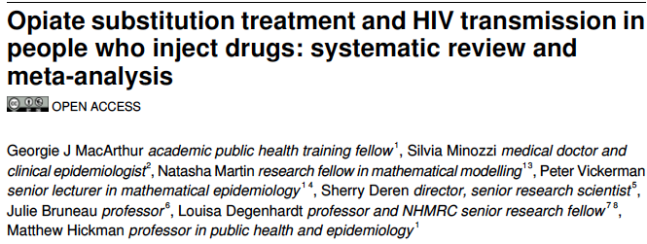
BMJ 2012; 345: e5945.
12 studies that specifically evaluated the impact of OST on HIV transmission among PWID, all were MMT and 9 of the studies had data that could be pooled
819 HIV infections over 23,608 person years of follow-up
Methadone was associated with a 54% reduction in risk of HIV infection among PWID (RR0.46, 95% CI 0.32 -0.67, p<0.0001)

Slide 36
MAT is acceptable among CJS involved persons and can decrease HIV VL and decrease morbidity

Slide 37
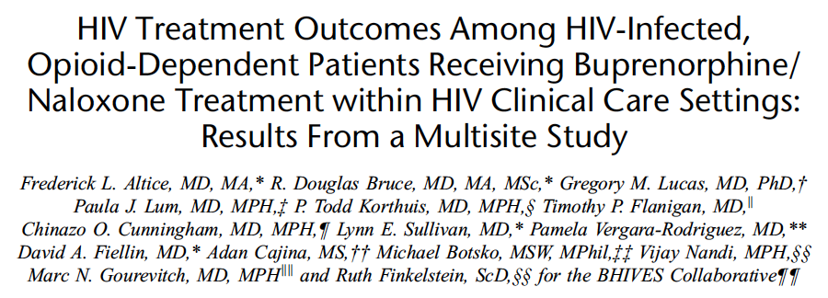
March, 2011

Slide 38
Buprenorphine Maintenance and HIV Treatment Outcomes
295 HIV+ subjects starting BPN at 10 sites
BPN increased likelihood of initiating ART and improving CD4 count; but had no impact on VL outcomes (most were on ART at baseline)
Stratified analysis by those on (N=176) and not on ART (N=119) at baseline
Longer retention on BPN (3 or 4 quarters) was associated with improved ART entry and viral suppression among those not initially on ART

Slide 39
Kinlock Study of HIV-s
8 (4%) deaths of the 204 subjects
6 due to overdose (none on MMT)
2 cardiovascular
MMT protective of death
12 month Outcomes (N=204 OD Prisoners) | Counseling Only | Counseling + MMT Transfer after release | Counseling + MMT in prison and after release | P value
Retention in Treatment (mean Days) | 23.1 | 91.3 | 166 | <.01
Urine Opioid Drug + (%) | 65.5 | 48.7 | 25.0 | =.008
Criminal Activity | 50.8 | 59.1 | 52.9 | NS
Notes:
As proof of concept using Methadone works for keeping people free of drugs; ? How well will it do for HIV+

Slide 40
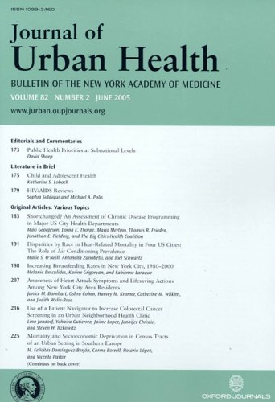
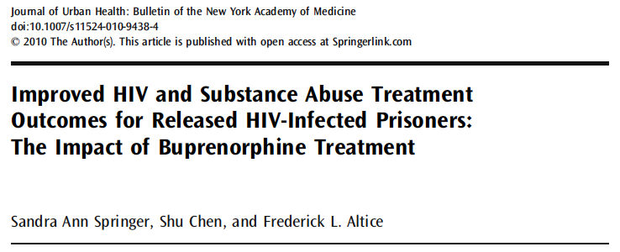

Slide 41
Buprenorphine Treatment for Released HIV+ Prisoners (N=23)
Opioid craving ⬇ within 3 days
Low mean BPN stabilization dose (9mg)
High satisfaction
Retention on BPN 74%
Springer et al. J Urban Health, 2010.

Slide 42
PLoS one June 2012.
%
VL
<50
HIV VL <50 copies/mL

Slide 43
Independent Correlates of Having HIV VL <50 at 6 Months Post-release (N=98)
 | AOR (95% CI)
Retained on BPN 24 weeks**** | 5.37(1.15-25.1)
Received any BPN or Methadone | 1.36 (0.59-3.15)
Months of incarceration | 1.02 (0.99-1.02)
Baseline VL<50 | 10.5 (3.21-34.1)
DAART | 1.56 (0.65-3.74)
Springer et al., PLoS One. 2012.
Multivariate Logistic Regression analysis

Slide 44
What about extended-release naltrexone (XR-NTX)?

Slide 45
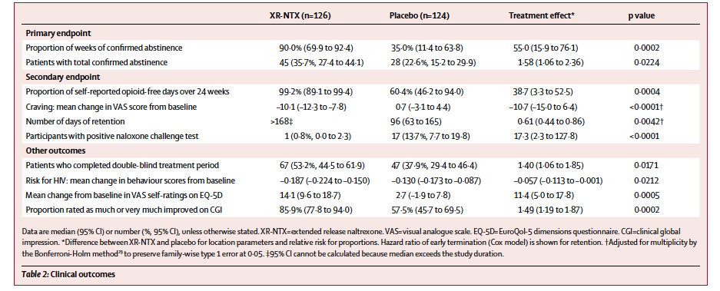
Krupitsky et al. Lancet, 2011
Notes:
A depot formulation of an opioid receptor antagonist, naltrexone (oral approved 1984 , ReVia®)
ReVia has not reduced recidivism, retention, : poor compliance so passive-compliance formulations developed (1)
Vivitrol FDA-approved 2006 for Alcohol dependence (effective for prevention of relapse to alcohol use)
FDA-approved in 2010 for Opioid dependence
An RCT in Russia 1:1 received 380mg Vivitrol vs. Placebo 6 month (N=250 treated for 6 month) (2)
40% HIV+ & 90% HCV
36% Vivitrol abstinent vs. 23% placebo (wk 5-wk20)
No deaths in clinical trials (pre-marketing 5 deaths :(cancer, suicide, homicide, CAD) ; post-marketing 19 deaths (suicide and 3 due to Opioid OD , ETOH intoxication) )
Minozzi SCochrane Database Syst Rev 2006; 1: CD001333
Krupitsky et al. Lancet , 2010.

Slide 46
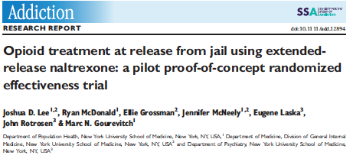
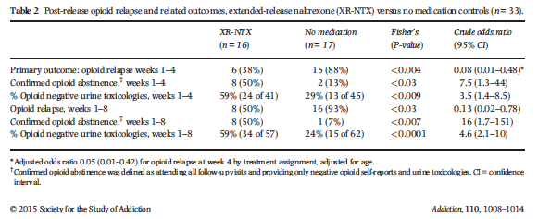

Slide 47
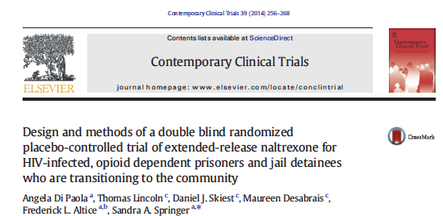
Di Paola A… Springer SA. Contemporary Clinical Trials. 2014.

Slide 48
Project NEW HOPE A Double Blind Randomized Placebo-Controlled Trial of XR-NTX among Opioid Dependent HIV+ CJ persons: Preliminary results
NIDA R01: DA 030762
Principal Investigator:
Sandra A. Springer, MD
Associate Professor of Medicine
Yale School of Medicine
Section of Infectious Disease
Co-Investigators:
Frederick L. Altice, MD
Thomas Lincoln, MD
Dan Skiest, MD

Slide 49
Hypotheses
Compared to placebo:
XR-NTX will stabilize HIV treatment outcomes (VL, CD4) and improve retention in HIV care.
XR-NTX will result in improved opioid treatment outcomes, including longer time to opioid relapse, lower % + urine tox screens, higher % days abstinent and lower craving for opioids.
XR-NTX will result in reduced HIV-related risk behaviors.
XR-NTX will result in decreased criminal activity and reincarceration.

Slide 50
Eligibility Criteria
1) HIV+
2) Returning to or within 30 days post-release to New Haven or Hartford areas
3) Meets DSM-IV criteria for opioid dependence
4) Able to provide informed consent
5) Speaks English or Spanish
6) AST or ALT < 5X ULN (≤Grade 3 hepatitis)
7) no evidence of Child’s Pugh Class C cirrhosis
8) no pending felony charges
9) for women, not being pregnant or willing to use contraception
10) Not receiving prescription narcotics or having a pain condition likely to need them

Slide 51
Study Design
Outcomes
HIV/AIDS Outcomes % VL<50 (primary) HIV risk behaviors Δ CD4 count
Opioid Relapse Time to relapse, % urine negative opioid , opioid craving
Ancillary
Acceptability, retention on NTX, adherence to NTX, adverse side effects, reincarceration
2
NTX-XR
Randomization (while incarcerated)
Recruitment (CT Prisons)
Enrollment (N=150)
Placebo
1
Notes:
CT DOC: Unified correctional system that includes prisons and jails
~20,000 inmates (18,400 men, 1,600 women)
HIV prevalence CT CJS (4.9% M; 7.4% W)^{1,2}
IDC nurses oversee management of all HIV+ patients including discharge to community
~10 HIV+s /mth released to New Haven
~15 HIV+s /mth to Hartford
~ 50-75% meet DSM-IV criteria for OD
HCCC: 1500 pretrial & sentenced inmates
85% come from 1 of 4 areas served by health centers in Springfield, MA
50-75% OD
All HIV+ patients will have release of information signed before any referrals
HIV prevalence rates in Prisons end of 2008: CT 2.0%; 4.1% F; 1.9% M (maruschak, BJS, 12.2009)
Recruitment: Subjects will be recruited from within the CTDOC by CMHC staff through a subcontract with CMHC as part of this award. All HIV+ patients in the CTDOC are managed by an Infectious Disease Control Nurse (IDCN) employed by CMHC who is housed at each CTDOC facility and responsible for overseeing the management of all HIV+ patients, including their discharge to the community. Each HIV+ prisoner will be screened for alcohol using AUDIT and for other chemical dependence. Regarding feasibility, there are 10 HIV+ prisoners per month returning to New Haven and 15 returning to Hartford each month, resulting in 300 per year. Of these, we anticipate one-third to meet criteria for alcohol dependence or problem drinking (N=100). In our buprenorphine trials, 57% of HIV+ subjects meeting DSM-IV criteria for opioid dependence participated in our trials. Thus, in three years of recruitment, we expect to have more than enough subjects to participate in our trial. Ultimately, we anticipate needing to screen 350 to 400 HIV+ inmates to recruit 125 who meet eligibility criteria. Discharge plans begin up to 90 days prior to release. All HIV+ prisoners are referred to and evaluated by Project TLC (developed by Dr. Altice) and receive transitional case management services for up to 90 days before release and one month after discharge. They ensure entitlements, medical appointments, referral to substance abuse treatment, and assistance with housing and other individualized needs. As part of this grant, the IDCN will administer a brief screening form (AUDIT) to all HIV+ inmates to determine if the inmate meets criteria for alcohol dependence or problematic drinking. All HIV+ inmates will be referred to this study based upon existing protocols that are essentially identical for Projects CONNECT, BRIDGE and PLUS. Subjects will also be recruited through other efforts. All inmates who enter the CTDOC with a history of alcohol use and who undergo supervised medical withdrawal will be referred for routine HIV testing. Additionally, we will advertise through the CTDOC for all inmates who have concerns about their alcohol use and would like to learn more about a study, they will be referred immediately for HIV testing. All those diagnosed with HIV through this method will come under the supervision of the IDCN and therefore will be referred to this study. An additional question will include the city to which they plan to return. Thus, the eligibility criteria will include the following: 1) HIV+; 2) returning to the cities of New Haven or Hartford (if recruitment is problematic, we will add the city of Waterbury); 3) meets DSM-IV criteria for alcohol dependence or problem drinking; 4) able to provide informed consent; and 5) speaks English or Spanish.

Slide 52
Project NEW HOPE Timeline
= IM injection
+ MM counseling
= Interview
= Chart Review
PRE-RELEASE
AFTER RELEASE
.
.
.
.
.
.
.
.
.
.
.
.
.
.
B
-12w
-1w
1m
2m
3m
4m
5m
6m
7m
8m
9m
10m
11m
12m
Day of Release
INTERVENTION PHASE
FOLLOW-UP PHASE

Slide 53
Baseline Demographics
Demographic | N=120
Age (mean) | 45.6 (±8.1)
Gender (male) | 81.3%
Race/ethnicity
Black | 23.3%
White | 12.5%
Hispanic | 64.2%
HCV Ab+ | 77.1%
Mean CD4 | 474.0 (± 254.4)
HIV VL <50 at time of release | 41.6%
HIV VL <400 at time of release | 64.4%
AUDIT Hazardous Drinking | 29.1%
Homeless | 38.3%
Mean Incarceration in months (mean) | 9.5 (± 10.6)
Referrals from Jail | 69.0%
Notes:
46 (38.3%) homeless; 28 (23.3%) unstable; 46 (38.3%) stable.

Slide 54
Baseline Demographics
MINI Criteria for Diagnosis |  | N=106
Mental Disorders
Any Mental Disorder Diagnosis |  | 69.8%
 | Major Depression Current | 37.7%
 | Bipolar Disorder | 12.3%
 | PTSD | 17.9%
 | Generalized Anxiety Disorder | 15.1%
Alcohol Use Disorder |  | 23.6%
Any Drug Use Disorder |  | 93.4%
 | Narcotics | 87.7%
 | Cocaine | 77.4%
 | Marijuana | 21.7%
Notes:
Any current includes antisocial (does not include suicide)
Not on slide: any current w/o antisocial = 47.2% (does not include suicide)

Slide 55
Drug Use History Prior to Incarceration
Drug | Mean Years Lifetime | Mean 30 Days Prior to Incarceration
Heroin | 20.84 (SD 10.40) | 21.63 (SD 12.54)
Methadone | 2.17 (SD 3.64) | 6.98 (SD 12.47)
Other Opiates | 3.03 (SD 7.16) | 2.98 (SD 7.75)
Cocaine | 18.17 (SD 10.98) | 18.89 (SD 13.36)
Notes:
From ASI
Any alcohol Years: 11.21 (SD 14.0) Days: 6.03 (SD 11.0)
Alcohol to Intox Years: 9.21 (SD 12.3) Days: 6.34 (11.1)
Cannabis Years: 12.75 (SD 13.1) Days 4.29 (SD 9.5)

Slide 56
Medication Assisted Therapy History Prior to Incarceration
* 93% of participants received some form of treatment for opioid dependence prior to incarceration, of those 84% had MAT
Notes:
93 prescribed a MAT; 77.5% of the full sample.
47 (50.5%) of the 93 prescribed a MAT had 2 or more forms of MAT

Slide 57
Blinded Opioid Outcomes (2 XR-NTX:1 Placebo)
Opioid Outcome | Baseline (30 days prior to incarceration) | Post release
Days used * | 25.35 (SD 9.70) | 4.93 (SD 4.93)
Drug used: Heroin | 89.5% | 84.4%
Route: Injection | 75.8% | 80.7%
Days to first use |  | 77.4 (SD 101.6)
Opioid Craving* | 3.00 (SD 3.54) | 0.85 (SD 2.4)
* P < 0.001
Notes:
Days used/Drug used and Route - 30 day post release
OF NOTE: Appx 1/3 of post release did not relapse for >100 days.

Slide 58
Primary & Secondary Outcomes
Notes:
For those being followed in the study
Adherence from VAS reported 90% + adherence:
BSLN of the 89% prescribed HAART; Month 3: 100% prescribed HAART
Cut offs for AST and ALT <2X ULN (AST<70, ALT<78)
Baseline shown is Day of release results N=71 as baseline. 3month N=37
Opioid utox includes: Methadone, opiates, buprenorphine, oxy

Slide 59
HIV Risk Behaviors Decrease
Risk Behavior | Baseline (pre-incarceration) | 3- Month post-release
People reporting Unprotected sex
Mean Unprotected Vaginal Events | 5.7 (SD 10.1) | 1.06 ( SD 2.5)
People Reporting Injection Drug Use
Injected in past 30 Days | 68% | 11%
Injected with others in 30 D | 43% | 25%
Mean injections per day | 7.7 (± 11.3) | 4.3 (± 4.3)
Notes:
70 reported having vaginal sex and of that 30 said they had unprotectedN too small for any meaningful analysis.
N=113 baseline
N=35 at 3 months
Baseline average partners 1.68 (SD 2.86); mean unprotected vag 5.7 (SD 10.1); Receptive 4.7 (SD 10.0); Insertive 1.2 (SD 1.8).
Month 3 average partners 1.26 (SD 3.42); mean unprotected Vag 1.06 (SD 2.5)

Slide 60
No Serious Adverse Events
 | Baseline | 3 month | P-value
AST (mean) | 49.3 | 71.3 | 0.15
ALT (mean) | 56.3 | 79.9 | 0.10
Bun/creat | 14.4/1.00 | 14.2/1.00 | 0.65/0.84
Side Effect | Number | %
Skin/soft tissue infection | 2/170 | 1.12%
Immediate sensitivity to injection | 16/170 | 9.41%
Signs of Edema | 2/168 | 1.19%
Nausea | 10/140 | 7.14%
Diarrhea | 5/133 | 3.76%
Headache | 10/133 | 7.52%
Fatigue | 6/115 | 5.22%
Increased Anxiety | 4/101 | 3.96%
Notes:
BUN and Creatinine are from day of release.
Skin/tissue infection & immediate reaction taken from NXT administration teleform
Nausea, diarrhea, headache, fatigue & anxiety taken from SAFTEE – not done at 1st injection which is why the N is different. Some did not receive injections but had extra SAFTEEs completed

Slide 61
XR-NTX does NOT cause liver failure
Vagenas P …. Springer S. Journal of Substance Abuse Treatment 47 (2014) 35-40.

Slide 62
LFT Elevations (Grades 3,4) are NOT significantly different between XR-NTX and Placebo after 6 injections
AST Levels
ALT Levels
p=1
p=1
p=1
p=1
p=1
p=1
Percentage of Participants
Percentage of Participants
Baseline
3 Months
6 Months
Baseline
3 Months
6 Months
GGT Levels
p=1
p=1
p=1
XR-NTX n=61
Placebo n=24
HIV+ participants
81% on ART
Percentage of Participants
Vagenas,et al, Springer. JSAT 2014
Baseline
3 Months
6 Months

Slide 63
Alcohol and HIV : ? benefit of XR-NTX

Slide 64
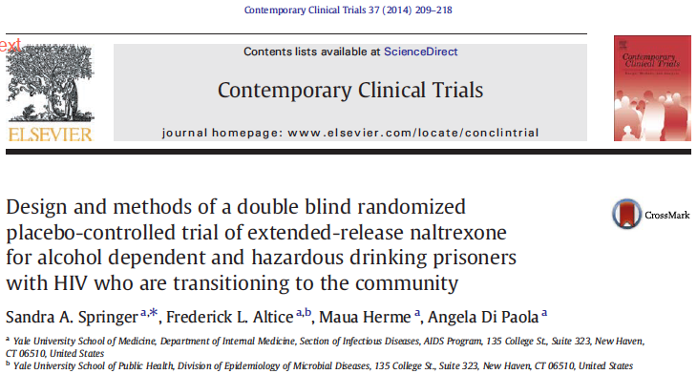
PIs: Sandra A. Springer, M.D. &
Frederick L. Altice, M.D.
R01-AA018944 NIAAA

Slide 65
3-month Blinded Alcohol Outcomes (N=85)
Outcome Measure | 30 days prior to incarceration | 3 month after release | p value
Alcohol Craving 1-10 | 3.82 | 1.59 | <0.001
TLFB Percent Relapsed Time to First Drink Mean Drinking Days Mean Heavy Drinking Days | 21.1 20.3 | 58.8% 26.9 days 4.9 4.1 | <0.001 <0.001
Krishnan A, Di Paola A, Winn T, Altice FL, & Springer SA. A ;
8th Academic & Health Policy Conference on Correctional Health, Poster Feb 20, 2015
Notes:
BLINDED results
No poster #

Slide 66
Blinded HIV Viral Load Suppression Outcome
P<0.001
P=0.002
Notes:
INSPIRE
Baseline N=110, 3 month N=60

Slide 67
XR-NTX is highly acceptable among HIV+ persons as they transition from CJS to community
90% of HIV+ opioid and alcohol dependent persons accepted initial injection with XR-NTX prior to release
60% returned for their 2nd injection 1 month after release to the community
Main reason for not returning was relapse to cocaine use
Bottom Line: HIV+ CJS populations will accept tx and will stay on treatment but need to identify history of others drugs of abuse to prevent relapse especially stimulants.
Springer et al. Drug and Alcohol Dependence. October, 2015. IN PRESS
Notes:
Would show slide about next

Slide 68
Conclusions
HIV infection and Opioid Addiction are coalescing epidemics that require urgent treatment to improve individual morbidity and decrease harm to the public
Correctional systems are an integral part of our public health system and prisoners, concentrated with persons who have HIV, mental illness and substance use disorders, will return to the community
HIV treatment and substance use outcomes may be improved by preventing relapse to substance use for released HIV + prisoners
XR-NTX is safe in HIV+ persons on ART with comorbid HCV and mental illness
XR-NTX is accepted by CJS populations and it may be a feasible conduit to care for HIV+ OD CJ persons as they transition to the community

Slide 69
Acknowledgements
Funders NIDA & NIAAA:
R01:DA 030762 (Springer, PI)
K02: DA032322 (Springer, PI)
R01: AA018944 (Springer & Altice, co-PIs)
Alkermes: Providing XR-NTX and placebo through Investigator initiated application
All Yale Clinical and Community Research Staff
Angela Di Paola, MS (project coordinator)
Connecticut Correctional Managed Health Care
Connecticut Department of Correction
Springfield- Hampden County Correctional System and Bay State Medical Center
The patients!!!!

