Slide 1
Indiana Election Administrator's Conference
December 12, 2023

Slide 2
What is the EI-ISAC?
Elections Infrastructure Information Sharing and Analysis Center (EI-ISAC)
Mission is to improve the overall cybersecurity posture of State, Local, Tribal and Territorial (SLTT) election offices
Provide no cost solutions/services
More than 75 years of election experience
State, local and election vendor

Slide 3
Center for Internet Security (CIS)
CIS is a community-driven nonprofit
Mission is to Create Confidence in the Connected World
Develops security best practices
CIS Critical Security Controls and CIS Benchmarks
Home to the MS- and EI-ISAC
The CISA, CIS, and the EI-ISAC relationship
Voluntary and collaborative effort based on a strong partnership

Slide 4
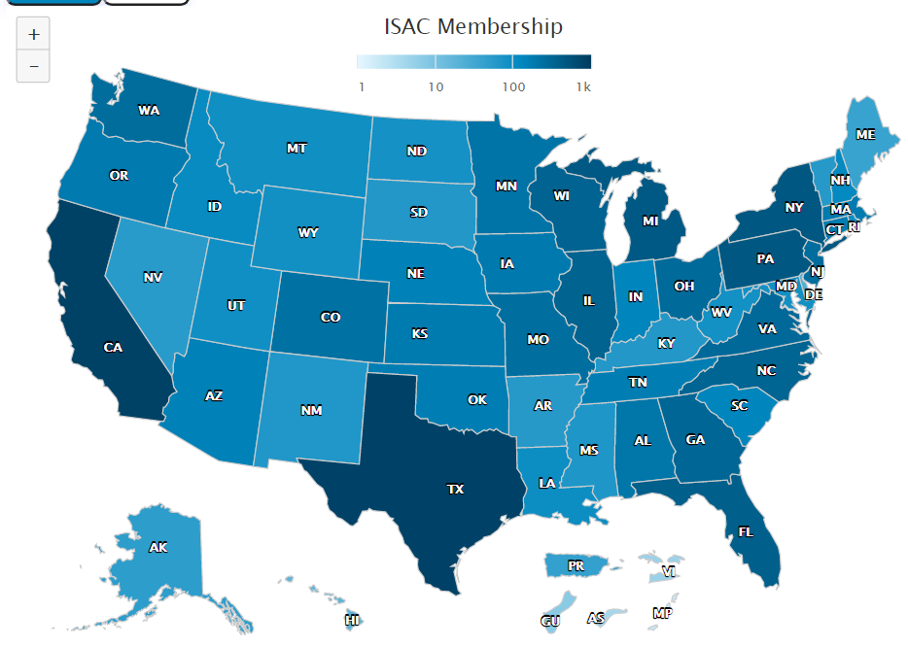
Who We Serve
+3,670 Members
50 State Election Offices
+3,500 Local Election Offices
6 Territorial Election Offices
14 Election Associations
54 Supporting Members
5 Tribes
Notes:
EI-ISAC is continuing to grow – exceeded 3,000 members earlier this year

Slide 5
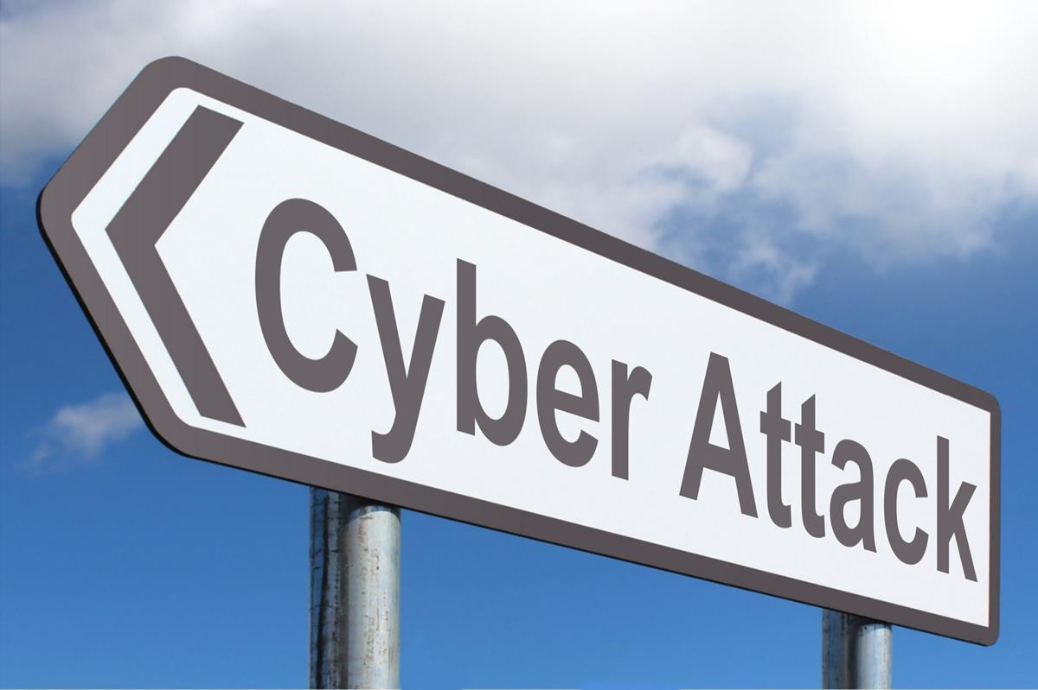
What to expect in 2024?

Slide 6
2024 General Election Threat Assessment
Phishing and scanning
Data leaks
Distributed Denial-of-Service (DDoS)
Vulnerabilities and Zero-Days
Ransomware
Generative Artificial Intelligence (AI)
Physical Threats
Campaigns targeting U.S. elections

Slide 7
Threat Assessment
Phishing
Impersonating familiar figures (co-workers, managers, etc.)
Conveys a sense of urgency
Thread hijacking
Use of attachments
Use of QR codes (quishing)
Scanning
Websites and networks looking for vulnerabilities
Data Leaks
Online sale of election related information

Slide 8
Threat Assessment
Distributed Denial-of-Service (DDoS)
Attempt to disrupt availability of critical systems
Prevents access to website
Vulnerabilities and Zero-Days
Known vulnerabilities
New vulnerabilities
Ransomware
Malware that encrypts all files on a device

Slide 9
Threat Assessment
Generative AI
Improve malicious campaigns
Collect information about targets
Defame participants by generating inaccurate information
Deep fakes
Physical Threats
Election offices and poll workers
Campaigns Targeting U.S. Elections
Foreign intervention

Slide 10
Insider Threats
What can they do in election offices?
Attempt to breach voting systems.
Steal sensitive data on voters from internal databases.
Use their access to let others into secured areas, bypassing controls that limit access to sensitive areas.
Attackers could use information stolen from election offices to further mis/dis-information narratives or sell it to others seeking access to systems.
Seek to damage and disrupt the electoral process.

Slide 11
What can you do?

Slide 12
Defense-in-Depth
No single action gives complete protection
Layered approach

Slide 13
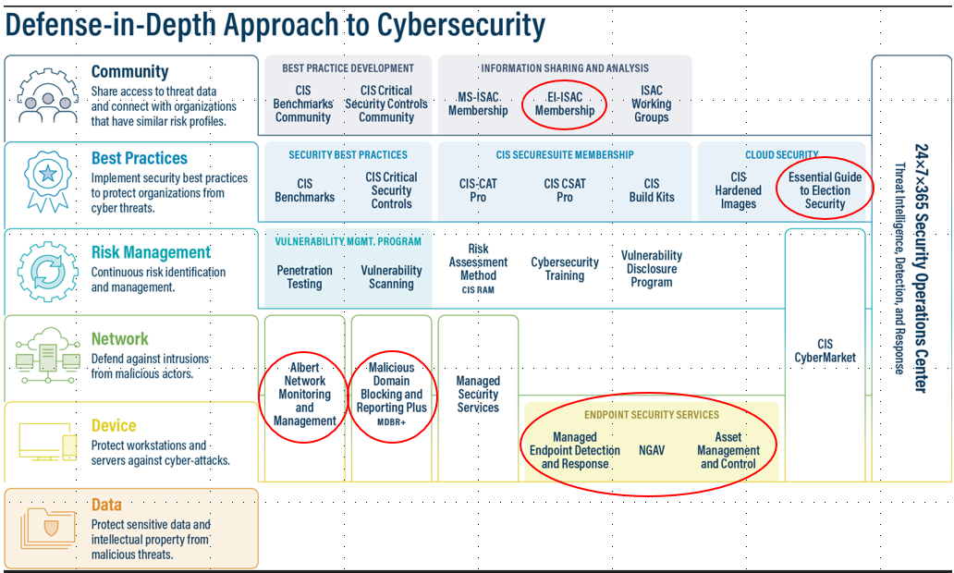

Slide 14
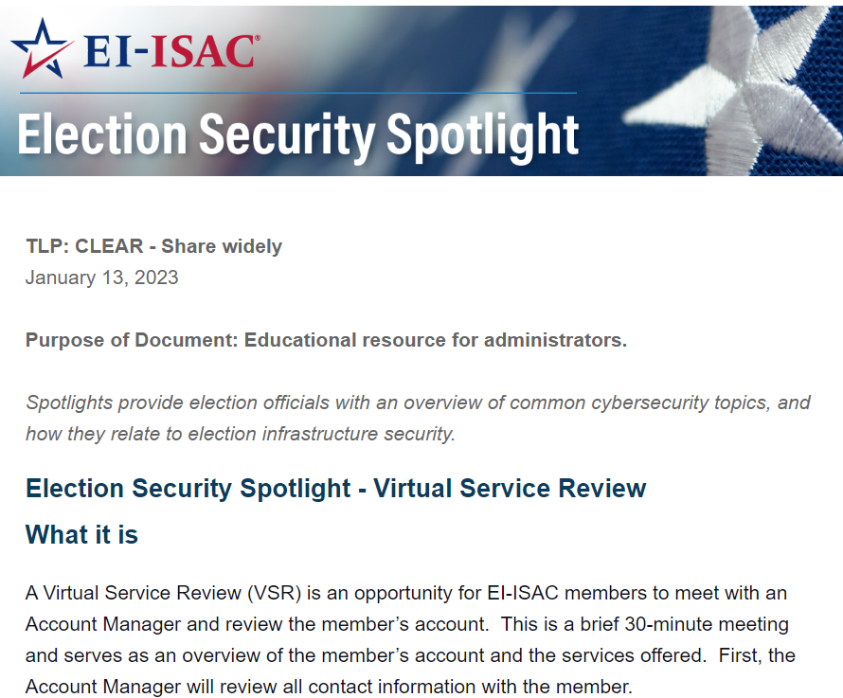
Communication for Election Officials
Content that put elections security topics into context for election officials

Slide 15
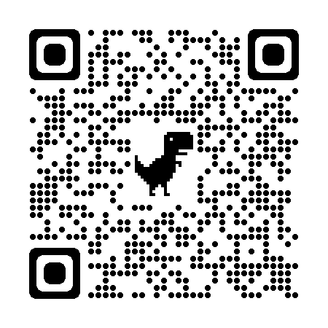
Essential Guide to Election Security
Replaces Handbook for Election Security
Dynamic model to incorporate real-time updates
Designed with election officials in mind
Establishes a maturity model that can be applied to a wide range of election offices
Guidance on best practices implementation that fits your needs
Cisecurity.org – search for Essential Guide
https://docs.cisecurity.org/en/latest/index.html

Slide 16
Albert Sensors
Intrusion detection system
Monitors traffic data as it flows across a network
Provides alerts for known cyber threats, helping to identify malicious cyber activity
Passively monitors traffic, does not block traffic and cannot negatively affect a member network or change the content
Technology was developed especially for state and local government organizations
The rapid updating of Albert sensors to look for emerging threats, as well as activity by known threat actors, significantly increases the cyber defenses of our members

Slide 17
Malicious Domain Blocking and Reporting (MDBR)
Security Focused
DNS service:
Blocks malicious domain requests before a connection is even established!
Simple
Implementation:
No new hardware or software required
Helps limit
infections related to:
Known Malware
Ransomware
Phishing
Other cyber threats

Slide 18
Endpoint Detection and Response (EDR)
Expanded eligibility to include - cyber underserved
EDR quickly identifies and limits the spread of malicious activity at the device/endpoint level
SOC monitors EDR endpoint detections 24x7x365
Added functionality for enhanced protection
Asset & Application Inventory
USB Device Control
Identification of vulnerable systems

Slide 19
Secure Email Systems
Email is the primary vector of cyber attack
EPS Features
Provides phishing protection – malware and ransomware
Screens incoming emails for malicious content
Message tagging of unwanted/unsolicited emails
Blocks malicious emails and documents
No loss of legitimate emails
Integrates with on-premise and cloud-based email solutions
Offers a robust web portal for SLTT use

Slide 20
No Cost Help for the Cyber Underserved
A county or city with little/no cyber security protection in place
No resources to increase cyber posture
Funds
Staffing
How can we help?
Provide MDBR
Provide endpoints
Provide email protection

Slide 21
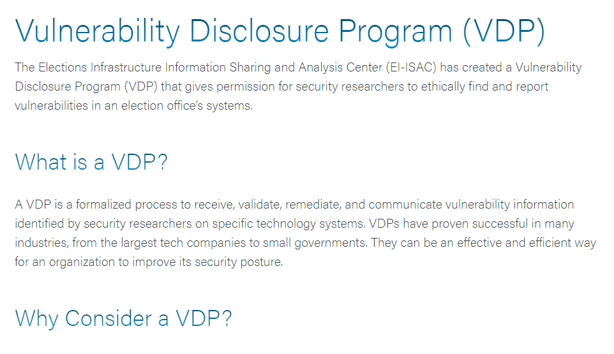
Vulnerability Disclosure Program
Many election organizations simply don't have skilled cybersecurity professionals on staff.
Formalized process to receive, validate, remediate, and communicate vulnerability information identified by security researchers on specific technology systems.
South Carolina and Idaho are initial pilot states

Slide 22
Generative AI
Established your office as a trusted source of information
#TrustedInfo2024
Train/retrain staff on threats – especially phishing
Implement Defense-in-Depth

Slide 23
Physical Safety
Physical safety assessment of your office - CISA
practical recommendations to improve security
Doors, locks, cameras, panic buttons, clear line of sight, etc.
Social media
do not list personal addresses, phone numbers, connections, etc.
Applies to your family members too
Consider purchasing a camera/security system for your home
Set Google/Bing news alerts for your name and organization
Change the routes you take to your office and the time you leave
Talk with local law enforcement!

Slide 24
Join the EI-ISAC
No cost to join
https://learn.cisecurity.org/ei-isac-registration

Slide 25
Virtual Service Review
Meet with the EI-ISAC Team to review your organization’s current status
Review Currently utilized services
New Membership Offerings
Update Contacts
Reserve a time slot with our team today!
elections@cisecurity.org

Slide 26
Thank You!
elections@cisecurity.org

