Slide 1
S.R. 28 Road Reconstruction in Clinton County
Thursday, September 26, 2019
6 p.m.

Slide 2
Welcome
Purpose of public hearing
Format
Visit our sign-in table
Informational handouts
Participate during public comment session
Submit written public comments
Project display area

Slide 3
S.R. 28 Road Reconstruction in Clinton County
INDOT Project Team
INDOT Crawfordsville District
Project Management
Public Involvement
Communications
Design/Engineering
Environmental Analysis
Real Estate
Recognition of elected and local public officials
Sign-in at attendance table to be added to project mailing list
Public hearing notice published in Frankfort Times 9/11 and 9/18
Mailed notification to known property owners within project area
Announcement of this meeting was posted to INDOT website. A media release was also issued
A copy of presentation and project documentation are available for review online via INDOT website

Slide 4
Project Stakeholders
Indiana Department of Transportation
Federal Highway Administration
City of Frankfort
Clinton County
Elected & local officials
Residents and citizens
Commuters
Businesses
Emergency services
Schools
Churches
Community organizations

Slide 5
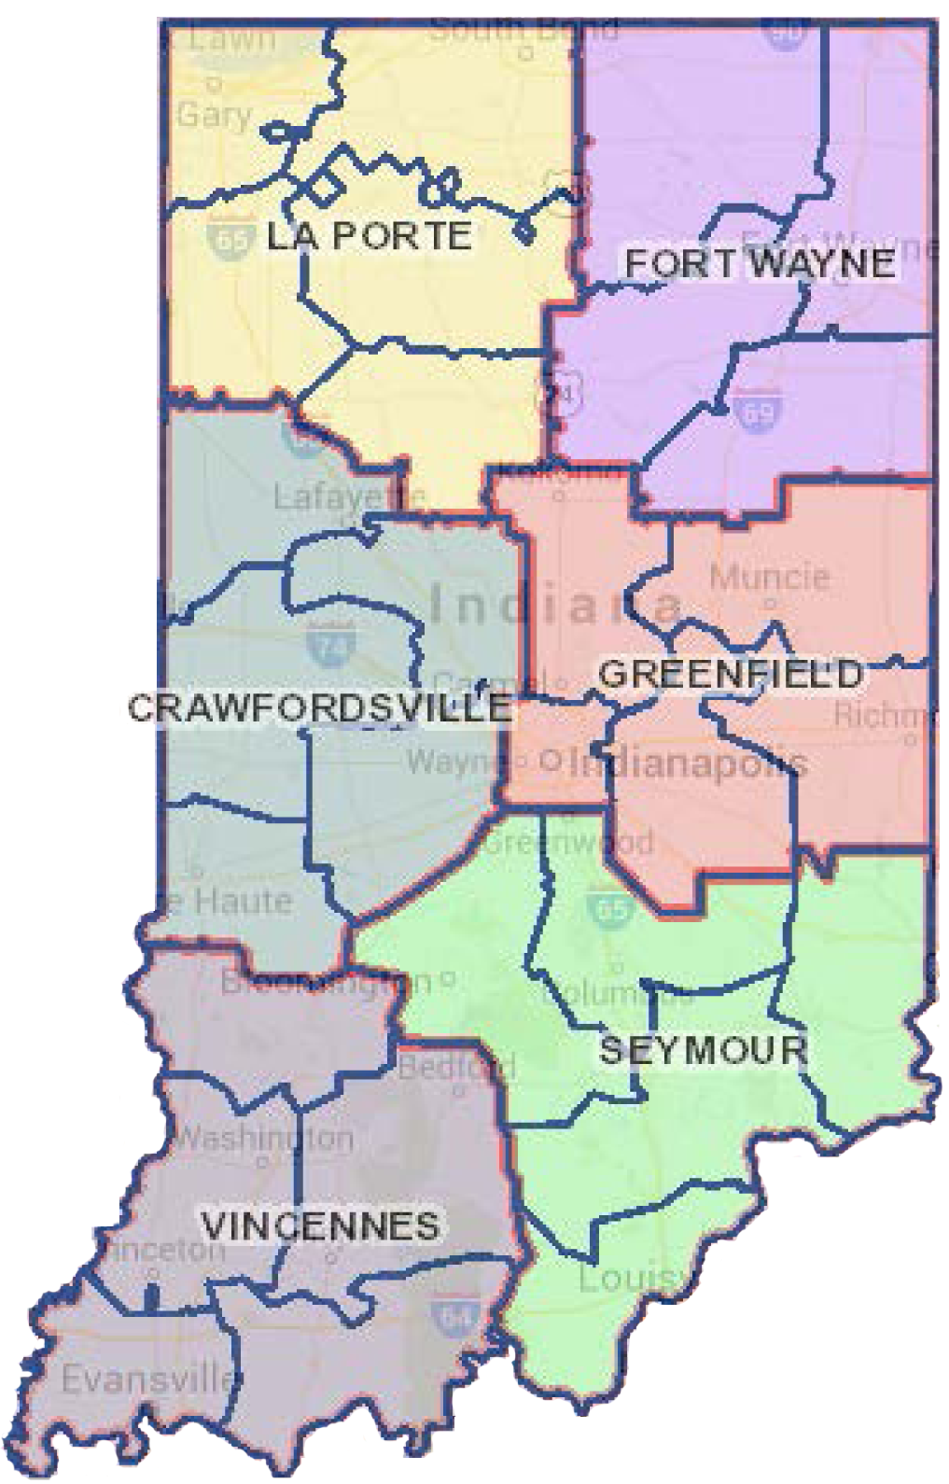
How a Project Becomes a Project
INDOT - Transportation agency for State of Indiana
Six Districts – Central Office is located in Indianapolis
Project Selection
Prioritize needs
Call for Projects
Program projects
4 Year project listing – Statewide Transportation Improvement Program
Project listing can be amended based on needs
Development / Pre-Construction
Requests for – Information, Qualifications, Proposals (RFI, RFQ, RFP)
Consultant team selection
Engineering
Environmental Analysis
Cultural Resource Evaluation
Public Involvement / Community Outreach & Engagement
Design (roadway, bridge)
Utilities Coordination
Real Estate Acquisition – appraising, buying, relocation
Project Delivery / Construction
Project letting – contractor bidding process
Construction, Maintenance, Operations

Slide 6
Project Development
Project Selection
Early Coordination
Purpose & Need
Develop alternatives
Preliminary design phase
Environmental Analysis
PUBLIC INVOLVEMENT
Design
Environmental
Additional public involvement
Project Decision
Real Estate
Project Letting
Construction
Public hearing during environmental analysis phase 2019
Communicate project decision late 2019 / early 2020
Public Involvement:

Slide 7
Environmental Consideration
National Environmental Policy Act (NEPA)
Requires INDOT to analyze and evaluate the impacts of a proposed project to the natural and socio-economic environments
NEPA is a decision-making process
Purpose and Need
Develop & Screen Alternatives
Preferred Alternative – determine a course of action
Impacts are analyzed, evaluated and described in an environmental document
What are the impacts this project might have on the community?
How can impacts be avoided?
Can impacts be minimized?
Mitigation for impacts?
Draft environmental document(s) released for public involvement August 2019
Available for review via public repositories and online

Slide 8
Types of items evaluated
Right-of-way
Streams, Wetlands, and Other Waters
Floodplains
Endangered Species
Farmland
Cultural Resources (Historic/Archaeological)
Parks and Recreational Lands (Trails)
Air Quality
Community Impacts
Public Involvement

Slide 9
Environmental Analysis & Public Involvement
Notice of Entry for Survey
Letters were mailed to properties within general area adjacent to the public right-of-way
Section 106 of National Historic Preservation Act – 2018 thru 2019
Take into account proposal’s impact to historic & archaeological properties
Public invited to participate
Consulting Parties Meeting scheduled 11/1/18
INDOT, FHWA and design consultant attended
Invitations sent to identified local consulting parties, none attended the meeting
Public notice issued with 30-day comment period
Frankfort Times on 2/20/19
“Adverse Effect Finding” finding issued by the Federal Highway Administration (FHWA)
Draft environmental documents released for public involvement – August 2019
Available for review via public repositories and online

Slide 10
Project Resources
INDOT Crawfordsville District Office
41 West 300 North, Crawfordsville, IN 47933
http://www.in.gov/indot/2701.htm
Planning, Project Development/Delivery, Construction, Maintenance for West Central Indiana
Frankfort Community Public Library
208 West Clinton Street, Frankfort, IN 46041
Phone: (765) 654-8746
INDOT Office of Public Involvement
100 North Senate Avenue, Room N642, Indianapolis, IN 46204
Phone: (317) 232-6601
rclark@indot.in.gov
Transportation Services Call Center
Provides citizen and business customers with a single point-of-contact to request transportation services, obtain information, or provide feedback through multiple channels of communications.
855-463-6848 • INDOT4U.com • INDOT@indot.in.gov

Slide 11
S.R. 28 Road Reconstruction – Project Limits
Approximately from intersection of S.R. 28 and C.R. 200 West, proceeding east along S.R. 28 to Hoke Avenue
Project length is 2.4 miles

Slide 12
S.R. 28 Road Reconstruction
Resurface S.R. 28 from C.R. 200 West to Blinn St.
Reconstruct S.R. 28 from Blinn Street eastward to Hoke Avenue
Add right turn lane from (WB) S.R. 28 to (NB) Jackson Street
Reconstruct storm-water system, the sidewalks on the south side of S.R. 28 and replacing the sidewalk on the north side of S.R. 28 with a shared used path

Slide 13
Purpose and Need
Purpose
Address deteriorated pavement condition
Improve safety within the corridor by adding turn lanes at Jackson and Clay intersections
Improve pedestrian and bicycle infrastructure with ADA compliant facilities
Emphasize ADA compliance due to proximity to downtown commercial district, city office building, Ivy Tech campus
Address condition of sidewalks
Bicycle accommodations do not exist along S.R. 28
Need
Pavement condition is in need of repair / reconstruction
Concrete pavement installed in 1971
Most recent asphalt overlay installed in 2015
Curbs within the project limits are in poor condition
High number of vehicular accidents
S.R. 28 at Jackson Street
S.R. 28 at Clay Street

Slide 14
Alternatives Considered
Do Nothing/No Build
Perform routine maintenance only
Does not meet purpose and need
Alternative 1
Replace the existing pavement with full depth pavement
Alternative 2
Rubblize (reduce pavement into rubble) the existing concrete pavement from begin project to Doyal Street, full depth replace asphalt pavement east of Doyal Street.
Alternative 3
Full depth patch, profile mill and place a functional overlay on the existing pavement from begin of project to Doyal Street. Full depth replace asphalt pavement east of Doyal Street
Alternative 4 (Preferred)
Mill & overlay to Blinn and replacement of existing pavement with full depth pavement east of Blinn

Slide 15
Preferred Alternative
Pavement replacement and/or overlay with intersection improvements and pedestrian improvements
Roadway
Mill and overlay from C.R. 200 W to Blinn Street
Full depth replacement from Blinn Street to Hoke Avenue
Dedicated left turn lanes at Clay Street
Right turn lane at west approach leg of S.R. 28 at Jackson Street
Replace existing curbs and gutters, existing storm sewer system, extend storm sewer east on Walnut Street past pavement replacement to Hoke Avenue, extending north to an unnamed tributary
Bridge Deck overlay at Prairie Creek with repairs to curb and sidewalk on bridge
Sidewalk
5-foot wide concrete sidewalk will be reconstructed along the south side of S.R. 28 from Blinn Street to Hoke Avenue to replace the existing sidewalk that started at West St.
8-foot wide asphalt/concrete multi-use path will be constructed on the north side of S.R. 28 from C.R. 200W to Hoke Ave.
Provide tree lawn between sidewalk/shared use path and curb – varying locations
Trees will be replaced in the Historic District east of Prairie Creek
New Rail crossing equipment

Slide 16
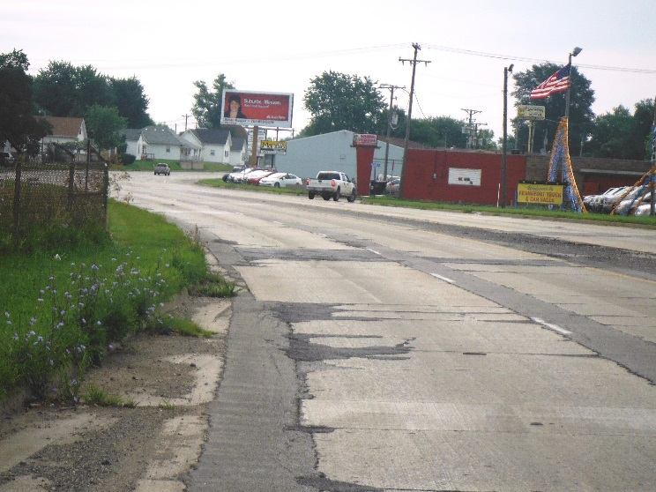
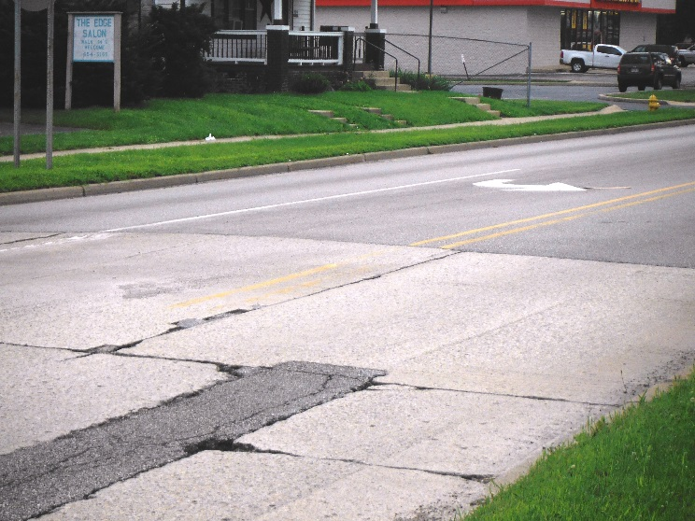
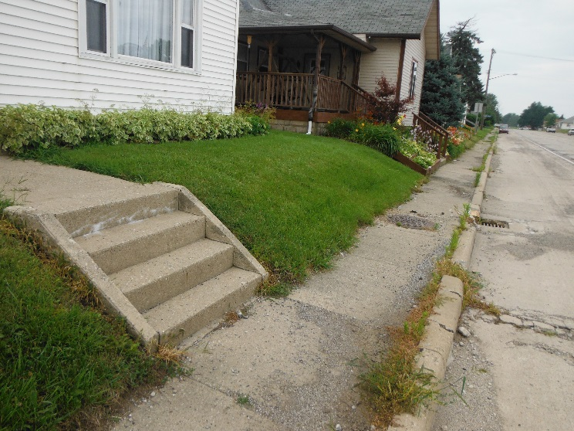
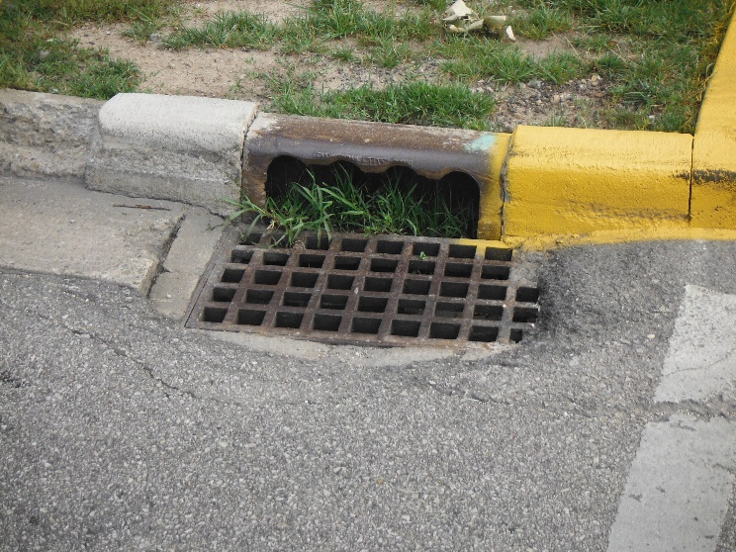
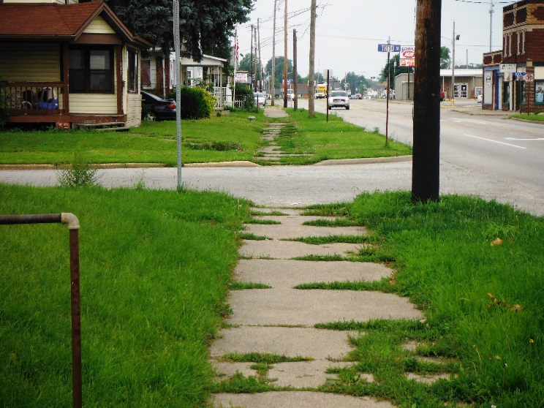
Existing Roadway
Failing Pavement
Poor Drainage
Curbs and Sidewalks in Disrepair

Slide 17
Typical Section
12-ft wide travel lanes
New Curb & gutter
8-ft wide multi-use path along the north side
5-ft wide sidewalk along the south side
2-way left turn lane from west end to Clay St.
Full depth pavement replacement east of Blinn
Improved Drainage - new inlets and storm sewers

Slide 18
Maintenance of Traffic
Maintain local access to all businesses and residences during construction by maintaining one lane of traffic in the westbound direction.
Traffic will be phased with construction west of Jackson Street in 2020 and construction east of Jackson Street in 2021.
While each of these sections is under construction the eastbound traffic will be detoured and the westbound will remain open to one lane of traffic.

Slide 19
Maintenance of Traffic – Detour 1

Slide 20
Maintenance of Traffic – Detour 2

Slide 21
Real Estate

Slide 22
Real Estate Acquisition Process
Uniform Act of 1970
All federal, state and local governments must comply
Requires an offer for just compensation
Acquisition Process
Appraisals
Review Appraisals
Negotiations
Right-of-way (ROW)
Permanent
Permanent ROW is land, once purchased by INDOT from the legal land owner, becomes ROW owned by INDOT
Approximately 0.3 acre required for improvement
Temporary
Temporary ROW is land required during the construction of a project and is used for the purposes of construction-related activity
INDOT pays legal land owner a fee for land use during construction
Approximately 0.4 acre required for improvement

Slide 23
Project Schedule
Preliminary design, evaluate community and environmental impact 2019
Public Hearing 2019
Complete Environmental Analysis Phase 2019
Real estate acquisition activities 2019-2020
Appraising
Negotiations/buying
Utilities relocations 2019 - 2020
Construction 2020 - 2021

Slide 24
Submit Public Comments
Submit public comments using the options described in first page of information packet:
Public Comment Form
Via e-mail
Participate during public comment session following formal presentation
INDOT respectfully requests comments be submitted by Monday, October 14, 2019
All comments submitted will become included in an official public hearings transcript and made part of the public record
Comments will be reviewed, evaluated and given full consideration during decision-making process

Slide 25
Next Steps
Public and project stakeholder input
Submit comments via options described on page 1 of information packet
INDOT review and evaluation
All comments given full consideration during decision-making process
Finalize/approve environmental document, complete project design
Communicate a decision
INDOT will notify project stakeholders of decision
Work through local media, social media outlets, paid legal notice
Make project documents accessible via repositories
Questions? Contact Public Involvement Team

Slide 26
Thank You
Please visit with INDOT project team following the presentation and public comment session
Project Open House
Project maps, displays, INDOT project team and informal Q & A
INDOT Crawfordsville District page http://www.in.gov/indot/2701.htm

