Slide 1
INVESTIGATING FRAUD, WASTE AND ABUSE
© IHCDA 2021

Slide 2
Purpose of investigating fraud, waste and abuse
Ensure Benefits are allotted in correct amounts and only to those individuals who are eligible
Recover tax dollars obtained by participants through fraudulent activities, unintentional participant error, administrative error or non-compliance
Deter future occurrences of fraud or non-compliance within all programs to help maintain program integrity
©IHCDA 2021

Slide 3
terms
Fraud: wrongful or criminal deception intended to result in financial or personal gain
Waste: consuming, spending or expending thoughtlessly or carelessly
Abuse: misusing or using improperly or excessively
Non-compliance: failure of the individual participant to act in accordance with the rules and regulations of the specific assistance program(s)
©IHCDA 2021

Slide 4
Is it fraud?
FRAUD:
Participant intentionally fails to report changes in his or her circumstances in a timely manner in order to receive benefits for which he or she is not eligible
Participant knows that the information he or she provides is false
Participant intends to gain something of value
NOT FRAUD:
Participant provides incorrect information by mistake
Participant is unaware of responsibility to provide certain information
Participant provides false information for reasons other than financial or personal gain
©IHCDA 2021

Slide 5
Early detection and prevention
Thoroughly train all intake workers on:
Conducting detailed eligibility interviews
Identifying cases that need to be referred to their supervisor
Check any applicable Ineligibility Lists
Make sure all applications are fully completed and no information is missing or doesn’t make sense
©IHCDA 2021

Slide 6
Beginning of investigation
Even though early detection and prevention are utilized, there will still be situations where people receive benefits they are not entitled to
Notification is usually through a whistleblower, an anonymous tip or an agency monitoring
©IHCDA 2021

Slide 7
investigation
Investigation: detailed examination or search to determine if an individual has committed an act of non-compliance or fraud and/or received benefits to which they were not entitled, resulting in a claim
©IHCDA 2021

Slide 8
Investigative steps
In-House Investigation: things that can be done at the agency through the agency’s database and records
1. Determine eligibility factors
If there is a specific eligibility question for the applicable time period, consult the appropriate Guidelines or Manual(s) for that time period
©IHCDA 2021

Slide 9
In-house investigation
2. Review background information
Previous application(s)
Relevant database(s)
Public and Government websites
©IHCDA 2021

Slide 10
In-house investigation
Does the information received from the applicant conflict with any information found during the background check or received from an informant?
©IHCDA 2021

Slide 11
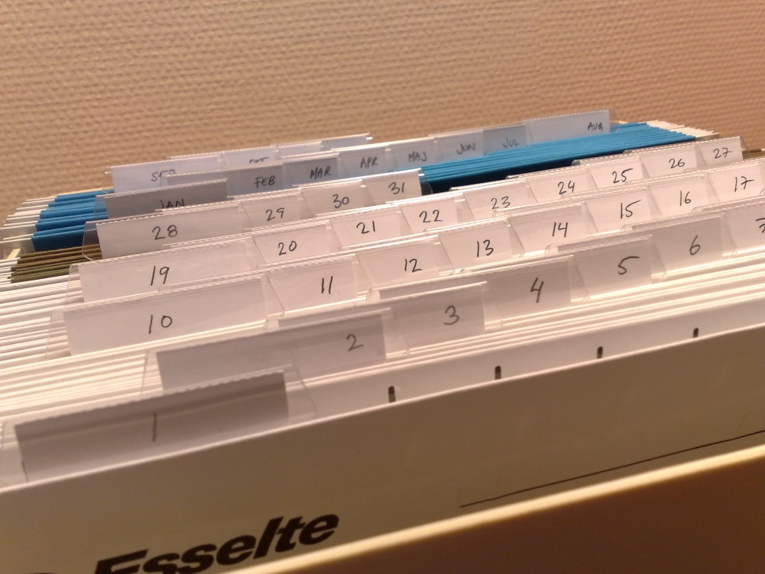
documentation
Document each step taken in the course of the investigation in chronological order
Include investigator notes as well as copies of relevant documents
Important not just for agency records, but for situations where law enforcement will also be involved
©IHCDA 2021

Slide 12
documentation
Six basic questions to consider while collecting information during the course of any investigation:
©IHCDA 2021

Slide 13
Who?
©IHCDA 2021

Slide 14
What?
©IHCDA 2021

Slide 15
When?
©IHCDA 2021

Slide 16
Where?
©IHCDA 2021

Slide 17
Why?
©IHCDA 2021

Slide 18
How?
©IHCDA 2021

Slide 19
Potential sources to assist with investigation
©IHCDA 2021

Slide 20
1. Employment records
Does the name match on the income documentation?
Does the social security number match on the award letter or tax return?
Does the participant work for the State of Indiana?
Are there tax deductions for children?
©IHCDA 2021

Slide 21
2. Utility and phone bill
Contact utility and phone service providers to determine:
Who is billed?
Who pays for the service?
Billing address
©IHCDA 2021

Slide 22
3. Landlord or mortgage company
Does the landlord know who lives in the rental property?
Who is a party to the rental agreement?
Who pays the mortgage?
©IHCDA 2021

Slide 23
4. Courthouse and/or recorders office records
Look at records of the participant or property owner concerning:
Loans
Judgments
Mortgages
Real estate transfers
Search divorce, custody and marriage records
Odyssey Court Records: mycase.in.gov
Beacon Property Records: https://beacon.schneidercorp.com
Doxpop Public Records (fee): https://www.doxpop.com
Local County Assessor Records
©IHCDA 2021

Slide 24
5. Sheriff or police department (If available)
Are there any records of local law enforcement calls or investigations?
Did law enforcement make a trip to the participant’s address?
Did law enforcement list the names of all persons living there?
©IHCDA 2021

Slide 25
confidentiality
The more people who know about an investigation, the greater the chances of the subject finding out.
©IHCDA 2021

Slide 26
Final steps
After violation has been corroborated, action needs to be taken.
Action needs to be taken against participant’s application or against benefits if they have already been distributed.
Action taken can range from the rejection of the application to the termination of benefits and request for repayment of funds.
Case can also be submitted to Federal Officials if the situation warrants.
©IHCDA 2021

Slide 27
IHCDA involvement
IHCDA Program Staff and Staff Attorney are available to assist during any phase of investigation.
Be sure to make IHCDA Program Staff aware of all substantiated acts of fraud, waste and abuse.
IHCDA Program Staff will then contact the IHCDA Staff Attorney if the situation warrants.
©IHCDA 2021

Slide 28
REPORT FRAUD, WASTE AND ABUSE
Please help us protect tax dollars and ensure the integrity of our programs by reporting suspected fraud, waste, abuse or gross mismanagement of programs.
If you believe that you have information regarding possible fraudulent activities, please let us know by completing this online form: http://form.jotform.com/IHCDA/fraud
A link to the online form can also be found on both the IHCDA partner and consumer websites.
©IHCDA 2021

Slide 29
appeals
The Appeals Process is in place
to allow applicants or participants
redress if they object to certain
decisions or determinations of the
Agency.
The process is outlined in each
program’s guidance manual and
IHCDA Legal is always available
to assist with any interpretations
or questions.
It’s very important that the procedures in the guidelines be followed, such as notice
and timelines. This makes the IHCDA review process a lot easier.
©IHCDA 2021

Slide 30
subpoenas
Indiana Trial Rule 34(C) allows a
party to issue a request to a
non-party for the production of
documents, writings, etc.
This request is done through a
Subpoena Duces Tecum. In the
past, pursuant to Trial Rule 34(C),
we have contacted the requesting
party (in writing) and generally
objected to providing the requested
information without an Order from
the court. Our objection was
based on Federal requirements of confidentiality. If you are ever issued a
subpoena, be sure to immediately notify the IHCDA Legal Dept.
©IHCDA 2021

Slide 31
QUESTIONS…
©IHCDA 2021

Slide 32
IHCDA Contact:
DAVID W. STEWART General Counsel Indiana Housing and Community Development Authority PHONE 317-234-6980 OR 800-872-0371 EMAIL dstewart2@ihcda.in.gov
©IHCDA 2021

