Slide 1
Individual Unemployability

Slide 2
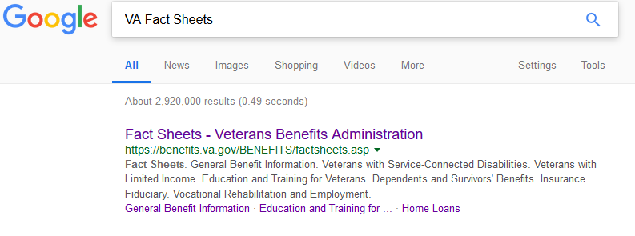
Individual Unemployability (IU)
FIRST:
Get the Facts for your veteran
Get your Google On!

Slide 3
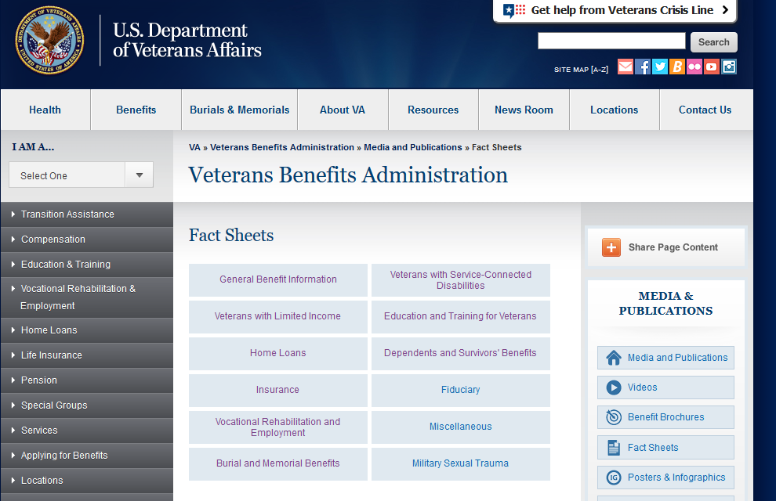
Individual Unemployability (IU)
The Fact Sheets on https://benefits.va.gov/BENEFITS/factsheets.asp
Always updated
Easy to print
Well explained

Slide 4
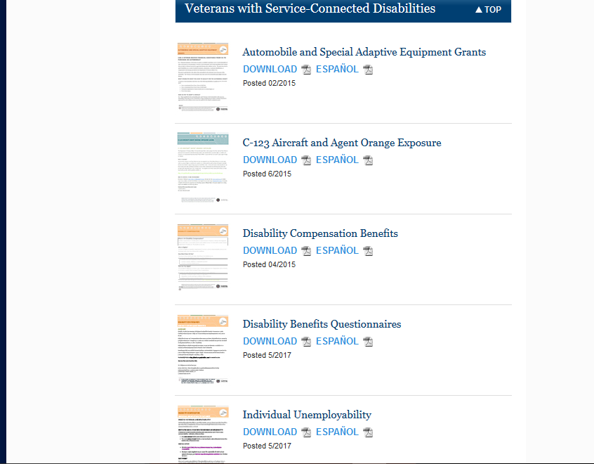
Individual Unemployability (IU)

Slide 5
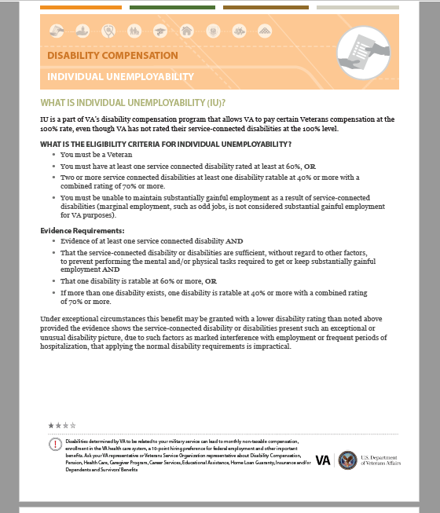
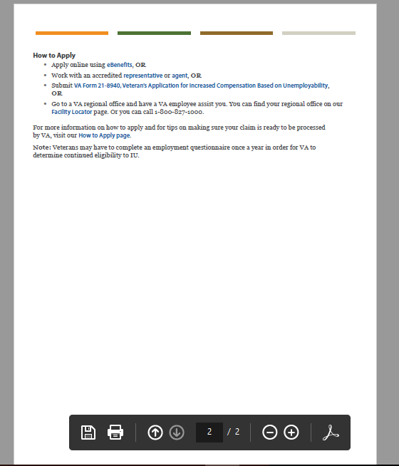
Individual Unemployability (IU)

Slide 6
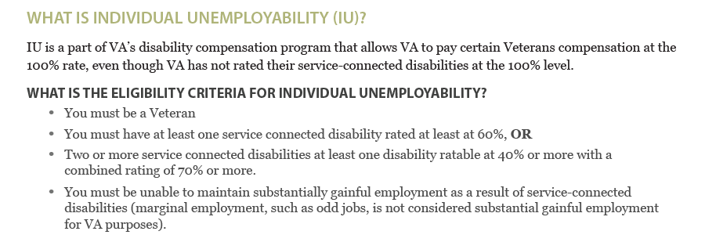
Individual Unemployability (IU)

Slide 7
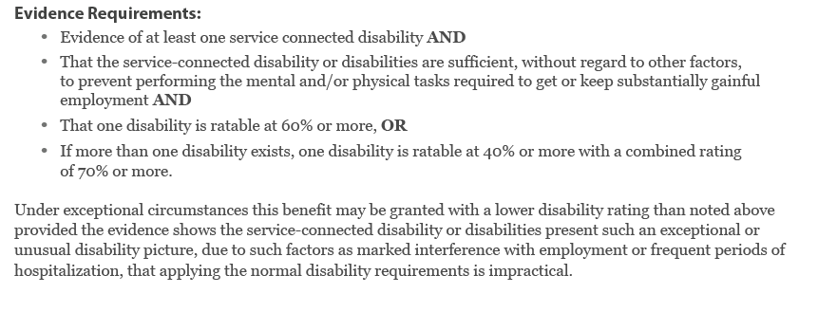
Individual Unemployability (IU)

Slide 8
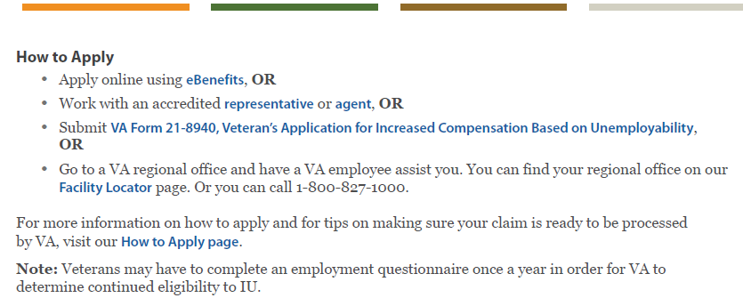
Individual Unemployability (IU)
In Indiana, your CVSO!

Slide 9
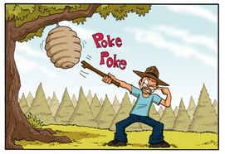
Individual Unemployability (IU)
“sometimes it is best to not poke the beehive…”
- DAV National Service Officer
Discussion Points with veterans seeking IU claims:
To the VA “Sedentary Work” is based on ability not training
C&P will review ALL Service Connected Disabilities
There is potential to have Combined Rating reduced
It is good practice to have the veteran discuss his/her IU claim with their POA.

Slide 10
Individual Unemployability (IU)
Q & A

