Slide 1
U.S. 12, U.S. 20 Reconstruction and Realignment in Lake County Des. No. 1601716 & 1801738
Indiana Department of Transportation
Thursday, July 11, 2019
6:00 p.m.

Slide 2
Welcome
Purpose/Explanation of Public Hearing
Presentation Format
Project Description
Maintenance of Traffic
Right-of-Way Impacts
Anticipated Project Costs and Schedule
Environmental Document – Impacts to Natural and Human Environment
Land Acquisition Process
Public Comment Session
Project Open House
Visit our sign-in table for informational handouts

Slide 3
U.S. 12, U.S. 20 Reconstruction & Realignment
Introduction of INDOT Project Team
Project Management
Public Involvement
LaPorte District – INDOT Regional Office
Environmental Services
American Structurepoint, Inc.
Engineering, Design & Environmental Analysis Team
Recognition of elected and local public officials
Sign-in at attendance table to be added to project mailing list
Legal notice of public hearing was published in the Times of Northwest Indiana on 6/24, 7/1 and 7/9
A notice of the public hearing was mailed to known property owners within project area
Announcement of this hearing was posted to INDOT website. A media release was also issued
A copy of presentation and project documentation are available for review on-line via INDOT website

Slide 4
Project Stakeholders
Indiana Department of Transportation
Indiana Division Federal Highway Administration
Lake County
City of Gary
Elected & local officials
Residents and citizens
Commuters
Businesses
Emergency services
Schools
Churches
Community Organizations

Slide 5
Project Development
Project Selection
Early Coordination
Environmental phase begins
Purpose & Need
Develop alternatives
Preliminary design phase
Release environmental document for public review and comment
HOLD PUBLIC HEARING
Additional work to finalize environmental document and project design
Communicate Project Decision
Project Letting
Construction

Slide 6
Environmental Analysis Phase
National Environmental Policy Act (NEPA)
Requires INDOT to analyze and evaluate the impacts of a proposed project to the natural and socio-economic environments
NEPA is a decision-making process
Purpose and Need
Alternatives Screening
Preferred Alternative
Impacts are analyzed, evaluated and described in an environmental document
What are the impacts this project might have on the community?
How can impacts be avoided?
Can impacts be minimized?
Mitigation for impacts?

Slide 7
Types of items evaluated
Right-of-way
Streams, Wetlands, and Other Waters
Floodplains
Endangered Species
Farmland
Cultural Resources (Historic/Archaeological)
Parks and Recreational Lands (Trails)
Air Quality
Community Impacts
Public Involvement

Slide 8
Environmental Analysis Phase
Natural Environment
Wetlands and Waterways
A Wetland Delineation and Waters Report was approved on January 23, 2018 by INDOT Ecology and Waterway Permitting Office
No water resources were identified within the project area
Threatened, Endangered & Rare Species
No high-quality natural communities were identified within the project area
The project will clear approximately 0.75 acre of woody vegetation
All applicable time-of-year clearing restrictions will be followed
Floodplains
No floodplains present

Slide 9
Environmental Analysis Phase
Human Environment
Cultural Resources
Three historic properties were identified and evaluated within the project vicinity
A “No Adverse Effect” finding was issued for this project by INDOT Cultural Resources Office (CRO) acting on behalf of the Federal Highway Administration (FHWA)
Hazardous Materials
Multiple sites have the potential for hazardous material concerns within the project area
A Phase II Environmental Site Assessment is currently being conducted and results are forthcoming
Social & Community
Temporary impacts from construction
Benefit from improved pedestrian facilities and train transportation expansion
Environmental Justice (EJ)
Elevated minority populations were identified within the project area
Due to the scope of work and lack of social and community impacts, no disproportionately high and adverse impacts were identified for this population
Noise
This project was determined to be a Type III project, therefore no formal noise analysis is required

Slide 10
Environmental Analysis Phase
Public Involvement
Notice of Entry for Survey – 2017
Describe early project proposal
Project personnel in area, may need to enter properties
Collect data for environmental analysis
Section 106 of National Historic Preservation Act – 2018
Consulting Parties Process
Groups invited to participate
Public notice issued with 30 day comment period
Published in the Times of Northwest Indiana
“No Adverse Effect” finding issued by INDOT CRO acting on behalf of the FHWA
Draft environmental document released for public involvement – May 2019
Available for public review
Available locations on next slide

Slide 11
Project Resource Locations
INDOT LaPorte District Office
315 E. Boyd Boulevard, LaPorte, IN 46350
http://www.in.gov/indot/2705.htm
Planning, Project Development/Delivery, Construction, Maintenance for Northwest Indiana
Gary Public Library – Carter G. Woodson Branch
501 South Lake Street, Gary, Indiana 46403
Phone: (219) 886-2484
INDOT Office of Public Involvement
100 North Senate Avenue, Room N642, Indianapolis, IN 46204
Phone: (317) 232-6601
rclark@indot.in.gov
PROJECT WEBPAGE: https://www.in.gov/indot/3958.htm
Transportation Services Call Center
Provides citizen and business customers with a single point-of-contact to request transportation services, obtain information, or provide feedback through multiple channels of communications.
855-463-6848 • INDOT4U.com • INDOT@indot.in.gov

Slide 12
U.S. 12, U.S. 20 – Purpose and Need
Purpose
Facilitate the Northern Indiana Commuter Transportation District (NICTD) expansion of the Miller Train Station and double track improvement project
Maintain surrounding vehicular and pedestrian routes able to accommodate increased ridership
Need
Create space for NICTD double track improvement project and expansion of Miller Train Station
Address lack of pedestrian facilities
Enhance limited sidewalk in project area, address ADA non-compliance

Slide 13
Existing Conditions
Miller Train Station
Current US 12 and US 20 Intersection

Slide 14
Proposed Design - Overview

Slide 15
Proposed Design –Intersections
US 12 and US 20
The current intersection west of Clay Street will be removed
The new intersection, east of Lake Street, will be stop controlled
Traffic along US 12 will stop and yield to traffic along US 20
US 12 and Clay Street
Pavement from the current US 12 and US 20 intersection to Clay Street will be removed
The current 4-way stop will be removed and only traffic traveling west along US 12, east of Clay Street, will have a stop sign
US 12 and Lake Street
The current traffic light at US 12 and Lake Street will be removed
This will no longer be an intersection as pavement along US 12 will be removed
US 20 and Lake Street
This intersection will be enhanced with pedestrian safety features

Slide 16
Proposed Design – US 20 and Lake Street
Improvements along US 20 and Lake Street
Addition of sidewalks, with ADA-compliant curb ramps
New curb and gutter
Enclosed storm drainage system
Decorative lighting
Landscaping consisting of trees where feasible
Crosswalk markings, pedestrian refuge islands, and pedestrian push-button signals at the US 20 and Lake Street intersection
Bike lanes and parallel parking along Lake Street

Slide 17
Maintenance of Traffic
Closure of US 12 at the current US 20 intersection, west of Clay Street
Traffic will be detoured along US 20 and SR 249
Access to local residences and businesses will be maintained utilizing Clay Street
Partial closures along US 20 and Lake Street
A minimum of one lane will be maintained in each direction during construction

Slide 18
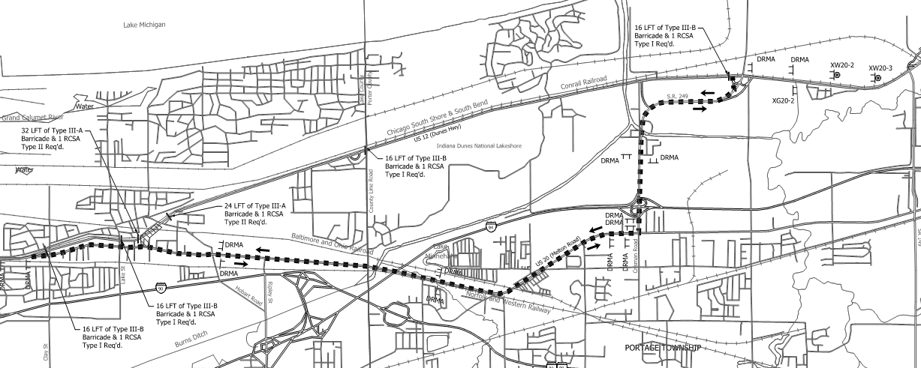
Maintenance of Traffic

Slide 19
Other Alternatives Considered
No Build
Leaves the existing transportation system as-is
Does not meet the purpose and need
Improvement of US 12 and Lake Street Intersection
Does not include the new alignment connection US 12 and US 20
Would not provide the space needed for the Miller Train Station expansion
Does not meet the purpose and need
Realignment of US 12 to US 20 – 0.2 mile east of Lake Street
Similar to the proposed alternative, but would provide more desirable geometrics
Meets the purpose and need
Would require the relocation of Mosley Motel

Slide 20
Real Estate Acquisition Process

Slide 21
Real Estate Acquisition Process
"Uniform Act of 1970"
All federal, state and local governments must comply
Requires an offer for just compensation
Acquisition Process
Appraisals
Review Appraisals
Negotiations
Building Removal
One vacant structure to be removed
0.2 mile east of Lake Street between U.S. 12 and U.S. 20
INDOT Real Estate Team to work with impacted property owners
Right-of-Way (ROW)
Permanent ROW
Land, once purchased by INDOT from legal land owner, becomes ROW owned by INDOT
Project requires approximately 3 acres of new permanent ROW
Existing apparent ROW (3 acres) INDOT acquired land by Highway Grant some years ago, transactions in some cases were not properly recorded, requires further action by INDOT
Temporary ROW
Land (0.1 acre) required during the construction of a project and is used for the purposes of construction-related activity
INDOT pays legal land owner a fee for land use during construction and/or as part of construction-related activities

Slide 22
Right-of-Way
Amount (acres)
Land Use Impacts | Permanent | Temporary | Reacquisition
Residential | 0.379 | 0.028 | 0.056
Commercial | 5.293 | 0.046 | 2.997
Agricultural | 0.0 | 0.0 | 0.0
Forest | 0.0 | 0.0 | 0.0
Wetlands | 0.0 | 0.0 | 0.0
Other: Government owned property | 0.506 | 0.012 | 0.0
TOTAL | 6.178 | 0.086 | 3.053
Note: Values shown are estimated
No relocations will take place as a result of this project
One vacant structure, a former business located approximately 0.2 mile east of Lake Street between US 12 and US 20, will be removed to accommodate the new alignment of US 12

Slide 23
Project Schedule and Estimated Cost
Project Schedule
Complete environmental analysis phase – Summer 2019
Right-of-Way acquisition activities – Fall 2019
Construction anticipated to begin - 2021
Estimated Cost
5.5 million
Federal (80%) and Local (20%) funding sources

Slide 24
Submit Public Comments
Submit public comments using the options described in first page of information packet:
Public Comment Form
Via e-mail
Participate during public comment session following formal presentation
INDOT respectfully requests that comments be submitted by Friday, Aug. 2, 2019
All comments submitted will become included in an official public hearings transcript and made part of the public record
Comments will be reviewed, evaluated and given full consideration during decision-making process

Slide 25
Next Steps
Public and project stakeholder input
Submit comments via options described on page 1 of information packet
INDOT review and evaluation
All comments given full consideration during decision-making process
Finalize/approve environmental document, complete project design
Communicate a decision
INDOT will notify project stakeholders of decision
Work through local media, social media outlets, paid legal notice
Make project documents accessible via repositories
Questions? Contact Public Involvement Team

Slide 26
Project Resource Locations
INDOT LaPorte District Office
315 E. Boyd Boulevard, LaPorte, IN 46350
http://www.in.gov/indot/2705.htm
Planning, Project Development/Delivery, Construction, Maintenance for Northwest Indiana
Gary Public Library – Carter G. Woodson Branch
501 South Lake Street, Gary, Indiana 46403
Phone: (219) 886-2484
INDOT Office of Public Involvement
100 North Senate Avenue, Room N642, Indianapolis, IN 46204
Phone: (317) 232-6601
rclark@indot.in.gov
PROJECT WEBPAGE: https://www.in.gov/indot/3958.htm
Transportation Services Call Center
Provides citizen and business customers with a single point-of-contact to request transportation services, obtain information, or provide feedback through multiple channels of communications.
855-463-6848 • INDOT4U.com • INDOT@indot.in.gov

Slide 27
Thank You
Please visit with the design team and INDOT project officials following the presentation and Q & A.
Project Open House
Project maps, displays, INDOT project team and informal Q & A
INDOT LaPorte District page: http://www.in.gov/indot/2705.htm
LaPorteDistrictCommunications@indot.in.gov

