Slide 1
S.R. 26 Road Rehabilitation in Clinton County
Thursday, June 7, 2018
6:00 p.m.

Slide 2
Welcome
Purpose of public meeting
Format
Visit our sign-in table
Informational handouts
Participate during public comment session
Submit written public comments
Project display area

Slide 3
S.R. 26 Road Rehabilitation in Clinton County
INDOT Project Team
INDOT Crawfordsville District
Project Management
Public Involvement
Communications
Design/Engineering
Environmental Analysis
Real Estate
Recognition of elected and local public officials
Sign-in at attendance table to be added to project mailing list
Public meeting notice mailed to known property owners within project area
Announcement of this meeting was posted to INDOT website. A media release was also issued
A copy of presentation and project documentation are available for review on-line via INDOT website

Slide 4
Project Stakeholders
Indiana Department of Transportation
Federal Highway Administration
Clinton County
Elected & Local officials
Residents and citizens
Commuters
Businesses
Emergency services
Schools
Churches
Community Organizations

Slide 5
Project Development
Project Selection
Early Coordination
Purpose & Need
Develop alternatives
Preliminary design phase
Environmental Analysis
PUBLIC INVOLVEMENT
Design
Environmental
Additional public involvement
Project Decision
Real Estate
Project Letting
Construction
June Public Information Meeting
Public involvement during environmental analysis phase
Communicate project decision
Public Involvement:

Slide 6
Environmental Consideration
National Environmental Policy Act (NEPA)
Requires INDOT to analyze and evaluate the impacts of a proposed project to the natural and socio-economic environments
NEPA is a decision-making process
Purpose and Need
Develop & Screen Alternatives
Preferred Alternative – determine a course of action
Impacts are analyzed, evaluated and described in an environmental document
What are the impacts this project might have on the community?
How can impacts be avoided?
Can impacts be minimized?
Mitigation for impacts?
Draft environmental document to be released later this year for public involvement
Will be made available for review via public repositories

Slide 7
Types of items evaluated
Right-of-way
Streams, Wetlands, and Other Waters
Floodplains
Endangered Species
Farmland
Cultural Resources (Historic/Archaeological)
Parks and Recreational Lands (Trails)
Air Quality
Community Impacts
Public Involvement

Slide 8
S.R. 26 Road Rehabilitation – Project Limits
Approximately from Rossville to Russiaville
One-half mile east of U.S. 421 to two miles west of Russiaville

Slide 9
Purpose and Need
Purpose
Enhance safety within the corridor
Preserve and extend the usable service life of the existing roadway
Need
Evidence of pavement deterioration
Roadway flooding due to undersized and debris-filled culverts under S.R. 26
Narrow travel lanes
Lack of shoulders
Substandard vertical sight distance

Slide 10
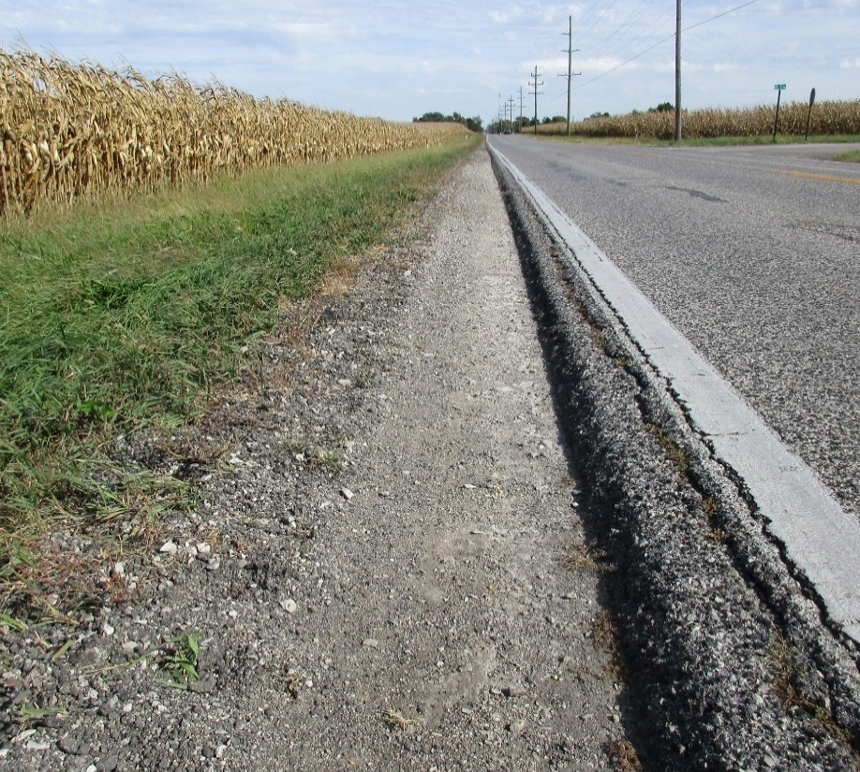
Existing Roadway
11ft travel lanes
No shoulder
Utility poles close to roadway
Pavement failing at edge due to lack of lateral support

Slide 11
Vehicular Accident Data
Years 2013 through 2015
SEVERITY | 2013 | 2014 | 2015 | Total
No Injury | 42 | 39 | 34 | 115
Non-Incapacitating Injury | 9 | 8 | 4 | 21
Incapacitating Injury | 2 | 4 | 6 | 12
Fatal | 0 | 1 | 1 | 2
TOTALS | 53 | 52 | 45 | 150

Slide 12
Proposed Improvements
Increasing lane widths
Provide roadside shoulders
Improve drainage
Modify and/or replace culverts
Install rumble striping
Vertical improvements to increase sight distance
Improve sidewalk (areas with existing sidewalk)
Adding a turning lane
S.R. 26 at S.R. 75
Other improvements

Slide 13
Rumble Striping

Slide 14
Typical Section
12’ wide travel lanes
West of S.R. 29: 2ft paved with 6ft stone shoulders
East of S.R. 29: 2ft paved with 4ft stone shoulders
Improved ditch drainage
Widen and rehabilitate existing pavement
Full pavement replacement in some areas

Slide 15
Maintenance of Traffic
Maintain local access to all residences, farm fields and businesses during construction using county roads, temporary entrances or other appropriate means
Close S.R. 26 to through-traffic during construction
Detour through-traffic to state maintained routes using portions of U.S. 421, S.R. 18, S.R. 75, S.R. 29, S.R. 28, U.S. 31 and S.R. 931
Local access maintained via local roads during culvert construction

Slide 16
Maintenance of Traffic – Detour 1

Slide 17
Maintenance of Traffic – Detour 2

Slide 18
Maintenance of Traffic – Detour 3

Slide 19
Project Schedule
Preliminary design, evaluate community and environmental impact – Spring/Summer 2018
Public Involvement – Fall 2018
Environmental Analysis Phase – Winter 2018 thru 2019
Real estate acquisition activities – 2019
Appraising
Negotiations/buying
Utilities coordination/relocation
Construction – 2020 thru 2021

Slide 20
Real Estate

Slide 21
Real Estate Acquisition Process
"Uniform Act of 1970"
All federal, state and local governments must comply
Requires an offer for just compensation
Acquisition Process
Appraisals
Review Appraisals
Negotiations
INDOT Real Estate Team to work with impacted property owners
Right-of-way
Permanent R/W
Permanent ROW is land, once purchased by INDOT from legal land owner, becomes ROW owned by INDOT
Temporary R/W
Temporary ROW is land required during the construction of a project and is used for the purposes of construction related activity
INDOT pays legal land owner a fee for land use during construction

Slide 22
Submit Public Comments
Submit public comments using the options described in first page of information packet:
Public comment form
Via e-mail
Participate during public comment session following formal presentation
Comments will be reviewed, evaluated and given consideration as part of the INDOT decision making process
INDOT Customer Service
1-855-463-6848 (1-855-INDOT4U)
INDOT4U.com
INDOT@indot.in.gov

Slide 23
Next Steps
Public and project stakeholder input
Submit comments via options described on page 1 of information packet
INDOT review and evaluation
All comments are given full consideration during decision-making process
Continue project development activities
Preliminary design, engineering and environmental analysis
Public Involvement Team
Additional public involvement activities to be scheduled as project development continues

Slide 24
Project Resource Locations
INDOT Crawfordsville District Office
41 West 300 North, Crawfordsville, Indiana 47933
Planning, Project Development/Delivery, Construction, Maintenance for West Central Indiana
District Webpage http://www.in.gov/indot/2701.htm
INDOT Customer Service
1-855-463-6848 INDOT@indot.in.gov
INDOT Office of Public Involvement
100 North Senate Avenue, Room N642, Indianapolis, IN 46204
Phone (317) 232-6601
rclark@indot.in.gov

Slide 25
Thank You
Please visit with INDOT project team following the presentation
Project Open House
Project maps, displays, INDOT project team and informal Q & A
INDOT Crawfordsville District page http://www.in.gov/indot/2701.htm

