Slide 1
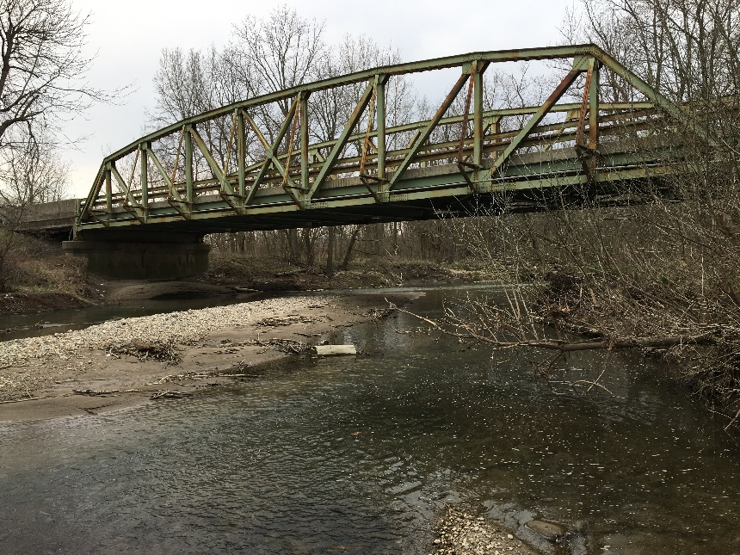
Public Hearing
US-421 over South Fork Wildcat Creek
Historic Bridge Rehabilitation
Bridge No. (421) 39-12-01792B
Des. No. 1593276
6:30 PM
Friday, September 04, 2020
TPA Park
Large Pavilion
©2018 GAI CONSULTANTS

Slide 2
Presentation Agenda
Purpose of the Hearing
Hearing Comment Process
Overview of Environmental Document
Review of Project Design
Right-of-Way
Project Schedule

Slide 3
Public Hearing
Conducted as requirement of the National Environmental Policy Act (NEPA)
Condition of Programmatic Agreement Regarding Management and Preservation of Indiana’s Historic Bridges (Stipulation III.A.7)
Requires the evaluation of the environmental impacts (direct, indirect, and cumulative) of the project to the natural and social environments
Requires the opportunity for the public to be involved and comment in the decision making process
Impacts are described in the environmental document prepared for the project
Environmental document was released for public involvement on March 12, 2020.

Slide 4
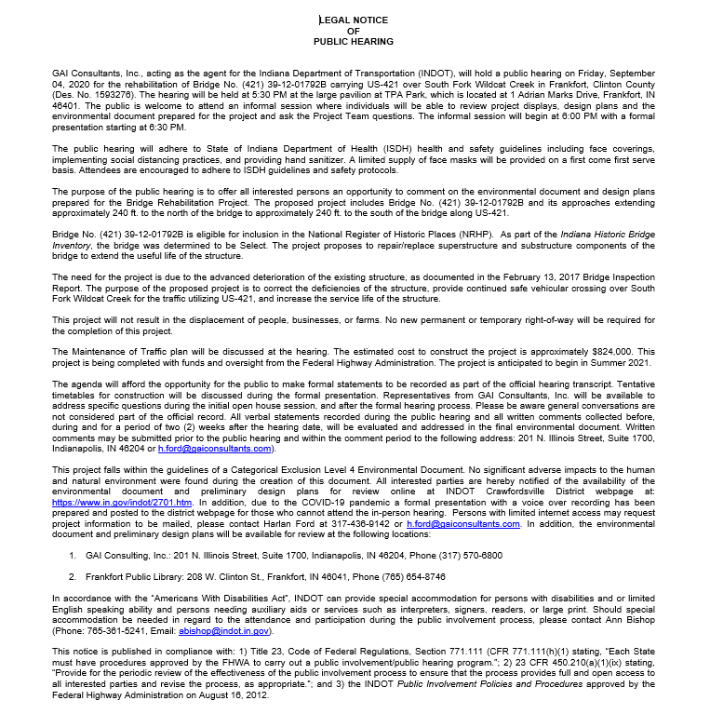
Notice of Public Hearing
Advertised in The Times Newspaper:
August 15, 2020
August 22, 2020
Project Information packet available online
Contains specific project details

Slide 5
How to Submit a Public Comment
There are several ways in which you can provide comments.
Mail or Fax comments to GAI
Email comments to GAI
Attend the In-person Hearing.
Statement made during the public comment session
Complete comment sheet and leave in comment box
After the Hearing
Mail or Fax comments to GAI
Email comments to GAI
Comment Deadline: September 19, 2020
Comments will be reviewed, evaluated, and given full consideration during the decision-making process

Slide 6
Environmental Document
Processed as a Level 4 Categorical Exclusion
Select Historic Bridge: Bridge No.: (421)39-12-01792B
No substantial environmental impacts associated with the project
Released for Public Involvement March 12, 2020
Establishes the Purpose and Need for the proposed project
Evaluates a number of possible alternatives, including a “Do Nothing” alternative as a baseline
Solicits public comment on environmental document and project design
Addresses and fully considers public comments as part of the decision-making process

Slide 7
Document Viewing Locations
Frankfort Public Library
208 W. Clinton St.
Frankfort, IN 46041
Phone (765) 654-8746
GAI Indianapolis Office
201 N. Illinois Street
Suite 1700
Indianapolis, IN 46204
Phone (317) 570-6800
INDOT Crawfordsville District Webpage:
https://www.in.gov/indot/2701.htm

Slide 8
Project Stakeholders
Indiana Department of Transportation
Federal Highway Administration
Elected Officials
Section 106 Consulting Parties
Community
Concerned residents and citizens
Business owners
Commuters

Slide 9
Elements of the Environmental Document
Hazardous Materials
Threatened and Endangered Species
Historic & Archaeological
Community Impacts
Floodplains
Farmland
Wetlands and Waterways
Noise
Air Quality

Slide 10
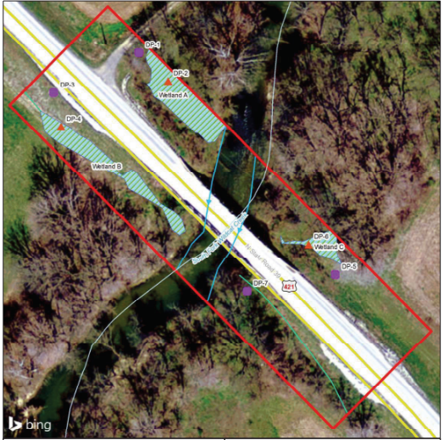
Wetlands and Waterways
Routine Wetland Determination and Waters of the U.S. Investigation
November 20, 2018
Wetlands
Three wetlands
0.028 acre cumulative impacts
One Jurisdictional Waterway
South Fork Wildcat Creek
Minor Impacts Anticipated
Temporary cofferdams and jacking pads
0.005 acres
57 linear feet
Permitted under the Clean Water Act, Section 401 and 404
South Fork Wildcat Creek
[ 10 ]

Slide 11
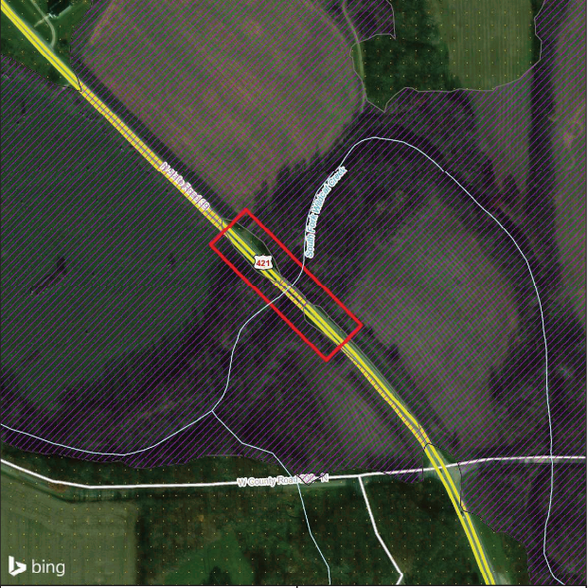
FEMA Floodplains
Federal Emergency Management Agency (FEMA) Flood Insurance Rate Map
Encroachment on Floodway
Floodway – discharges base flood
Regulated development
Flood Control Act (Permitting Required)
Category 3 Action
No substantial impacts on:
Floodplain Values
Flood Risks
Emergency Services
Emergency Evacuation
Encroachment is not substantial
Flood Zone A
[ 11 ]

