Slide 1
Detention Do’s Don’ts and Maybes
James Emerick, PE
Eric Harned, EI

Slide 2
Agenda
Introduction
INDOT Detention History
Current INDOT Requirements
Analysis
Reporting
Design Considerations
Project Examples
Common Errors Seen
Q/A

Slide 3
INDOT Detention History
1988 – Detention Requirements
Private developments draining to the right-of-way Q_{50 Post-construction →} Q_{10 Pre-const.}
INDOT projects only provided detention if legal drain required or known drainage issue
At this time any method of detention calculation was allowed.
1993 – Detention Requirements
Started requiring hydrographs for the large developments (>5 acres).
INDOT also included detention for new maintenance facilities.
1999 – Design Manual is published.
Inflow and outflow hydrographs required (no constant discharge)
Huff Distribution Required (no longer allowed Type II distribution)
2011 – Design Manual rewrite requires
Detention required on all new projects
INDOT Projects to mitigate Q_{100 Post-construction →} Q_{10 Pre-const}

Slide 4
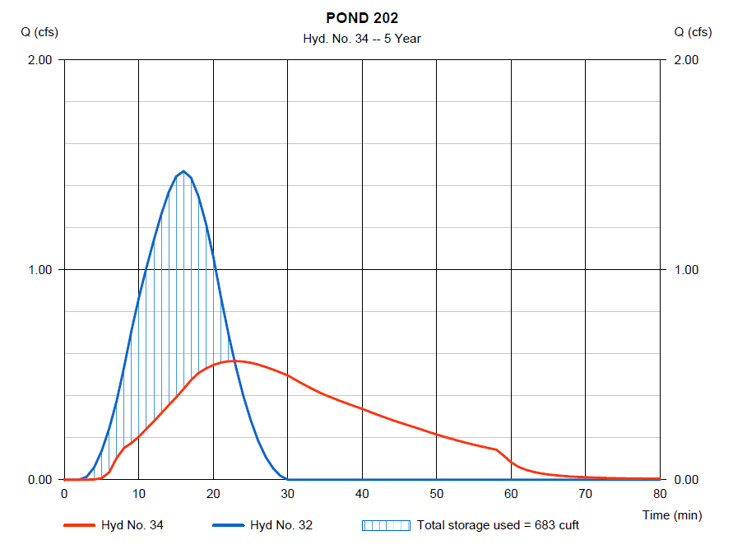
Where does INDOT Currently Require Detention?
Private or local development that drains to INDOT right-of-way
New road alignment
Road widening/added travel lanes
Intersection and interchange improvements
Redirection of runoff or changes to conveyance
Mitigation of existing flooding issues

Slide 5
INDOT Current Requirements
INDOT Projects
Q₁₀₀ Post-construction → Q₁₀ Pre-const
Local Stormwater Requirements
INDOT is not required to meet local ordinances
Discuss requirements with INDOT Hydraulics before project design
Still must show design meets INDOT requirements
Show Huff Distribution works even if local communities are using a Type II Distribution
Legal Drains
Coordination with County Surveyor may be required
Driveway permits
Private developments that drain to the INDOT right-of-way require
Q_{50 Post-construction →} Q_{10 Pre-const}
Required to meet local ordinance

Slide 6
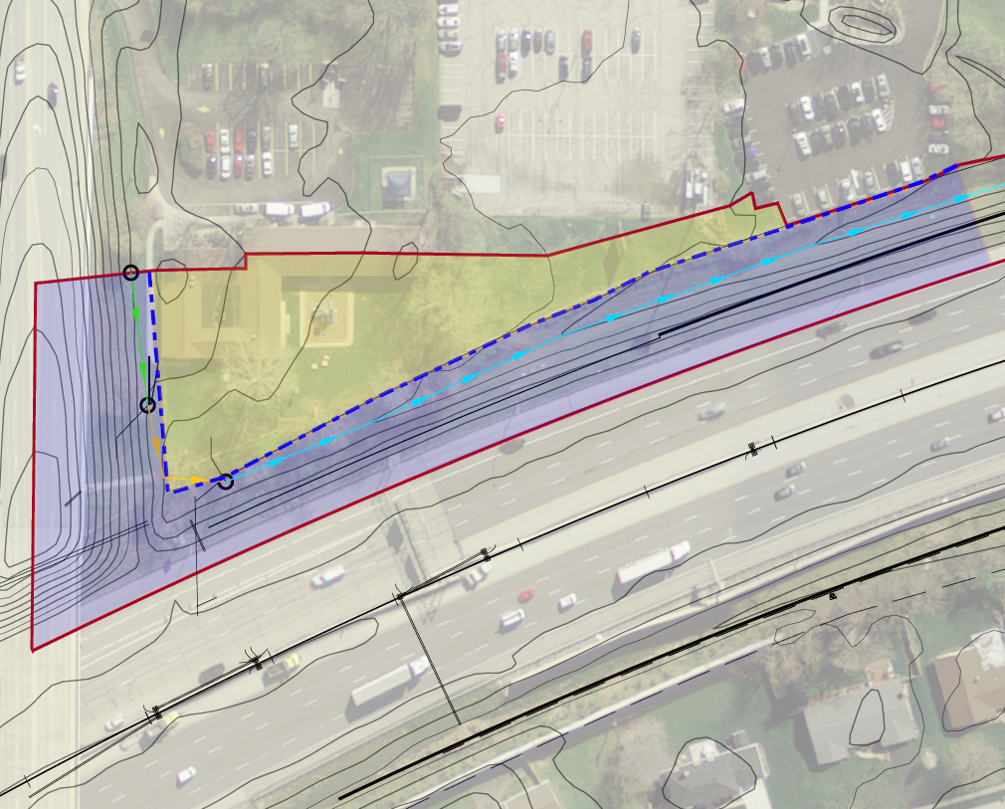
Special Considerations for Detention
Offsite Runoff Passthrough
Onsite area is within the right-of-way Q₁₀₀ Post →Q₁₀ Pre
Offsite is the area outside the right-of-way tributary to the detention area Q₁₀₀ Post →Q₁₀₀ Pre
Q₁₀₀ Allowable release rate
Q₁₀₀ Pre offsite + Q₁₀ Pre onsite
Outlet Design
Overflow Berm
Outlet Pipe
Proposed Ditch Detention
Offsite
Onsite
right-of-way

Slide 7
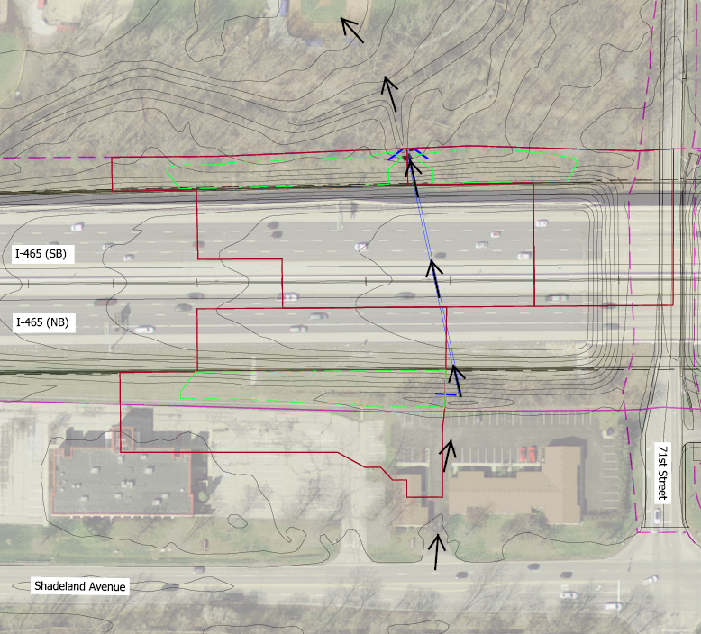
Special Considerations for Detention
Over-detaining
Providing excess detention in one location to make up for lack of detention in another
Only considered with a direct common point of discharge within or at the right-of-way boundary
Typically at stream or culvert crossings
Over-detain here
Over-detain here
Can’t detain here

Slide 8
Special Considerations for Detention
Exception from Q₁₀₀ _{Post} →Q₁₀ _{Pre} requirement to Q₁₀₀ _{Post} → Q₁₀₀ _{Pre}
IDM detention criteria
Would require purchase of additional right-of-way
Excessive additional project cost
No known flooding concerns
Sufficient capacity in downstream facilities

Slide 9
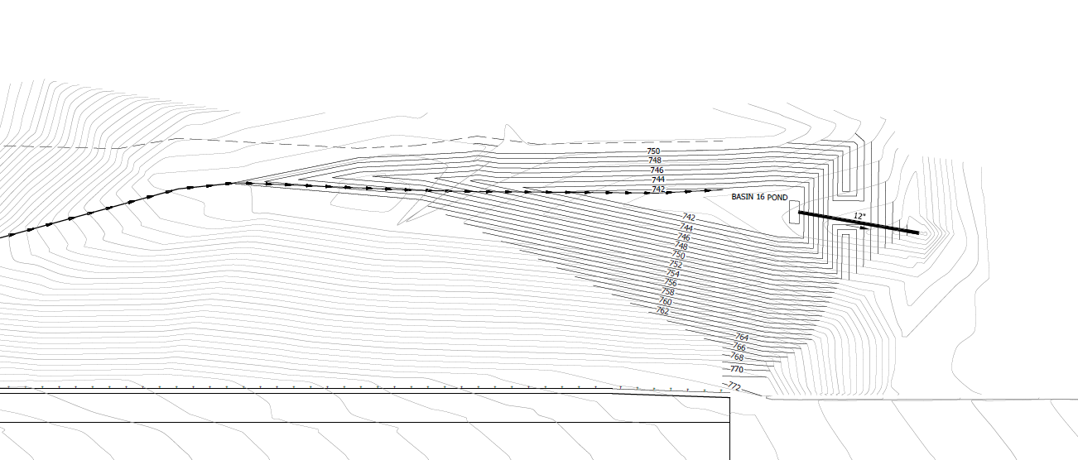
INDOT Current Requirements
Types of Detention
Ditch Detention
Used on a lot of recent projects
Inexpensive mostly grading and construction of berm
Constructed in the roadside ditch within right-of-way
Check Berm with pipe used for controlling discharge rates
May require multiple check dams along a ditch to reach allowable release rates

Slide 10
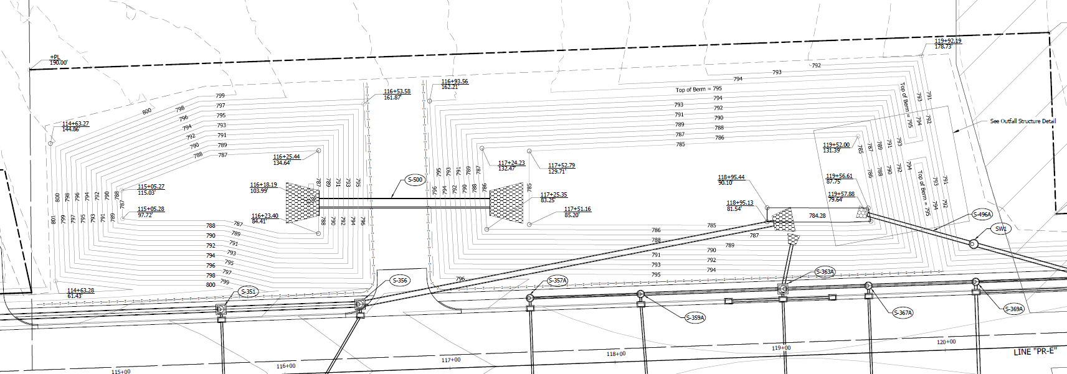
INDOT Current Requirements
Types of Detention
Dry Detention
Within the specially purchased right-of-way or infield
should consider serviceability and impact to median drains and storm sewer
Should have appropriate overflow incase primary outlet clogs

Slide 11
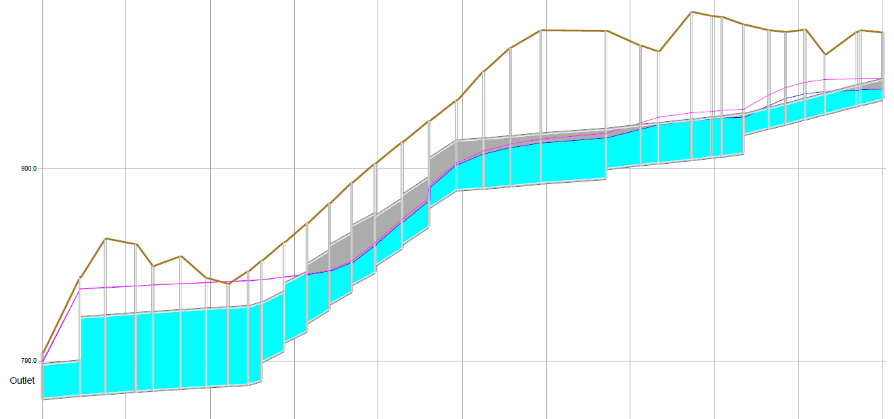
INDOT Current Requirements
Types of Detention
Oversized Storm Sewer
Increased storm pipes with smaller outlet pipe
Costs varies based on the upsizing of storm sewer pipes
Should consider upstream impacts so that HGL does not exceed rim elevations

Slide 12
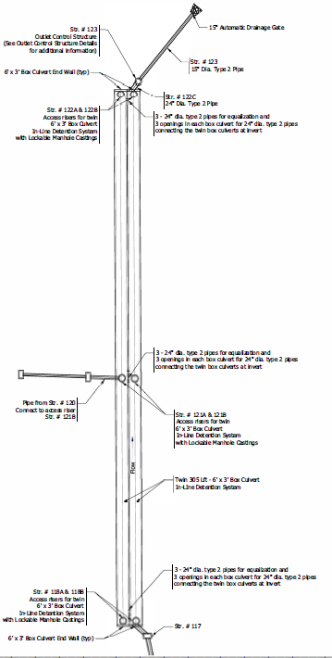
INDOT Current Requirements
Types of Detention
Underground Detention
Use of chambers or pipe system
Typically very expensive
Not under drive lanes
Maintenance and Access Concerns

Slide 13
INDOT Current Requirements
Types of Detention
Infiltration
Only would consider infiltration when no positive outlet is available
Should provide overflow routing incase infiltration fails
Should be sized for the storage of 1.5 times the total 100 year storm volume plus 1 ft of freeboard
INDOT’s Geotechnical Group has developed standardized testing
Protection during construction over compaction and sedimentation
Wet Detention
Requires special right-of-way
Typically not preferred due to safety concerns
No Median Detention
Too much risk to the roadway
No available emergency overflow path

Slide 14
INDOT Current Requirements
General Detention Basin Design Requirements
2 ft elevation from edge of lane to Q₁₀₀ Water Surface Elevation (WSE)
1 ft of freeboard is required
Overflow weir designed to pass Q₁₀₀
Maximum 72 hour drain time
Maximum of 5 ft operating-pool depth
Minimum of 0.5% running slope

Slide 15
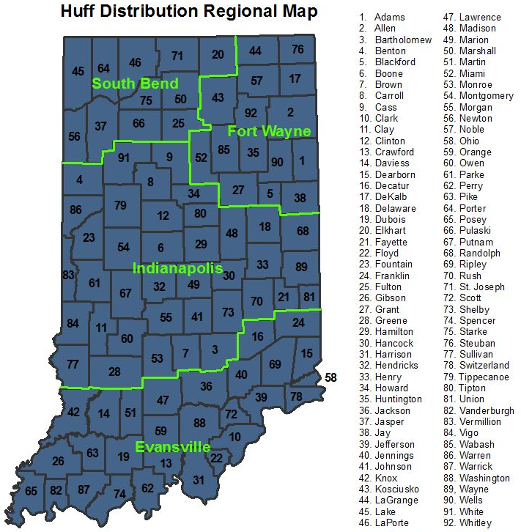
Detention Analysis
<5 ac. can use Rational Method
5 ac. or more TR-20 methodology using Huff Distribution
Critical storm analysis running multiple duration storms 15 min to 24 hour
Use appropriate quartile
Use appropriate Region
Allowable Programs
AutoCAD Hydrographs Extension
Autodesk Storm and Sanitary Analysis (SSA)
Bentley PondPack
HydroCAD
XPSWMM

Slide 16
Reporting
Narrative
Project Description
Design assumptions, criteria used, special exemptions
Detention Summary Table
Existing Peak Flow Rates
Proposed Peak Flow Rates No Detention
Proposed Peak Discharge Rates with Detention
Q₁₀₀ water surface elevation/Max Storage volume
Edge of Lane/Serviceability Freeboard
Overflow Weir Elevation/ Detention Basin Freeboard
Drainage Area Maps
Existing and proposed
Include offsite areas
Existing and proposed contours
Time of concentration (Tc) path
Tc calculations
CN or Rational C calculations
Model Input and Output –Hydrologic Parameters, Stage-Storage, and Stage-Discharge

Slide 17
Design Considerations
Outlet Structure
Type
Size
Locations
Overflow Weir
Location
Routing
Impacts to and from median drainage, storm sewer system, and culverts
Up and Downstream Impacts
Maintenance

Slide 18
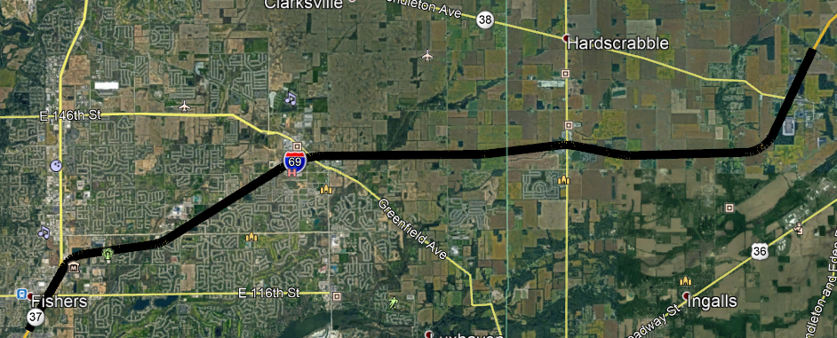
Project Examples
I-69 Major Moves 2020

Slide 19
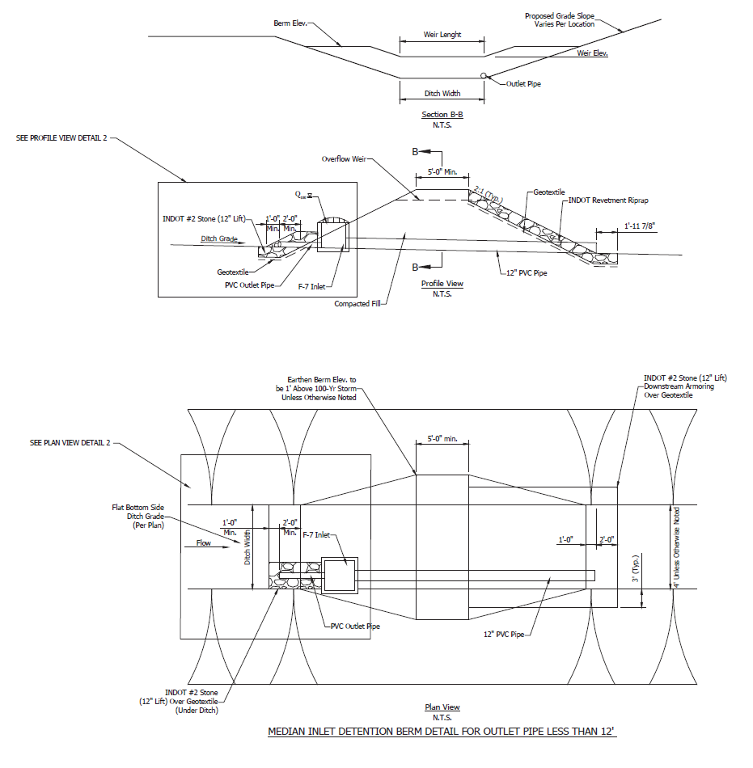
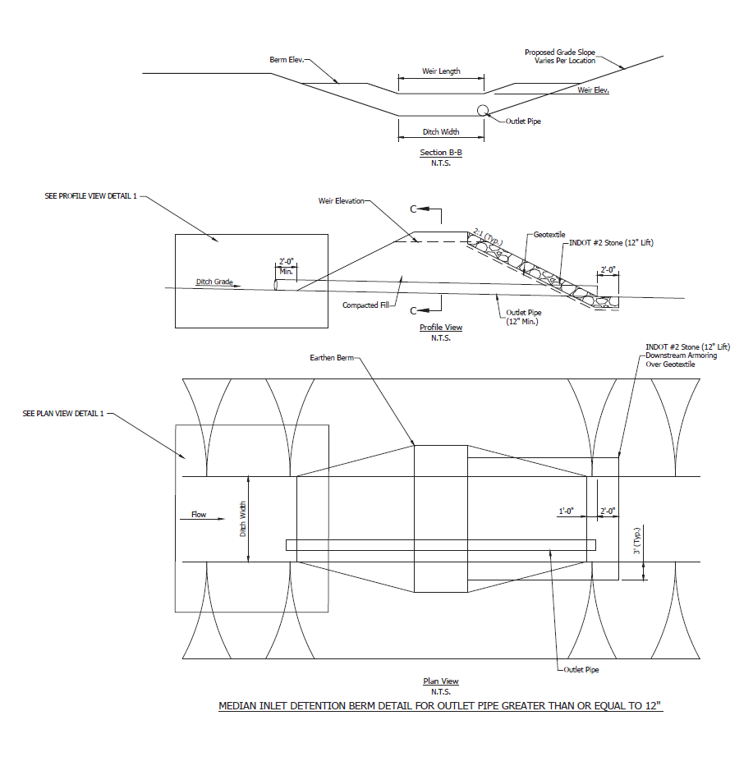
Project Examples
I-69 Major Moves 2020

Slide 20
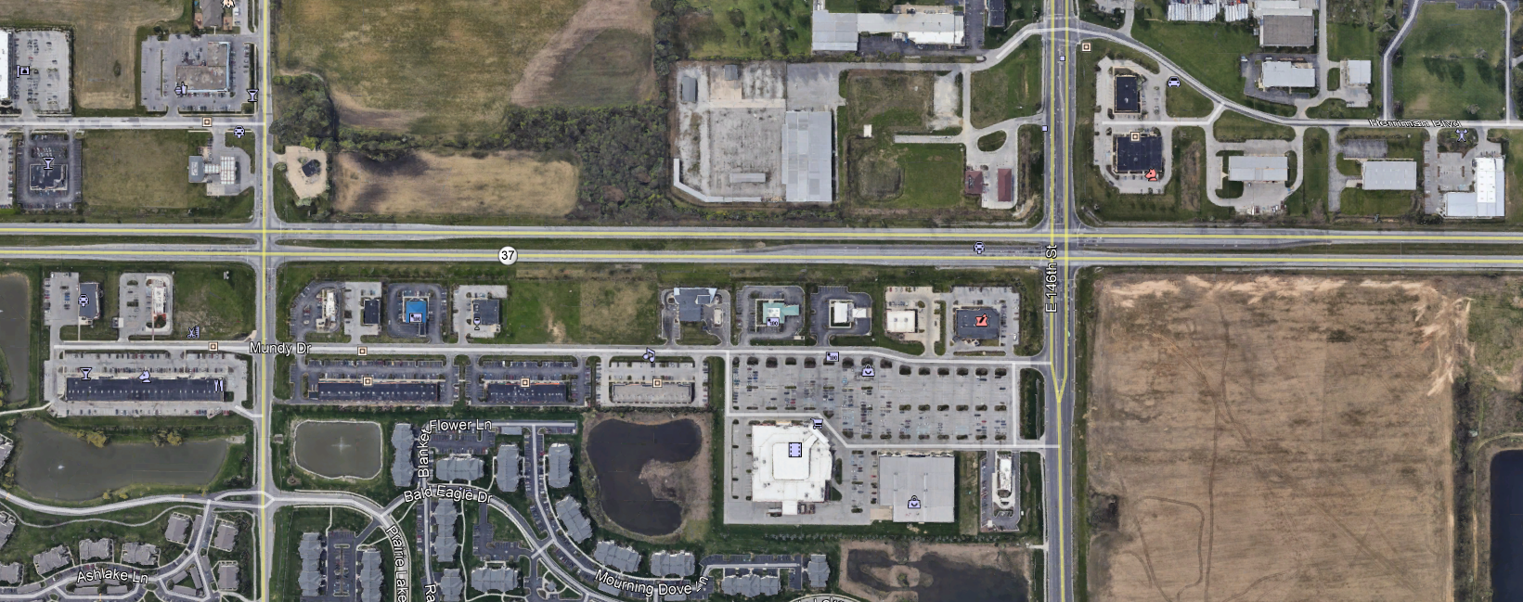
Project Examples
SR37 Interchanges at 141st and 146th Streets

Slide 21
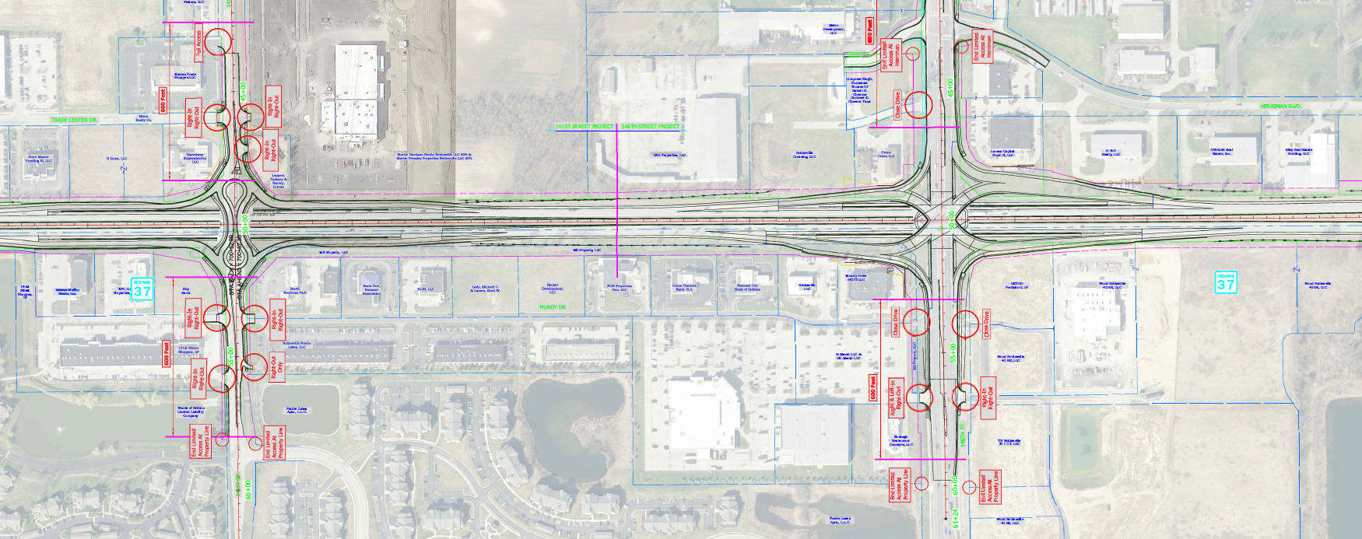
Project Examples
SR37 Interchanges at 141st and 146th Streets

Slide 22
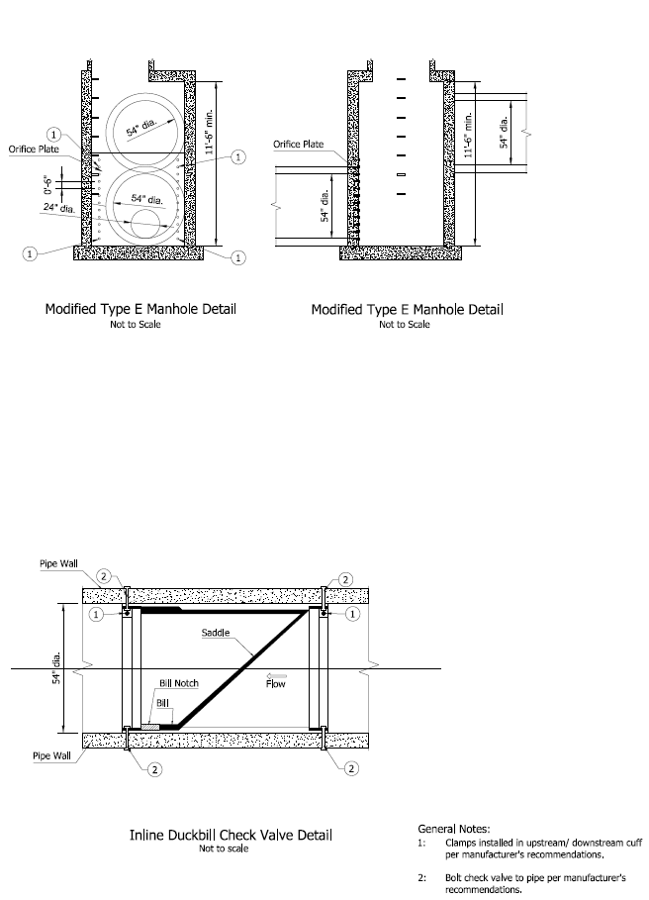
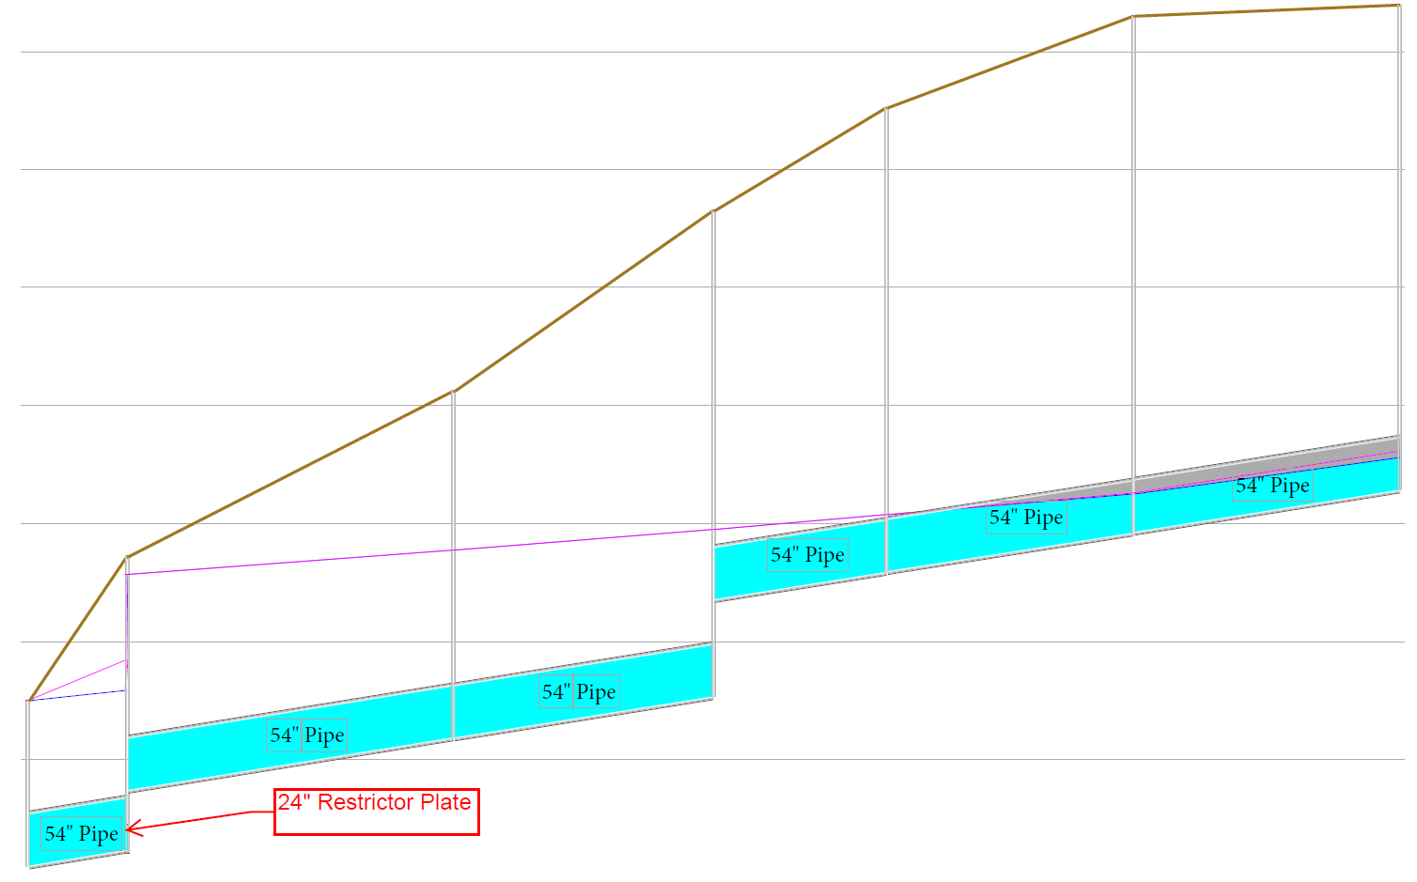
Project Examples
SR37 Interchanges at 141st and 146th Streets

Slide 23
Project Examples
Worthsville Road
Tracy Ditch

Slide 24
Project Examples
Worthsville Road
Tracy Ditch

Slide 25
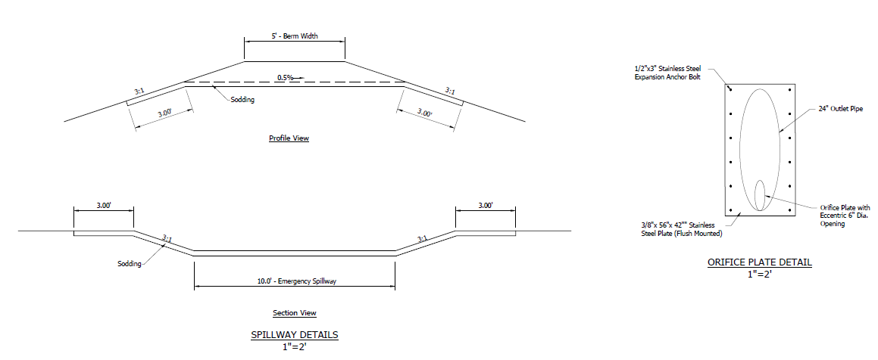
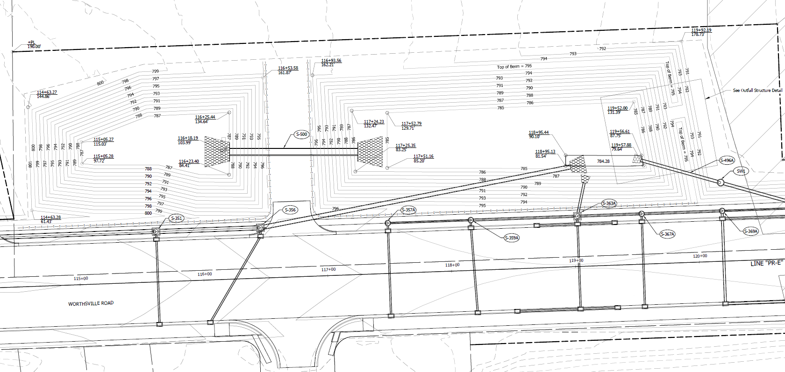
Project Examples
Worthsville Road

Slide 26
Issues Seen on Projects
Median Drains and Storm Sewer Outlets
should be daylighted above the Q₁₀₀ water surface or
analyzed with tailwater at the detention basin Q₁₀₀ water surface elevation
Adjacent properties
consider overtopping top of berm
pipes that may drain to the ditch
Freeboard and Roadway Serviceability
Overflow berm used to control design storms
Multiple outlet pipes
Prefer single pipe
Staged outlet
Pipe size less than minimum required by IDM for under road or drive
The IDM requires a minimum orifice size of 6 inches to prevent clogging
Prefer to have a small orifice with standpipe to allow passage of larger storms
Consider Impacts of Detention on overall DA
Small onsite with a larger offsite DA with long Tc detention may line up peak and make increase worse than undetained
Consider existing detention in the existing analysis
Consider tailwater conditions for the detention basin outlet pipe

Slide 27
Questions
Additional Resources:
INDOT Hydraulics Website - https://www.in.gov/indot/3595.htm
Infiltration Testing Guidelines - https://www.in.gov/indot/files/percolation-Infiltration-guidelines.pdf

